Slide 1
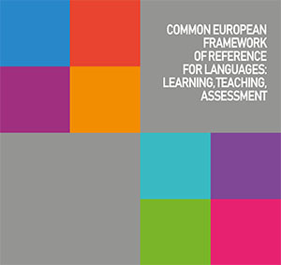
PROCESS OF DEVELOPMENT OF COMMON EUROPEAN FRAMEWORK OF REFERENCE IN EUROPEAN EDUCATION SYSTEMS
Dzubenko Olga 312-f

Slide 2
The aim
is to investigate the role of the Common European Framework of Reference in European education systems, prove the relevance of the CEFR and its meaning for education system modernization and development.

Slide 3
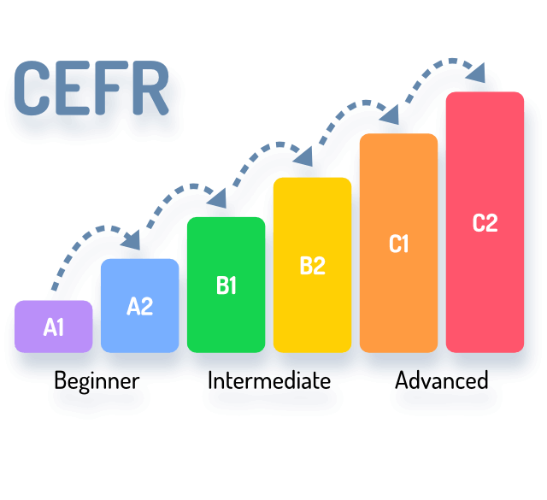
THE BROAD BANDS
The CEFR is an international standard for describing language ability. It describes language ability on a six-point scale, from A1 for beginners, up to C2 for those who have mastered a language.
Basic
Independent
Proficient

Slide 4
CAN DO
speaking
writing
listening
reading
The descriptions of levels are skills-based and take the form of Can Do statements. These descriptions of ability focus on communicative purpose and are made for a very practical approach, which looks at what people can do – rather than on specific linguistic knowledge. This kind of approach helps to understand the standard terminology of language levels.

Slide 5
PRACTICAL PURPOSES
developing syllabuses
creating tests or exams
evaluating language learning needs
designing courses
developing learning materials
other

Slide 6
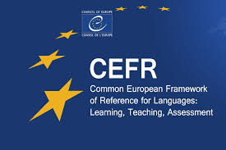
The CEFR is important …
The CEFR was designed to provide a framework for all European languages. Because it is language-neutral, it can actually be used for any language in the world. It has been produced in 38 languages, including Arabic, Chinese and Japanese.

Slide 7
Conclusion
Common European Framework of Reference is known all over the word and has a world recognition.
It is a universal document which helps the systems of education in many countries. It helps learners to get the description of their language skills levels, teachers – to create tests or exams, design courses and curriculum. Also the CEFR promotes the international cooperation among all European countries including their law, culture, language and education.

