Slide 1
Bogdan Khmelnitsky Melitopol State Pedagogical University

Slide 2
Bogdan Khmelnitsky Melitopol State Pedagogical University
is a community of researchers and educators based on innovative ideas and open dialogue.
The University starts its history from 1923 and is celebrating 100th anniversary this year.

Slide 3
A range of Studying opportunities
Educational and Scientific Institute of Social-Pedagogical and Artistic Education
The Faculty of Chemistry and Biology
Faculty of Information Technology, Mathematics and Economics
Philological Faculty
Faculty of Natural Sciences and Geography
Pre-school education
Primary education
Special education
Psychology
Pedagogy
Social work
Art
Chemistry
Biology
Ecology
Forestry and Gardening
Human health
Garden therapy
Economy
Information Technology
Sociology
Professional education
Management
Humanities
Media education and media literacy
Translation studies
Ethno studies
Intercultural communications
Foreign literatures
World literature
Geography
History
Archeology
Physical culture and sports
Tourism
Law

Slide 4
A range of Studying opportunities
35 specialties
(51 educational programs)
28 specialties
(39 educational programs)
10 specialties
(10 educational programs)
First
Bachelor's
level
The second master's degree
level
Third
educational and scientific
level
All educational programs are accredited by
The National Agency for Higher Education Quality Assurance

Slide 5
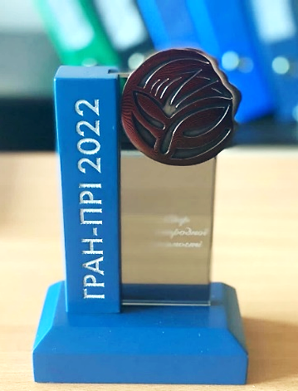
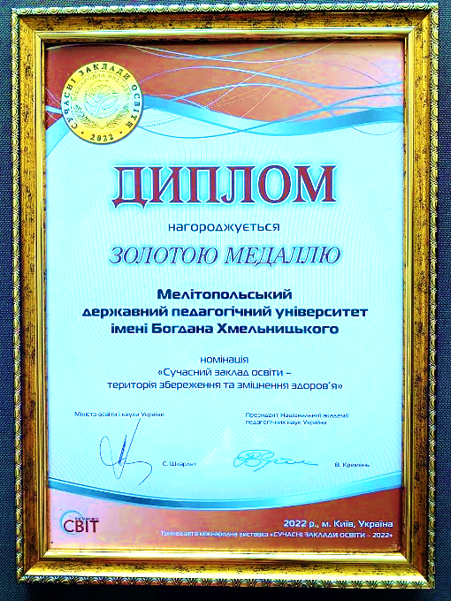
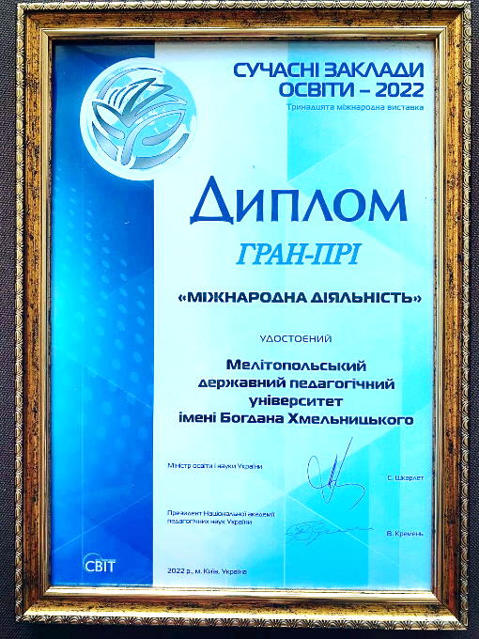
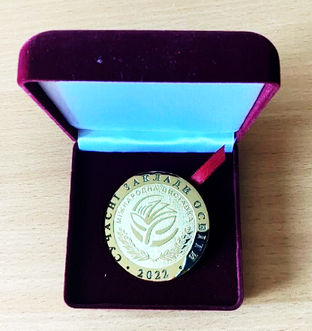
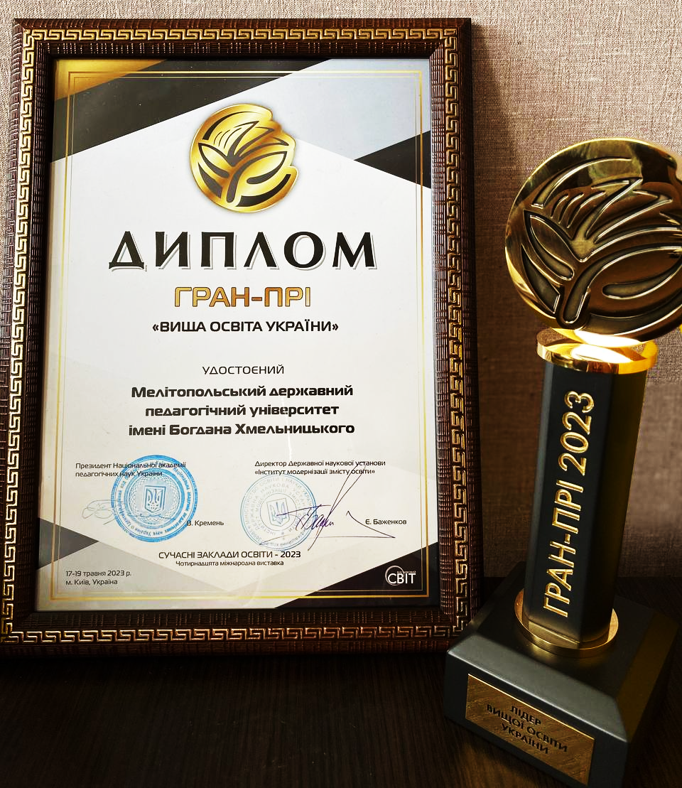
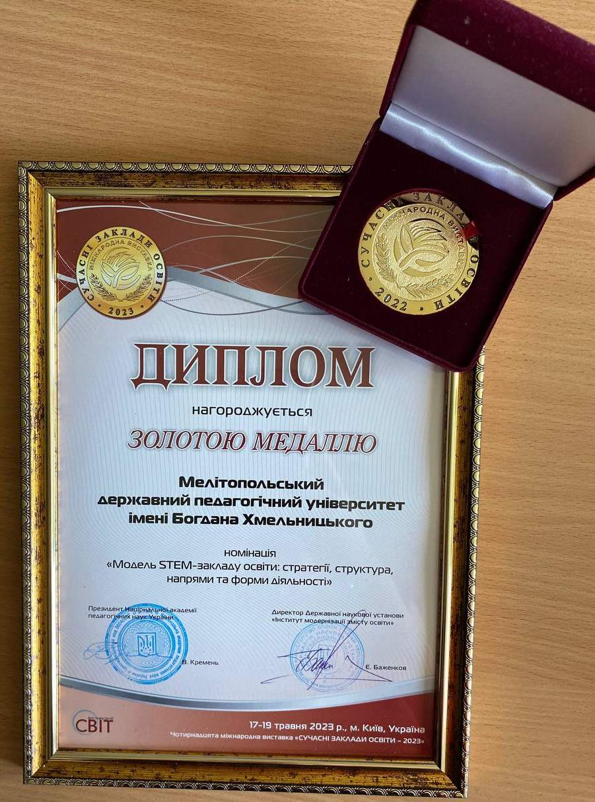
XIII International Exhibition
«MODERN EDUCATIONAL INSTITUTIONS - 2022»
Diploma of the Grand Prix
"International activity"
Gold medal in the nomination "Modern educational institution - territory of preservation and strengthening of health"
XIV International Exhibition
«MODERN EDUCATIONAL INSTITUTIONS - 2023»
Diploma of the Grand Prix
"Higher Education of Ukraine"
Gold medal in the nomination
"The STEM model of an educational institution: strategies, structure, directions and forms of activity"

Slide 6
all-Ukrainian rating based on data indicators of the scientometric database Scopus
2023
+26
97 place
POSITIONS
2022
105 place
2021
123 place
Vivat Alma-mater!
Notes:
Всеукраїнський рейтинг за показниками данних…. (КАРИНА) по-новому - слайдом

Slide 7
Our position in university rankings
University rankings | Position
Webometrics by Cybermetrics Lab | 73
UniRank | 51
Osvita.UA | 114
Top 200 Ukraine 2023 | 75
Best pedagogical universities (Ukraine) | 8
Universities of Zaporizhzhia region | 4

Slide 8
Erasmus+ project activity
101083203 Bringing Opportunities and Organizational Success To Small Local Universities in Ukraine
101082858 MOOC-based micro-credentials for teacher professional development
101083077 Universities-Communities: strengthening cooperation
101083321 Strengthening the EU common values through the policy of multilingualism in the education and training of future teachers
101129379 Boosting university psychological resilience and wellbeing in (post-) war Ukrainian nation

Slide 9
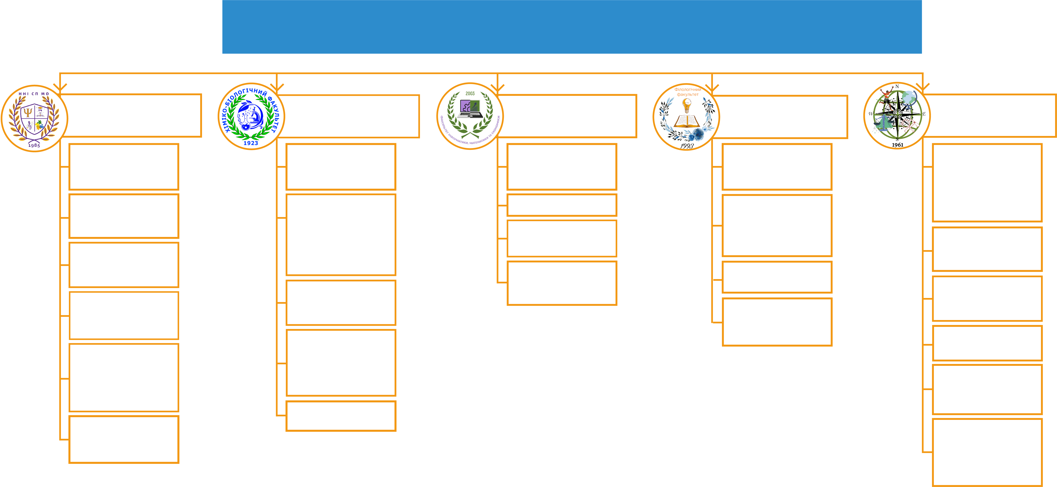
HIGH-QUALITY EDUCATION BASED ON RESEARCH
Research centers, educational and scientific laboratories
Educational and Scientific Institute of Social-pedagogical and Artistic Education
The Faculty of Chemistry and Biology
Faculty of Information Technology, Mathematics and Economics
Philological Faculty
Faculty of Natural Sciences and Geography
Laboratory of health psychology
Laboratory of inorganic synthesis
Laboratory of hotel and restaurant business
Center for studying foreign languages
Laboratory of History of Southern Ukraine Research
Laboratory of psychophysiological research
Laboratory of analytical control and molecular genetic research
STEAM-laboratory
Center for promoting of Ukrainian language development and functioning
Center of tutoring skills
Laboratory of complex regional studies
Laboratory spiritual and moral education
Center for non-discriminatory education
Center for European Studies
Laboratory of biochemical research
Center of Bulgarian Studies
Educational and scientific center of socio-cultural development of a child's personality
Scientific and Methodological Center "Lingua"
Laboratory of algoecological studies of terrestrial and aquatic ecosystems
Law clinic
Center for correctional and developmental technologies for children of preschool and primary school age
Science park “Melitopol travel university”
Pedagogical laboratory of primary school
Health center
Scientific and methodological center for the study of the Azov region peoples’ intangible cultural heritage

Slide 10
IMPORTANT DEPARTMENTS OF THE UNIVERSITY
Two hostels
Library
Preparatory department
Agro-biological complex
Education and scientific centre “Biodiversity”
Centre for IT and digital transformations
Centre of distance educational technologies
Centre of continuous professional development of educators
Geologic and palaeontologic museum
Museum of Ukrainian ornament
Technology transfer center

Slide 11
The University modern interactive centers and laboratories
ensure achievement of goals defined by educational programs and program outcomes
carry out scientific, methodological, educational and organizational activities
work on expansion of the University's international relations
increase effectiveness of professional and personal growth of all the participants of the educational process
develop and introduce innovations and technologies

Slide 12
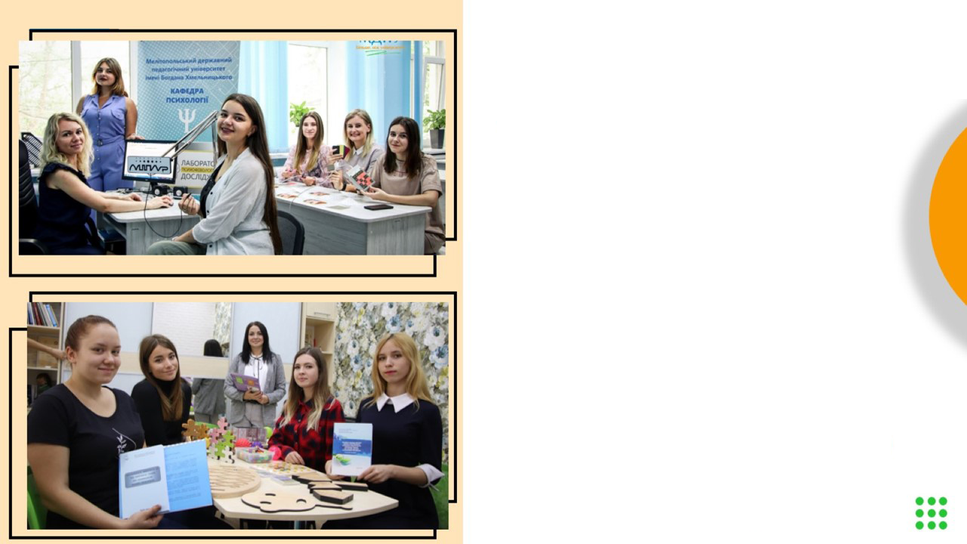
Laboratory of health psychology
Laboratory of psychophysiological research

Slide 13
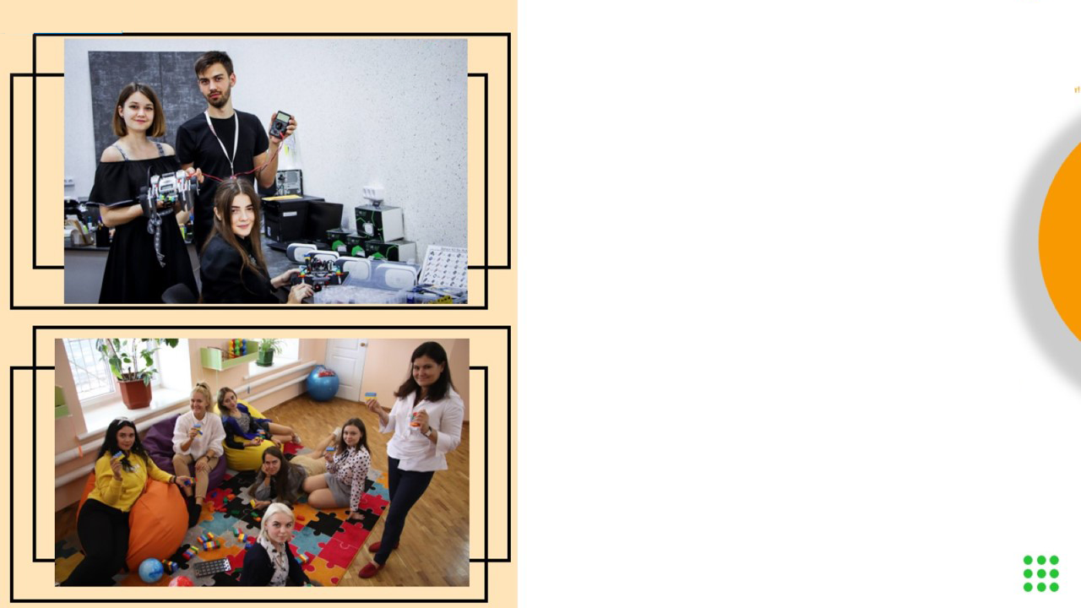
STEAM-laboratory
Pedagogical laboratory of primary school

Slide 14
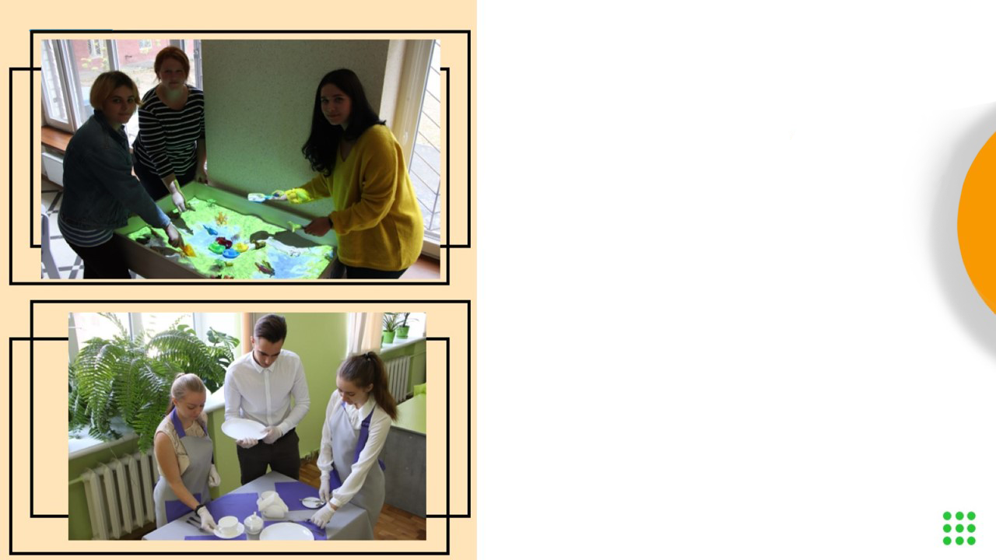
Educational and scientific center of socio-cultural development of a child's personality
Laboratory of hotel and restaurant business

Slide 15
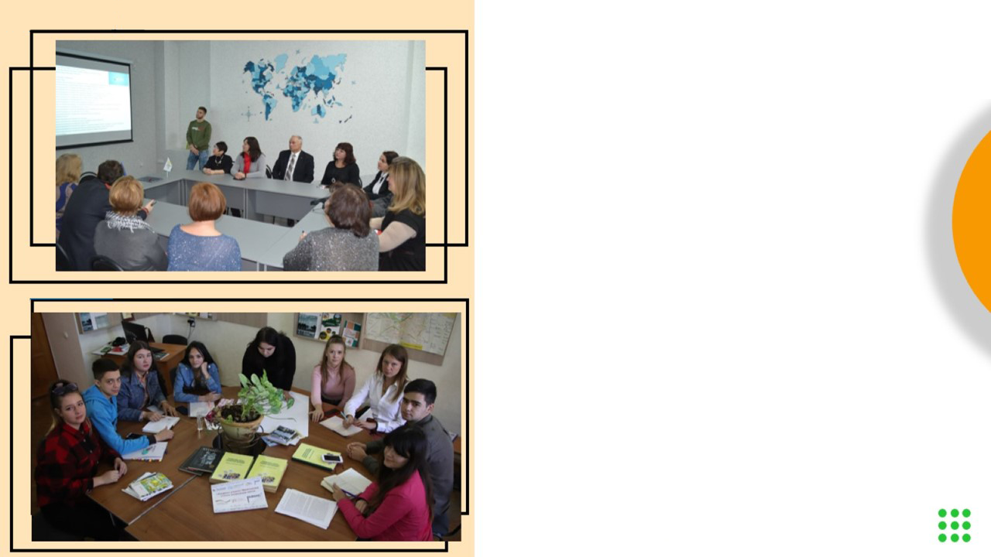
Laboratory of innovative technologies in tourism
Center for Sociological Research

Slide 16
Laboratory of analytical control and molecular genetic research

Slide 17
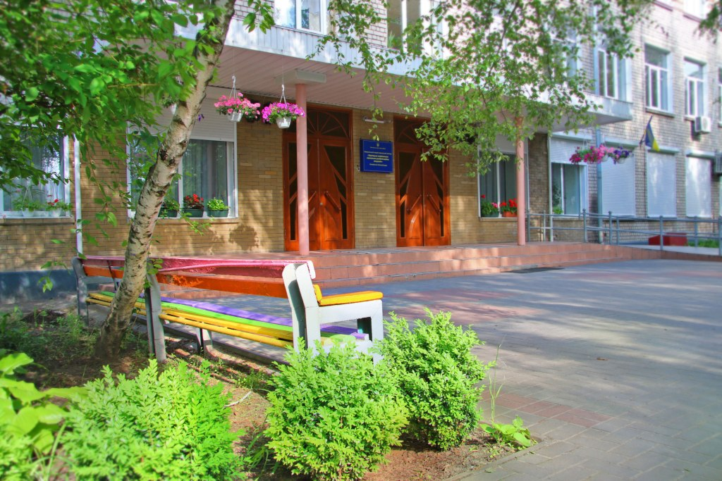
Relocation of BK MSPU
To Zaporizhzhia,
to Khortytsia National
Educational-Rehabilitation
Academy
From Melitopol

Slide 18
Needs for further development
Equipment
Software and hardware
Joint projects
Joint publications
Joint conferences, symposia and other events
Visiting lecturers
Academic and scientific exchange for students and staff
Study visits to European universities
Access to virtual laboratories, libraries, databases

Slide 19
We are open to cooperation

