Slide 1
EPERE Project Meeting
Enhancing the Participation and Ensuring the Right to Education for Children with Intellectual Disability: Developing Capacities and Opportunities

Slide 2
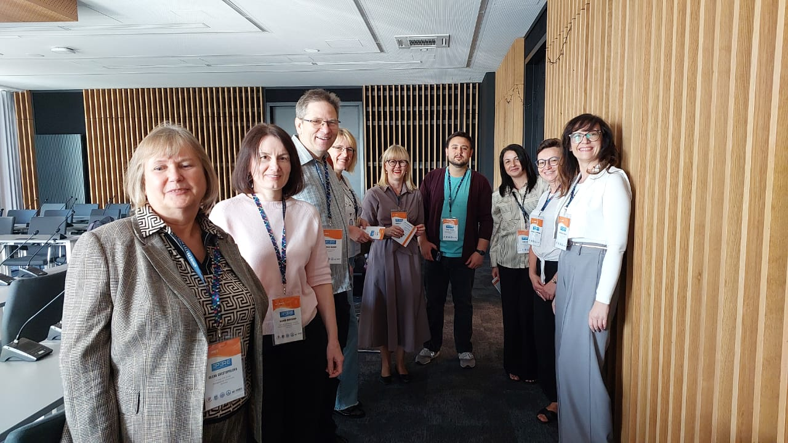
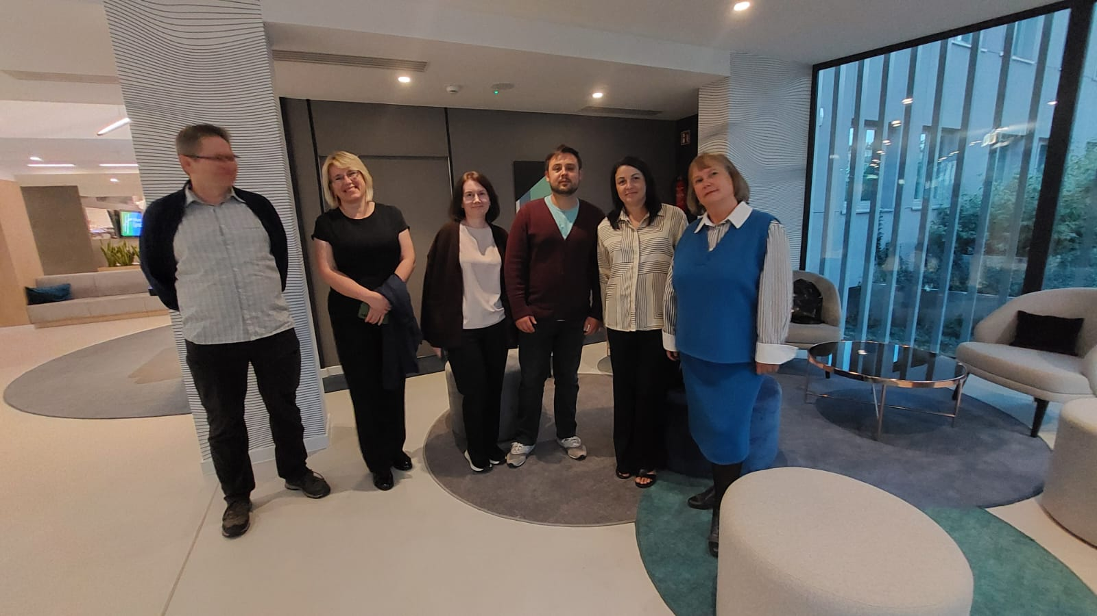
Meeting Details
Dates
Location
Focus
Faculty of Education and Psychology, UMCS, Lublin
Inclusive education for children with intellectual disabilities
September 22-24, 2025
Głęboka, 43

Slide 3
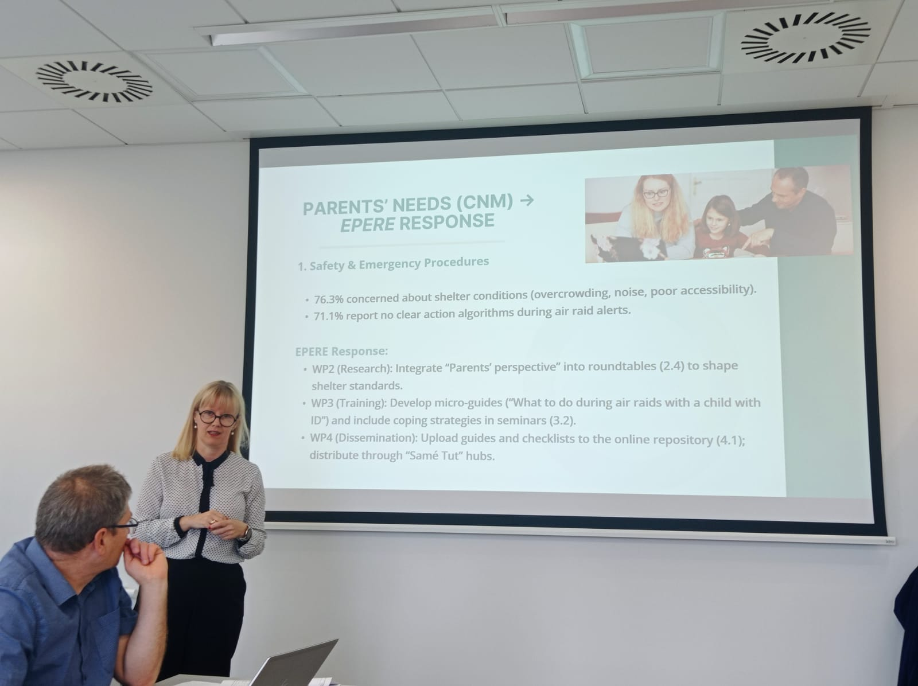


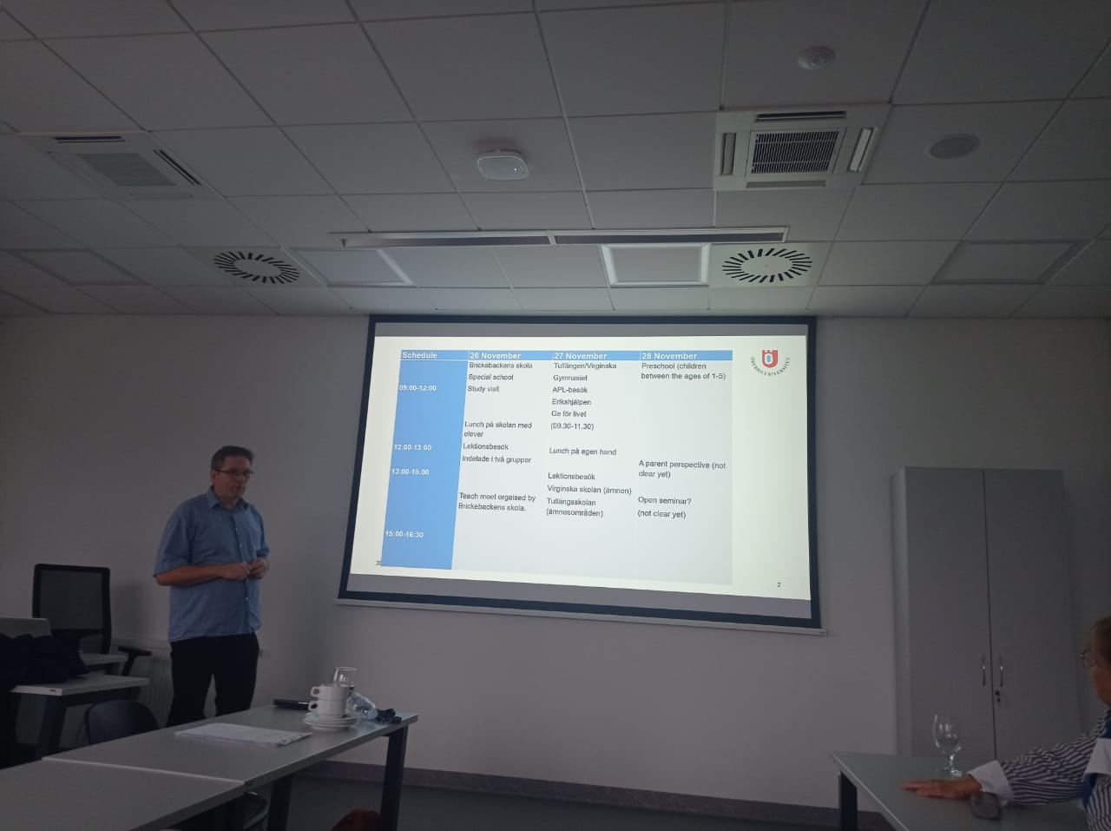

International Collaboration
This three-day meeting brings together educators and researchers from multiple universities across Europe to advance inclusive education initiatives.
Örebro University
Thomas Barow leading project coordination and management
Maria Curie-Skłodowska University
Stanisława Byra and Dorota Chimicz hosting the meeting
Ternopil Volodymyr Hnatuik National Pedagogical University:
Hanna Slozanska, Nadiia Horishna
Bogdan Khmelnitsky Melitopol State Pedagogical University:
Hanna Varina, Yevhen Topalov
Kryvyi Rih State Pedagogical University:
Kateryna Bondar, Olena Shestopalova
Ukrainian Universities

Slide 4
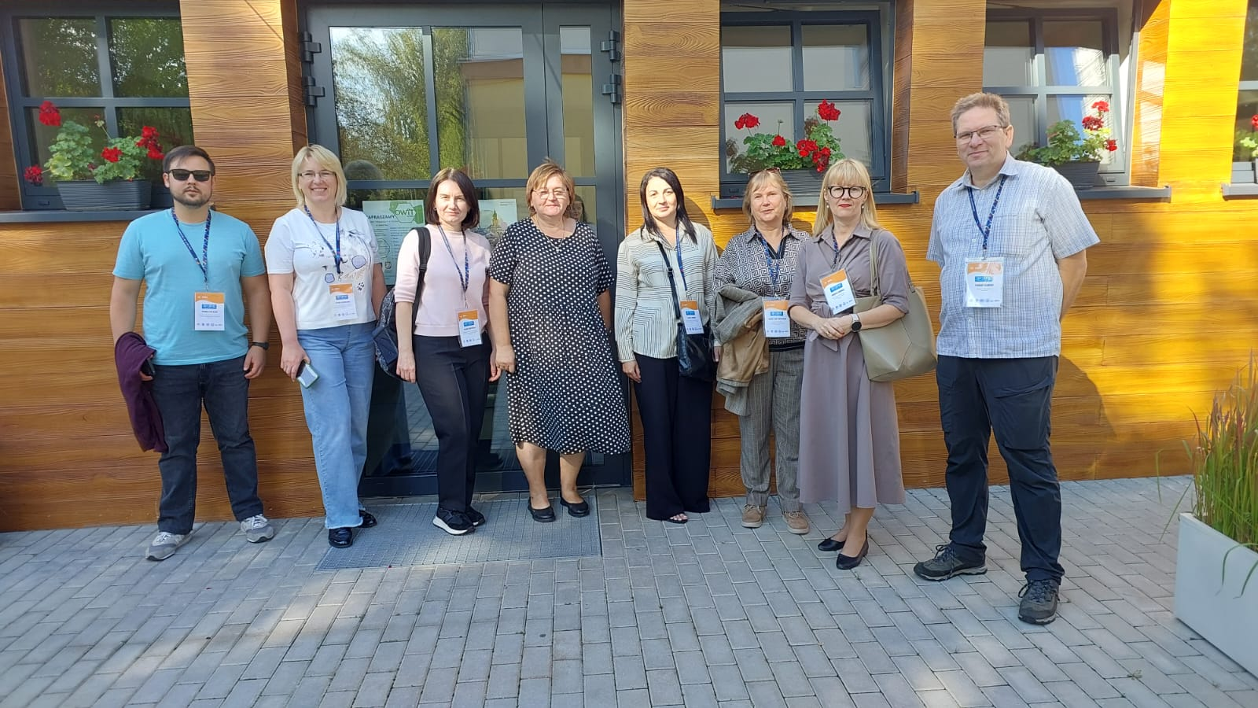
The opening day focuses on official welcomes, study visits to inclusive education centers, and project coordination discussions.
Day 1
1
Official Welcome at UMCS with Thomas Barow and Dorota Chimicz setting the stage for collaborative work
2
Study visit to Specialist Centre for Supporting Inclusive Education (SCWEW) at the Special Education and Training Centre in Świdnik, including lunch at the school

Slide 5
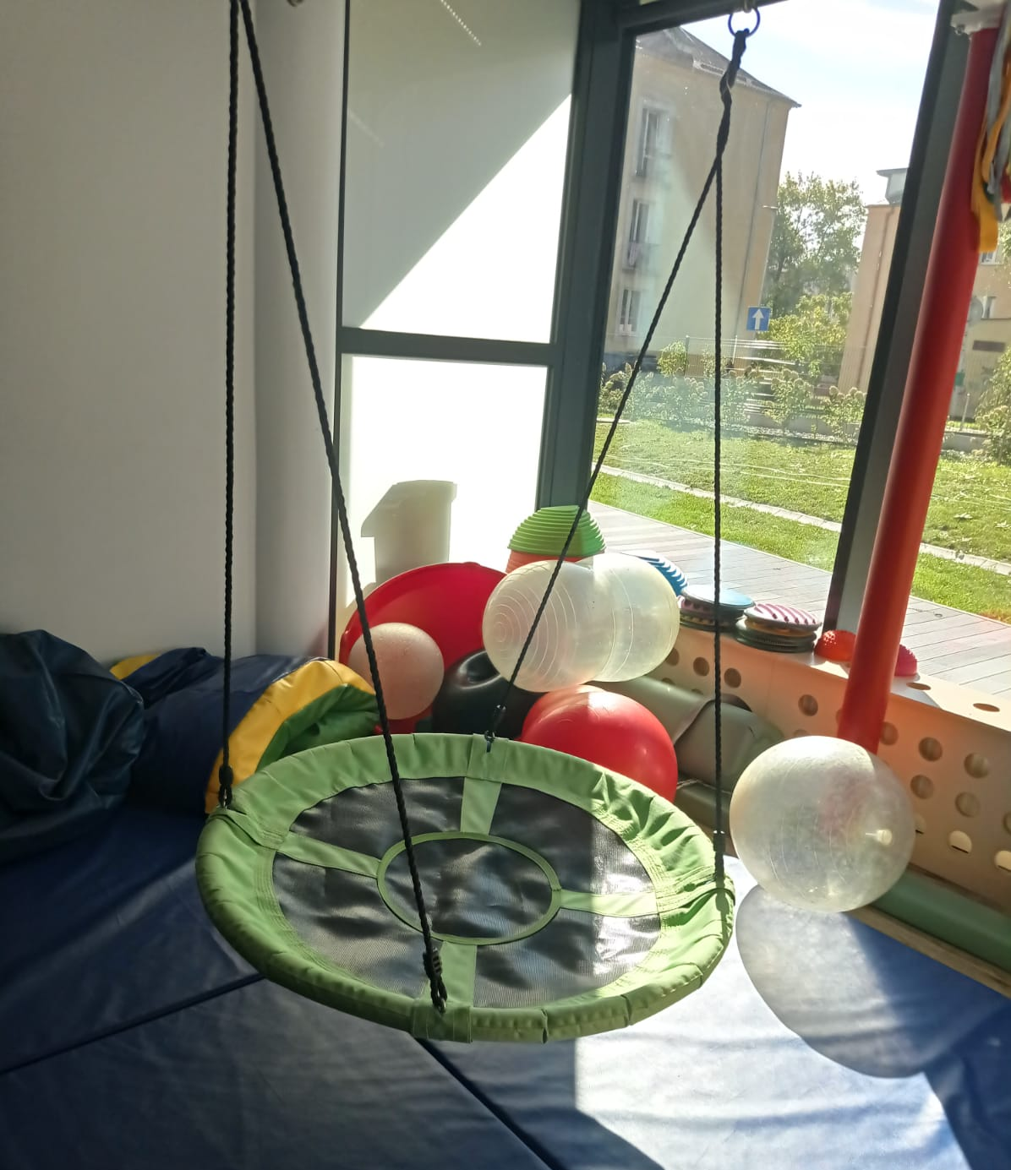
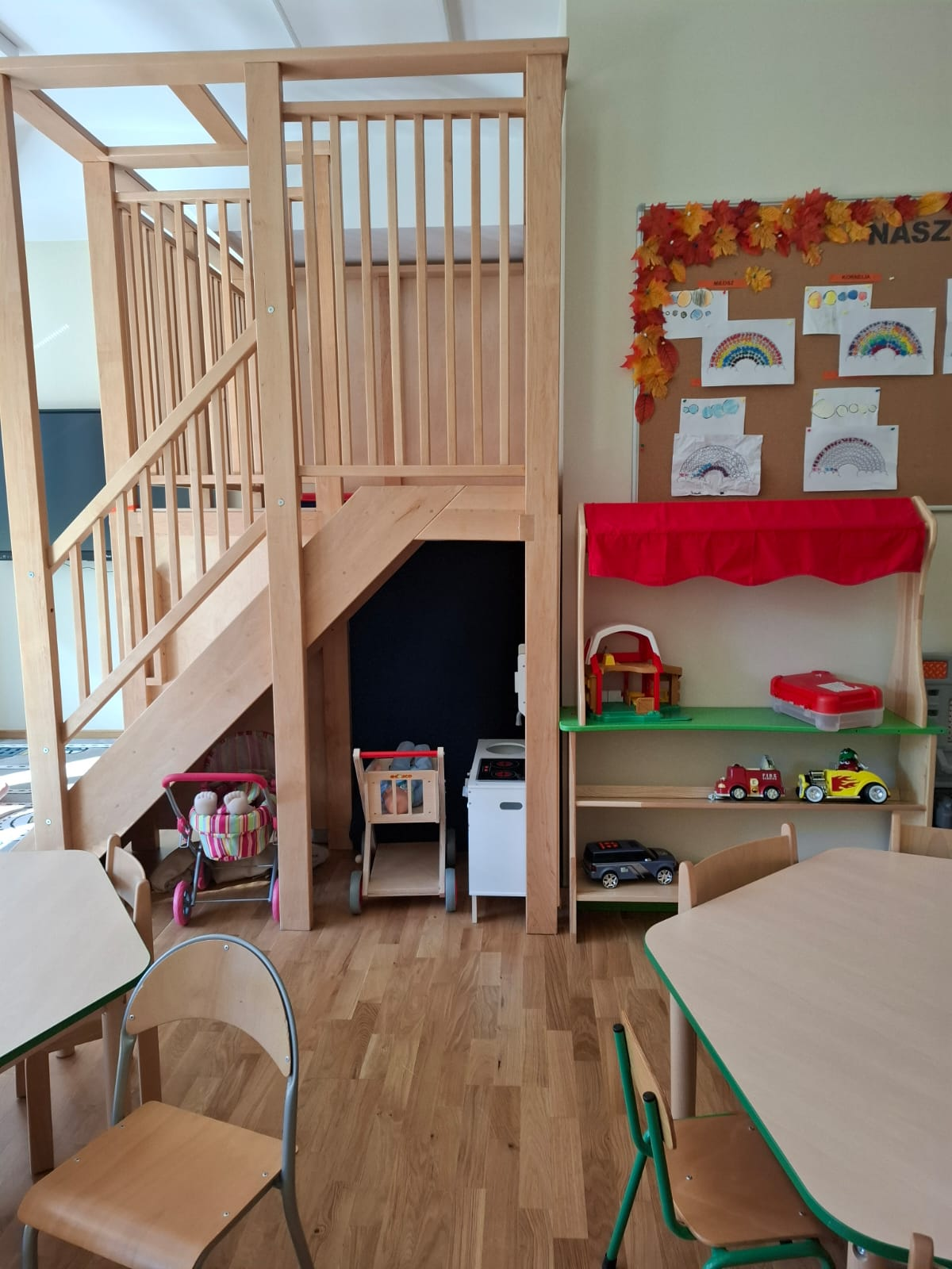
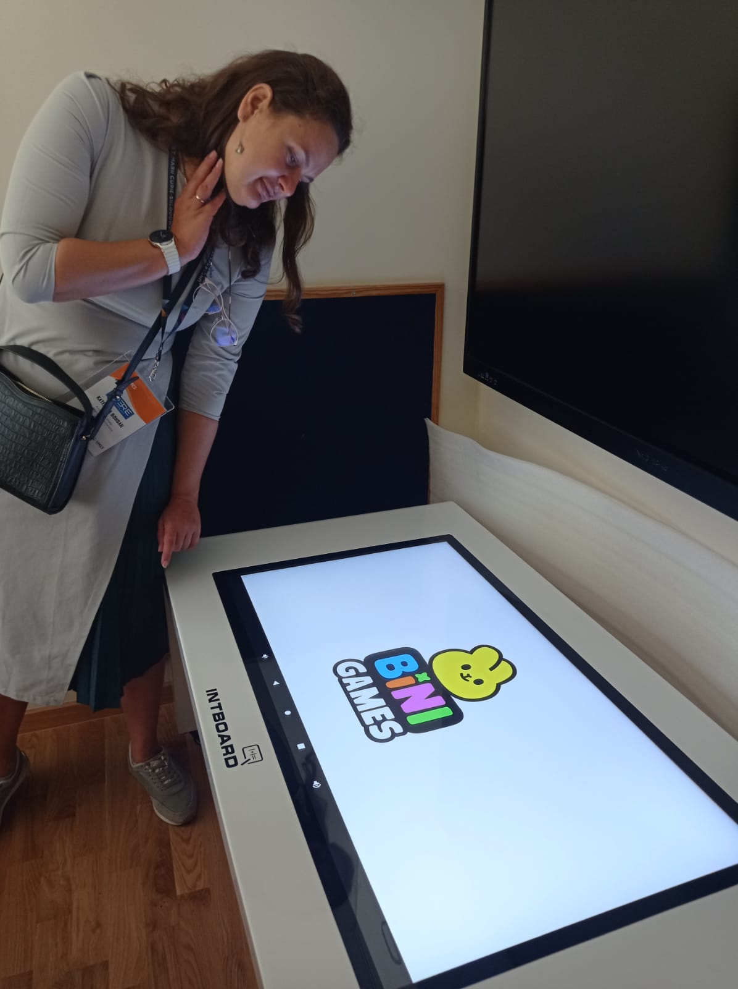
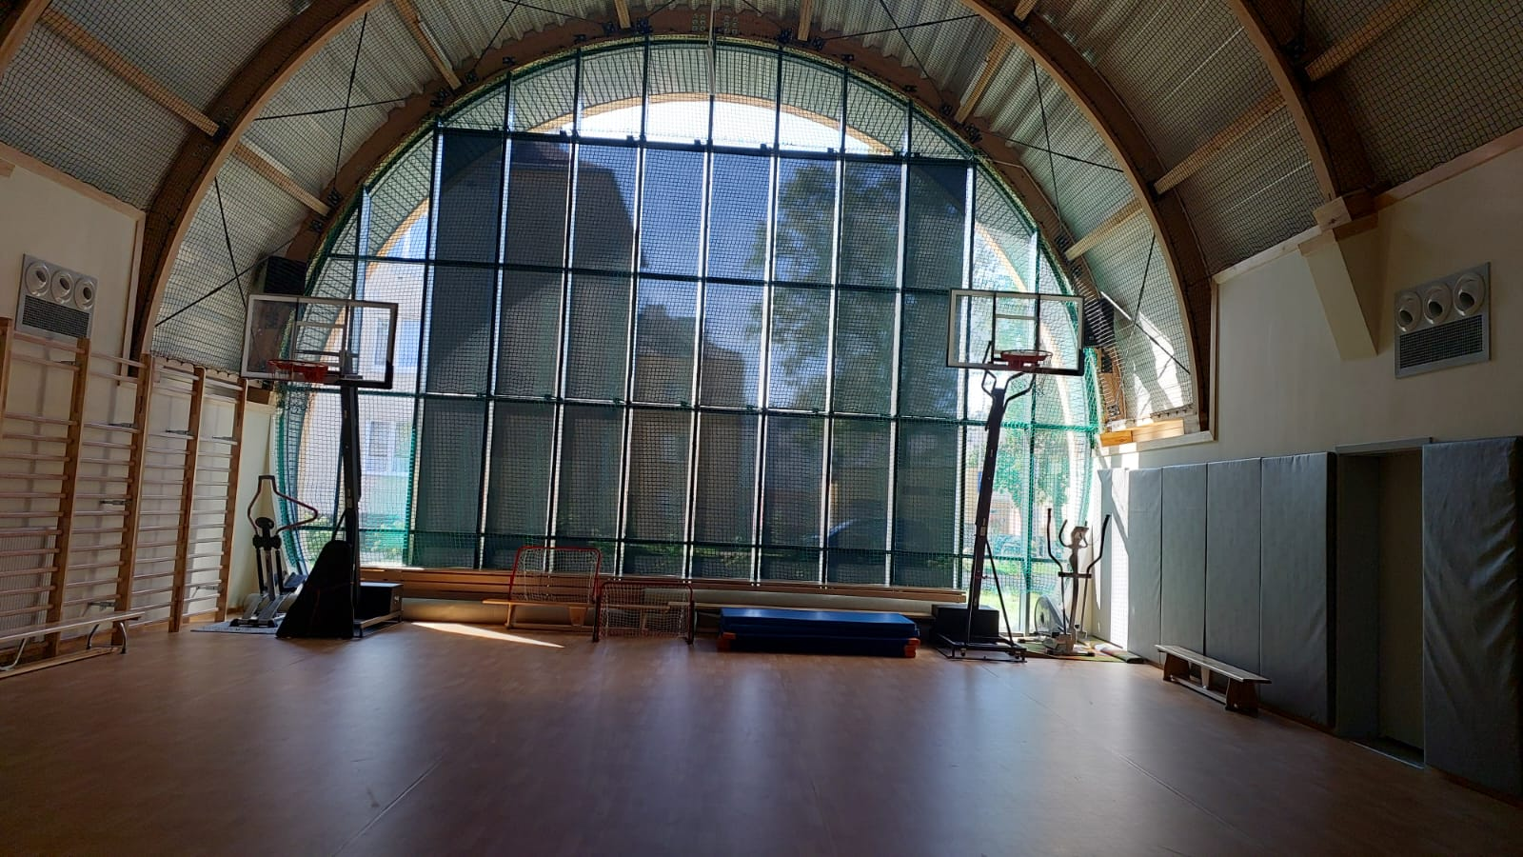
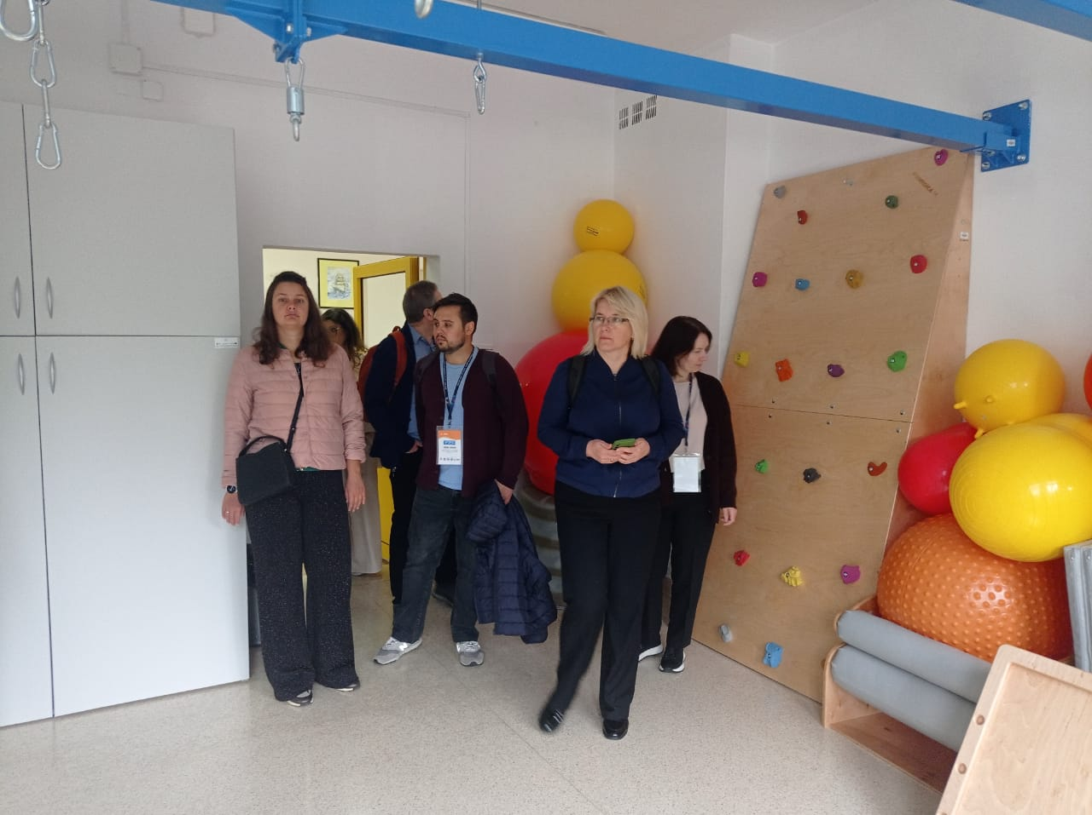
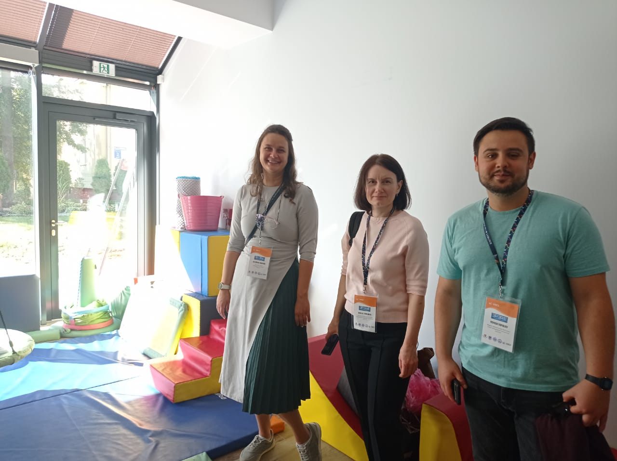

Slide 6
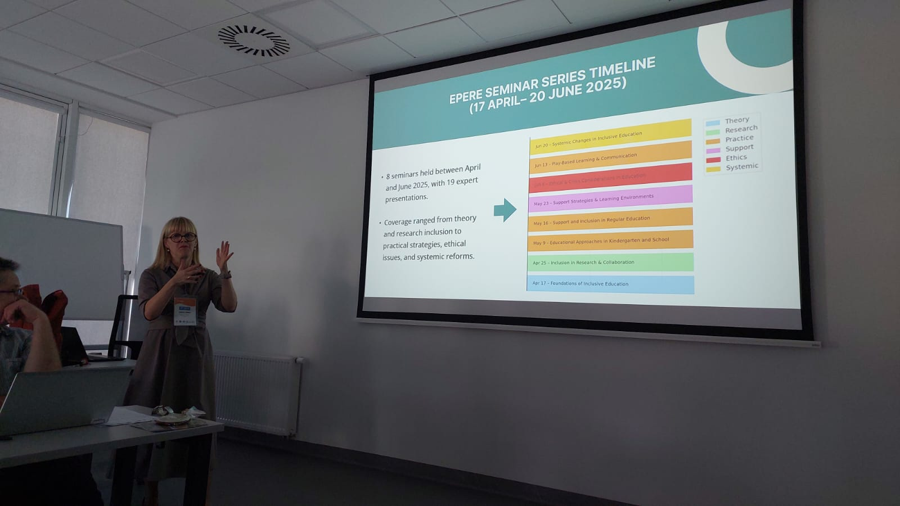
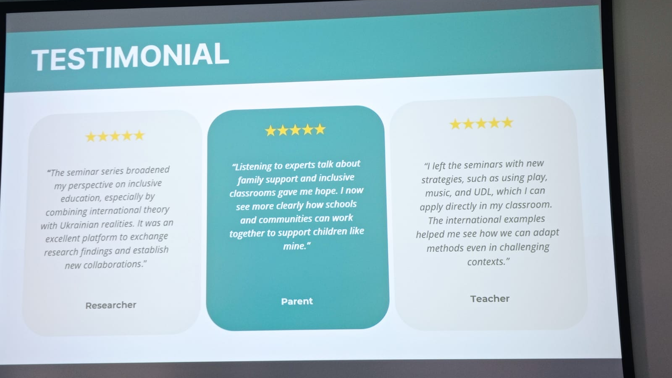
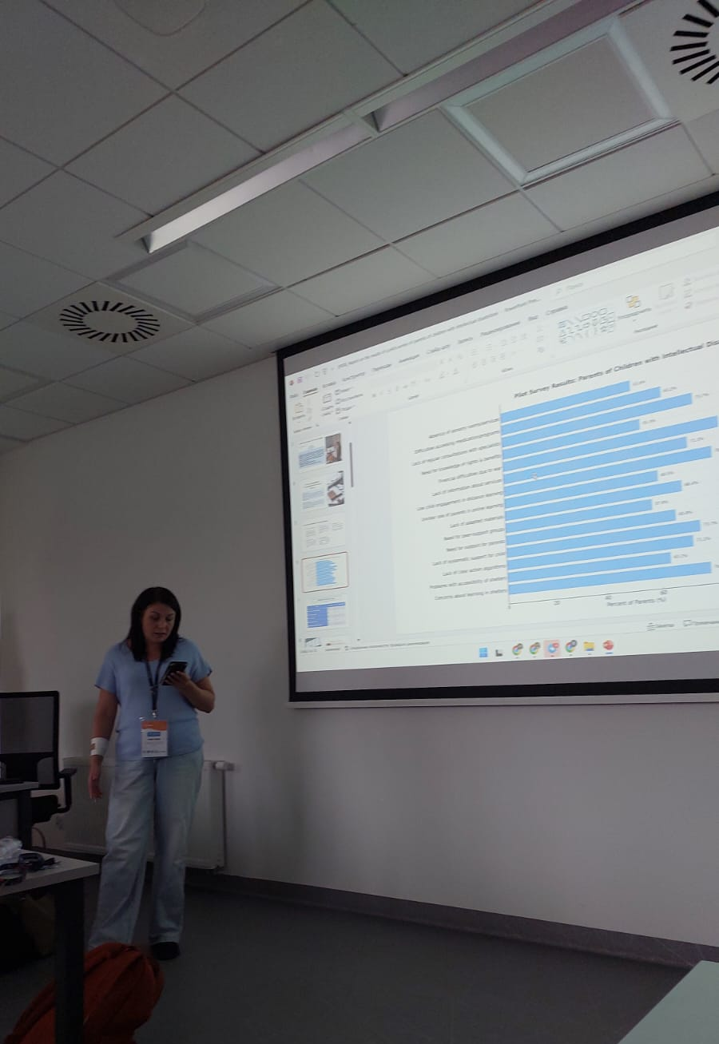
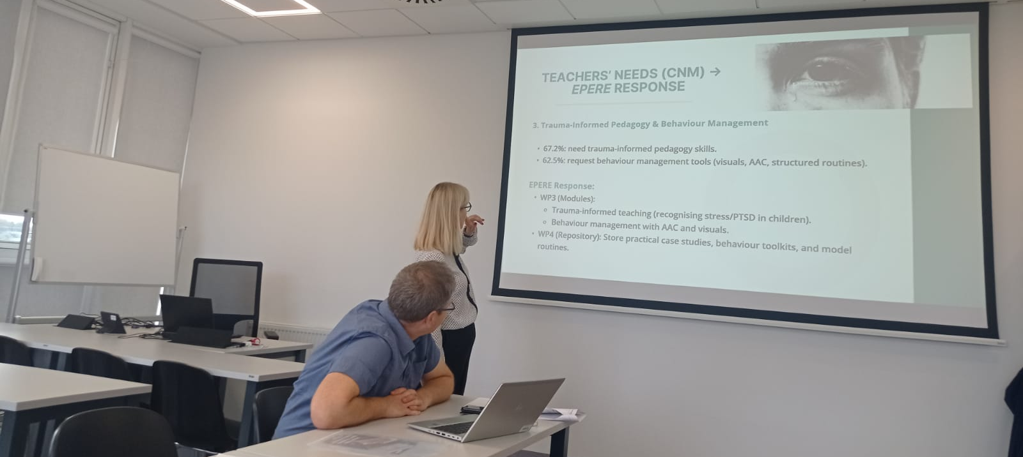
01
02
Project Management Review
Research Seminar Evaluation
WP1 coordination discussion led by Thomas Barow from Örebro University
WP2.1 assessment with Dorota Chimicz and KSPU team
03
Community Needs Mapping
14:00-16:00 - WP2.2 progress presentation by MSPU and
UMCS teams

Slide 7
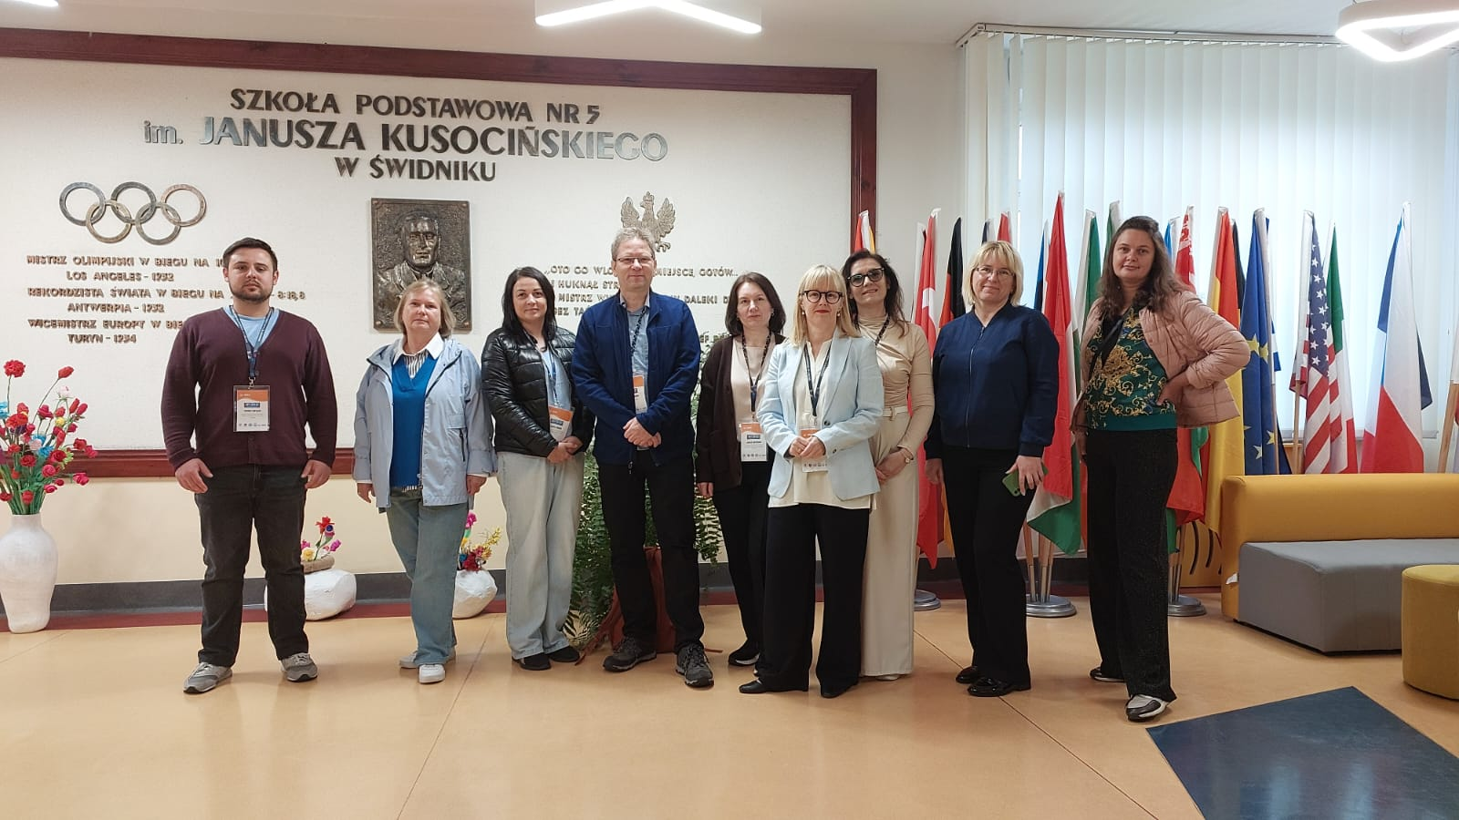

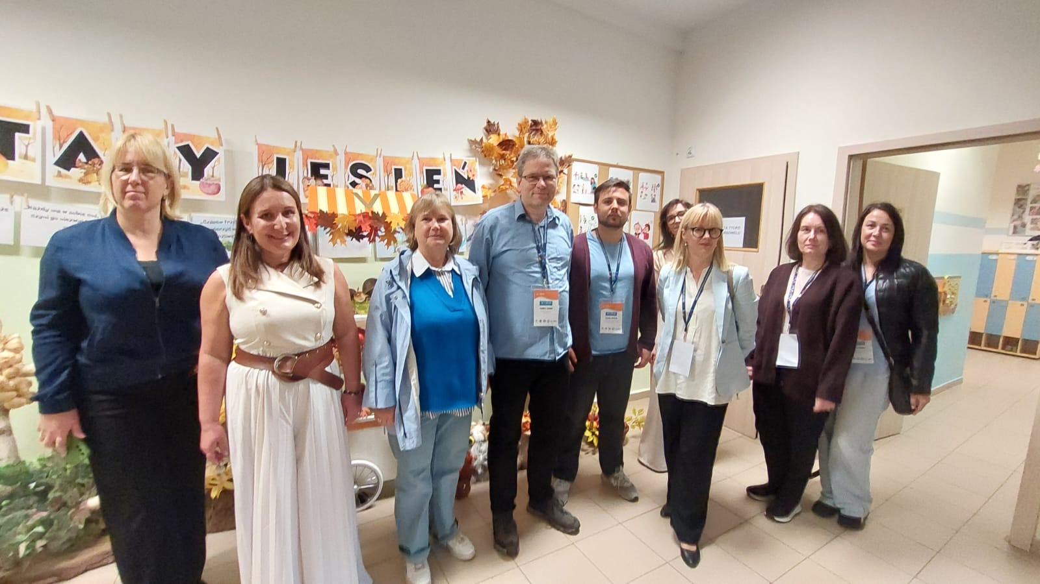

Day 2 Educational Visits
The second day emphasizes practical learning through school visits and strategic planning for future activities.
Primary School No. 5
Study visit to observe inclusive primary education practices
in Świdnik
Montessori Kindergarten
Exploring early childhood inclusive education methodologies

Slide 8
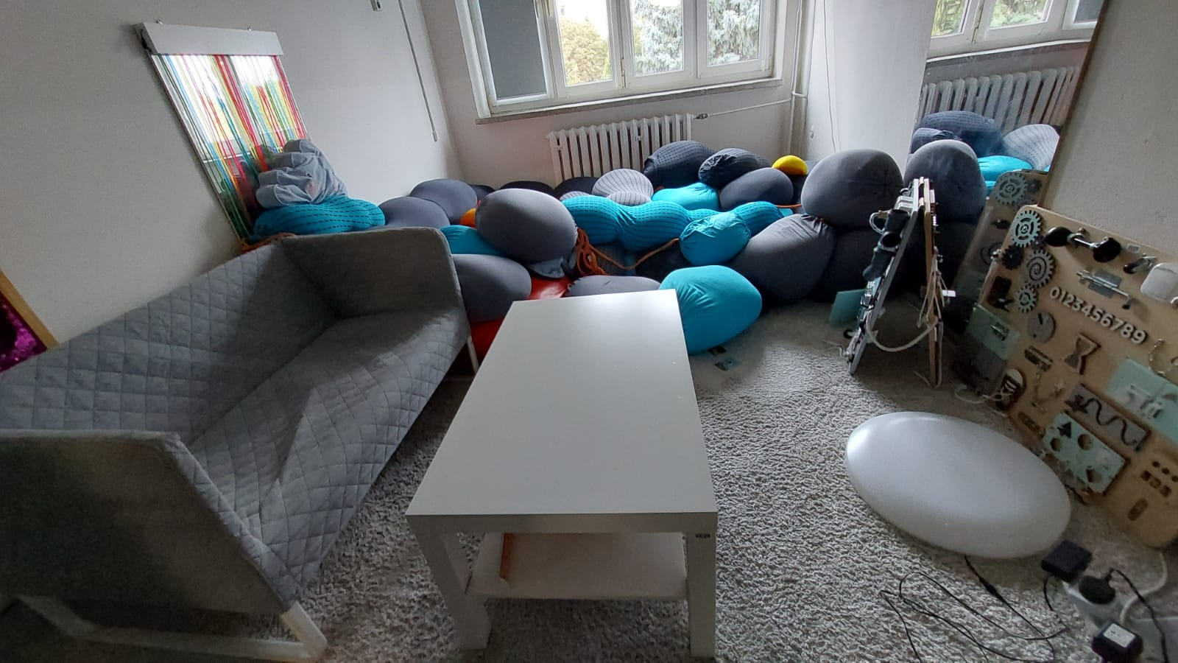
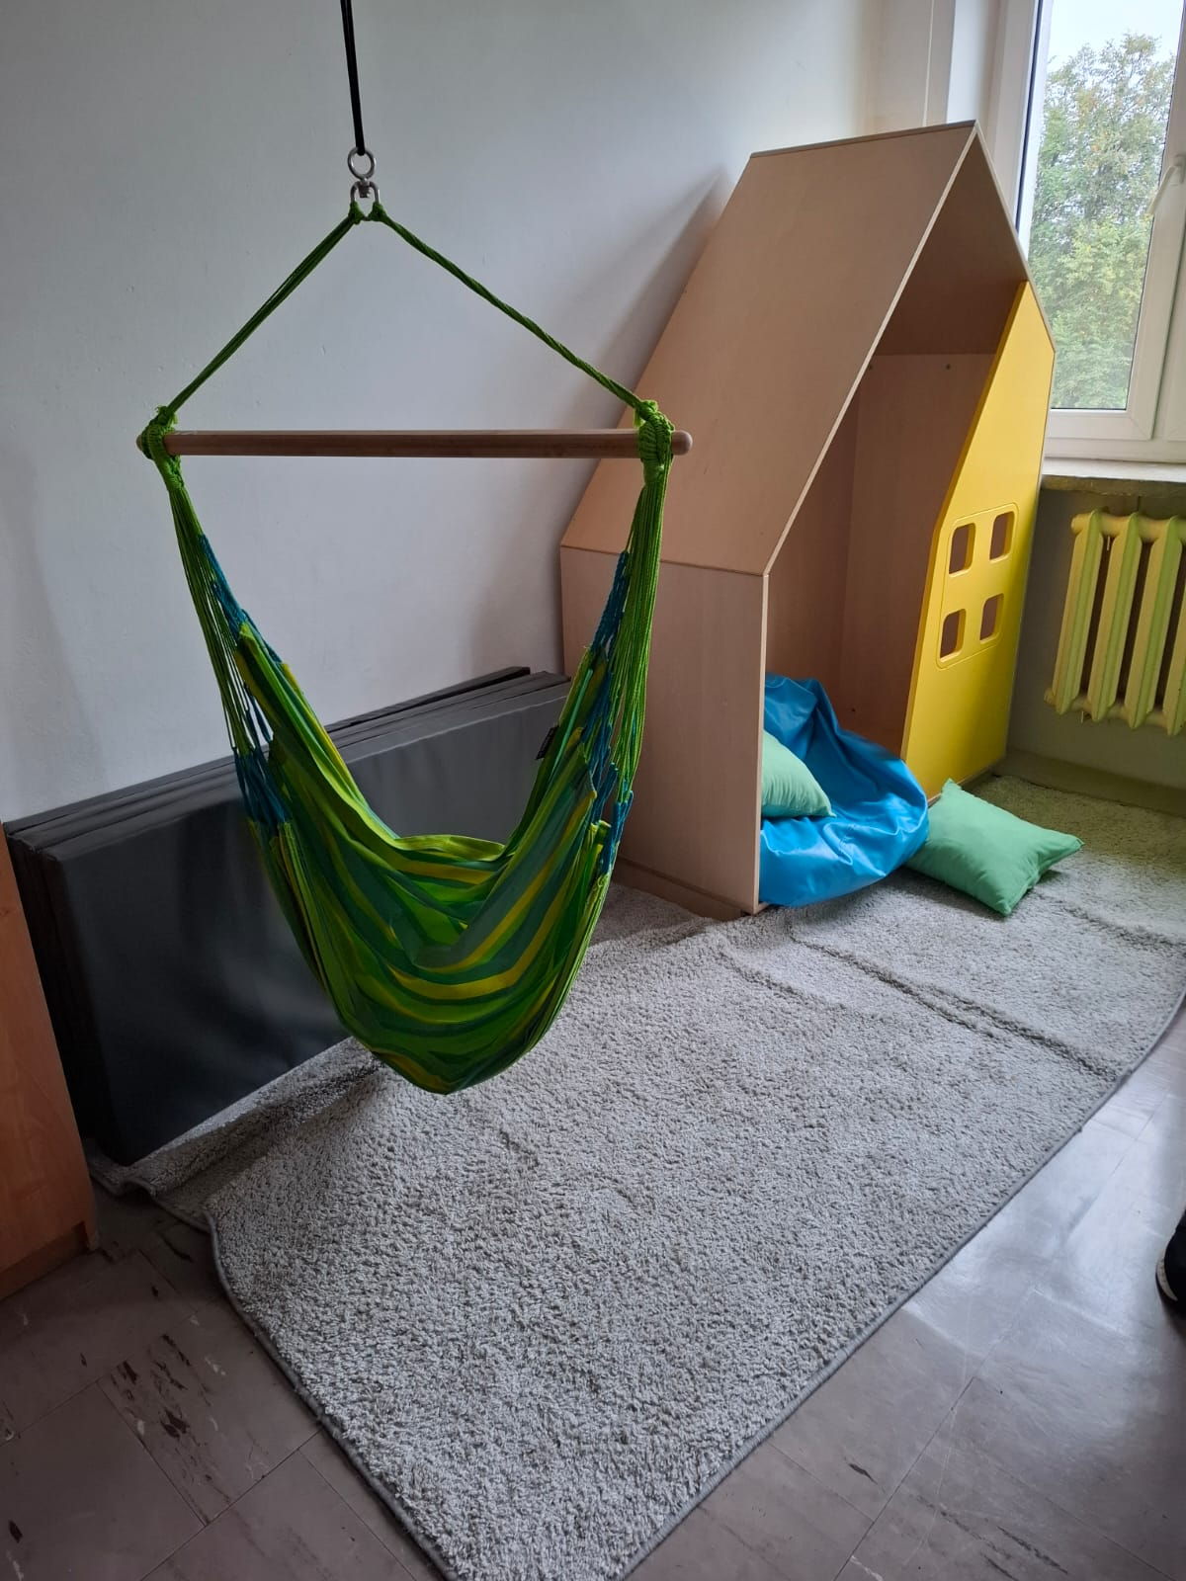
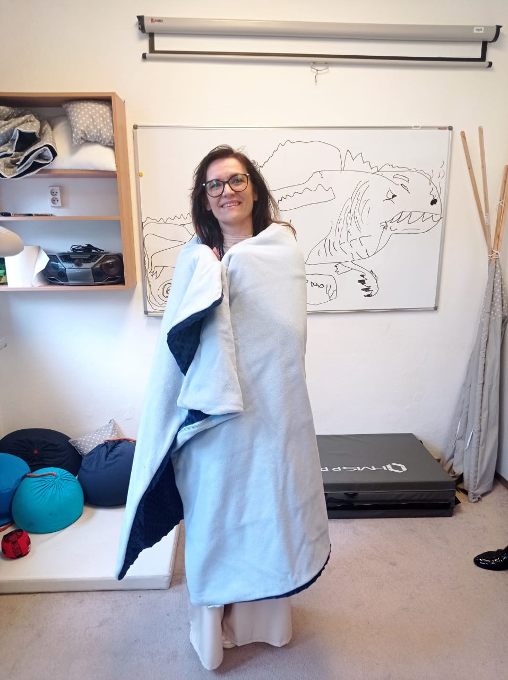
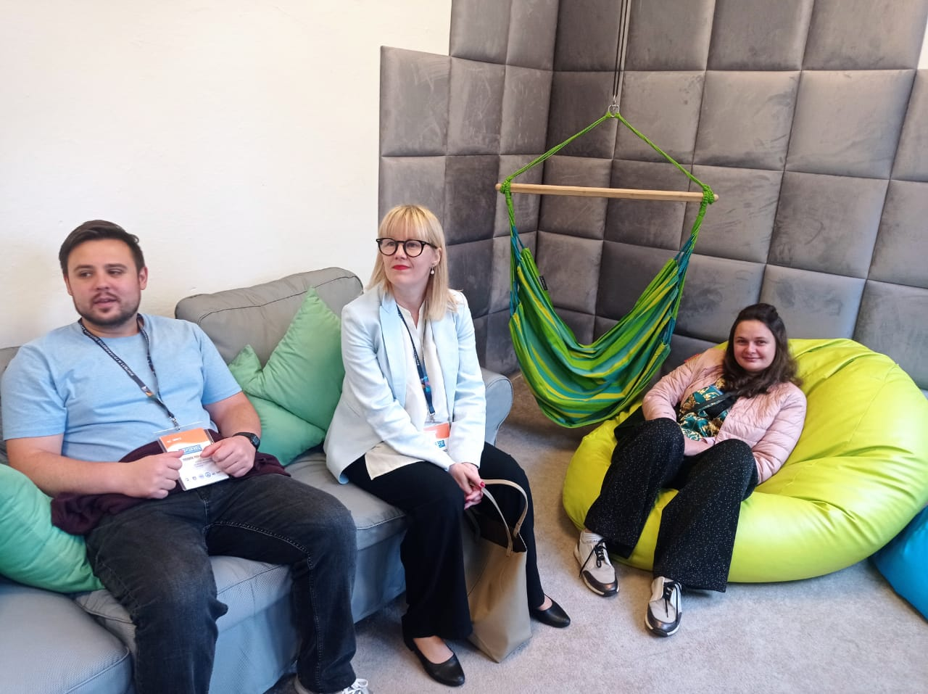
Primary School No. 5
Study visit to observe inclusive primary education practices
in Świdnik

Slide 9
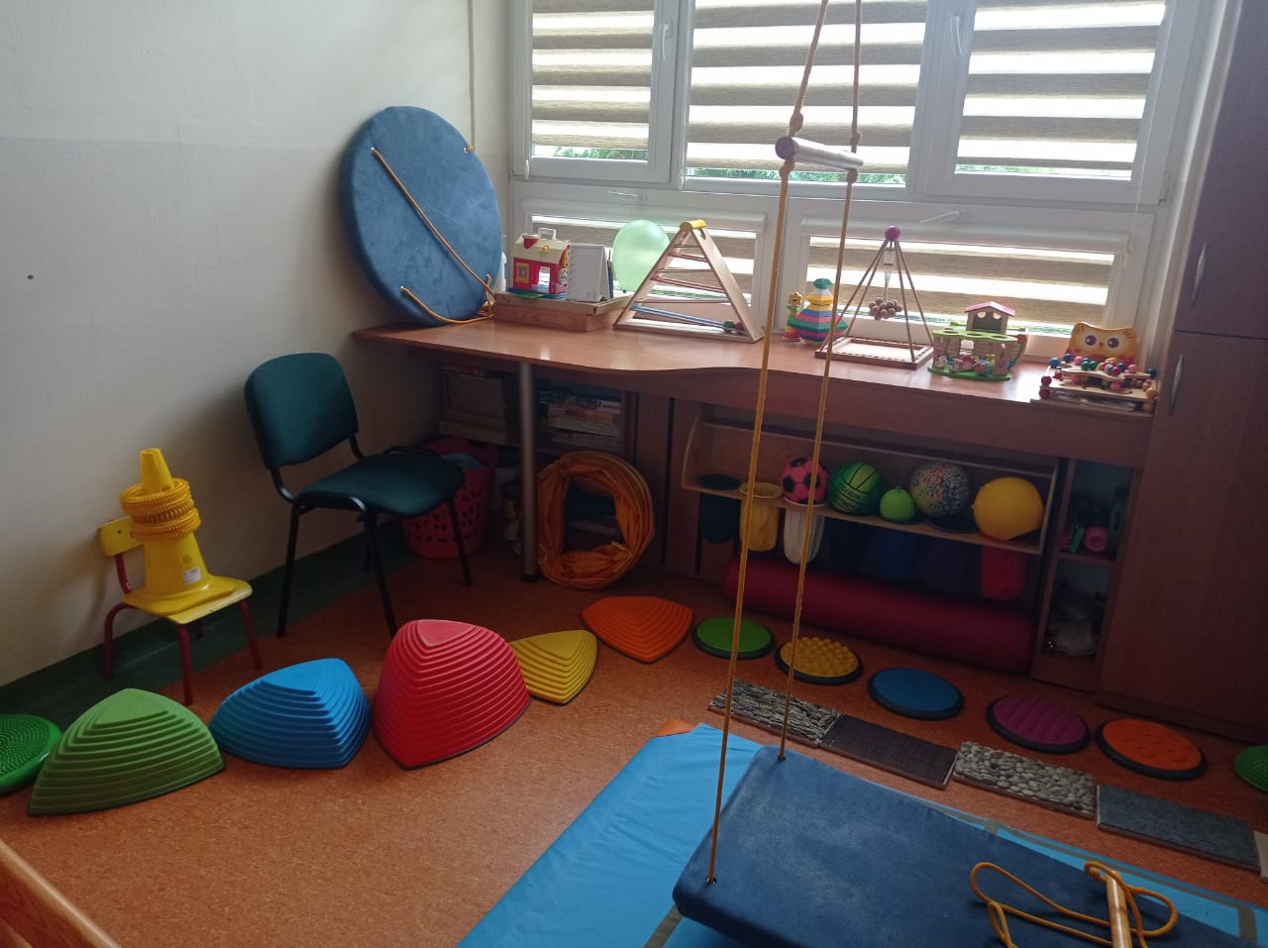
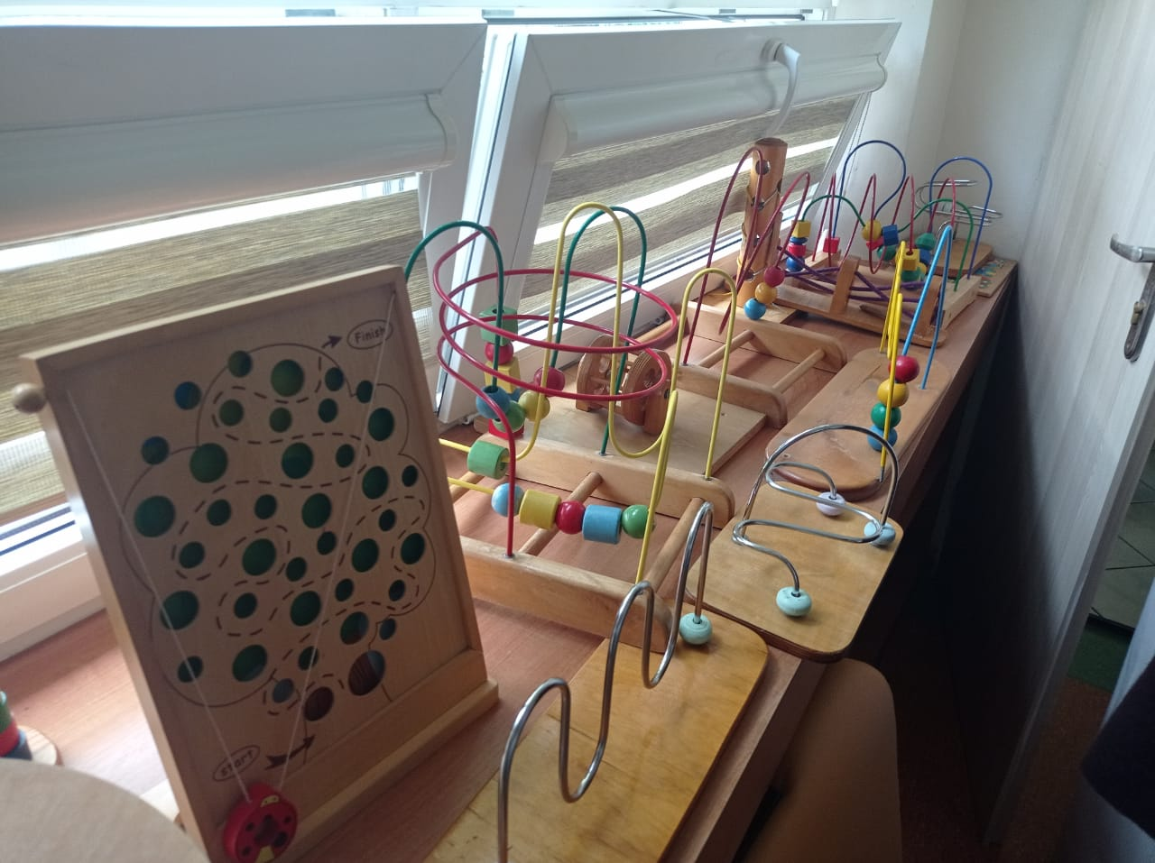
Montessori Kindergarten
Exploring early childhood inclusive education methodologies

Slide 10
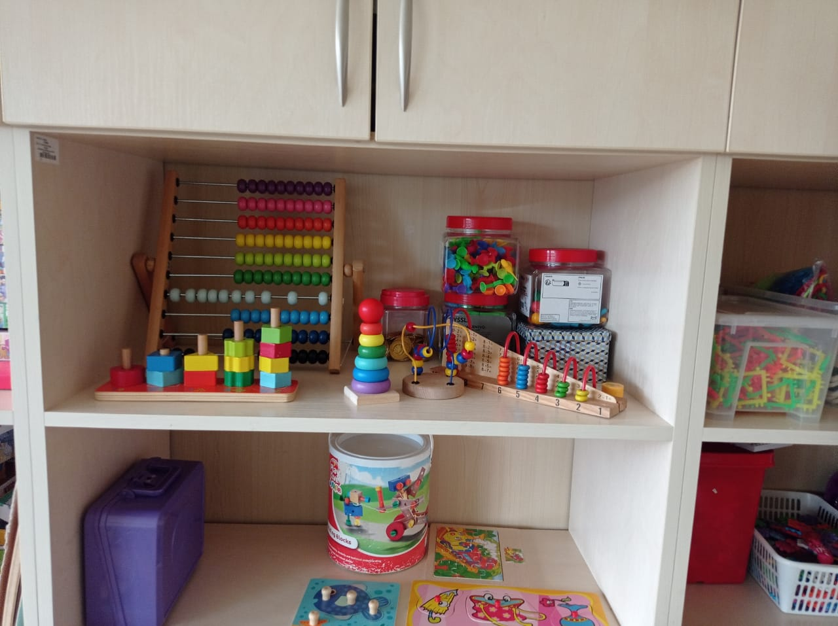
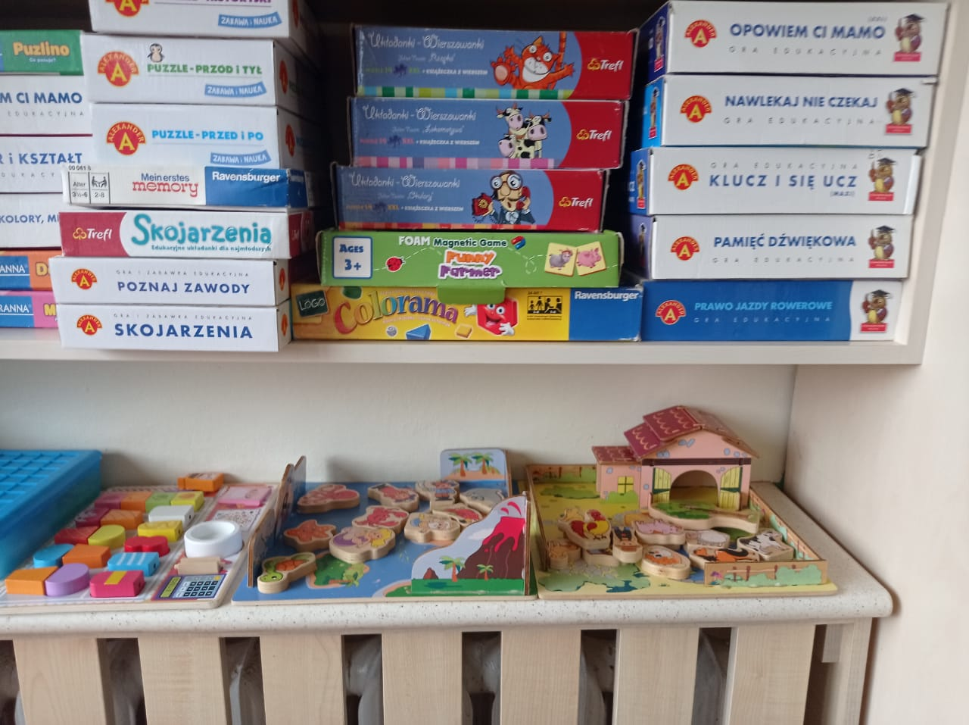
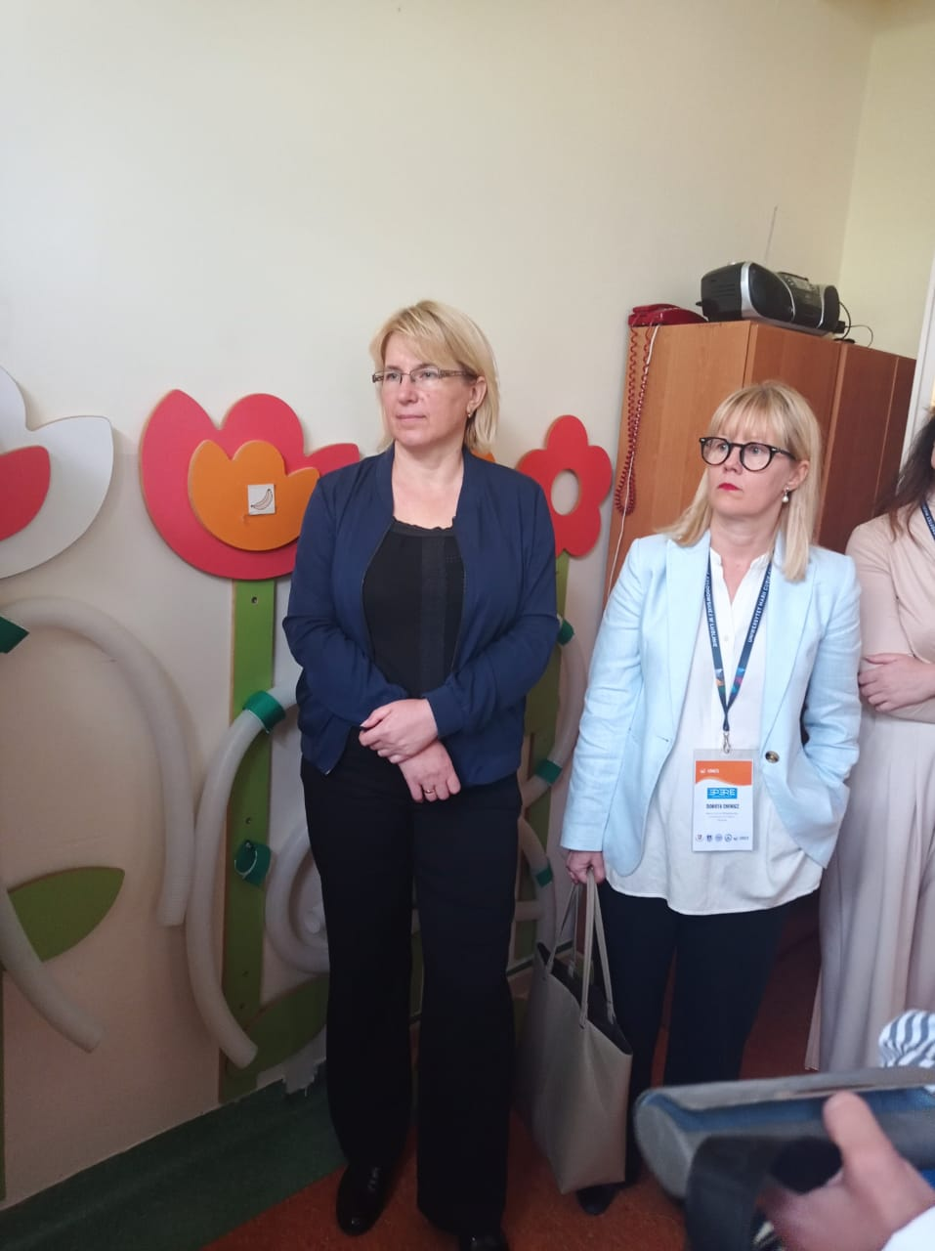
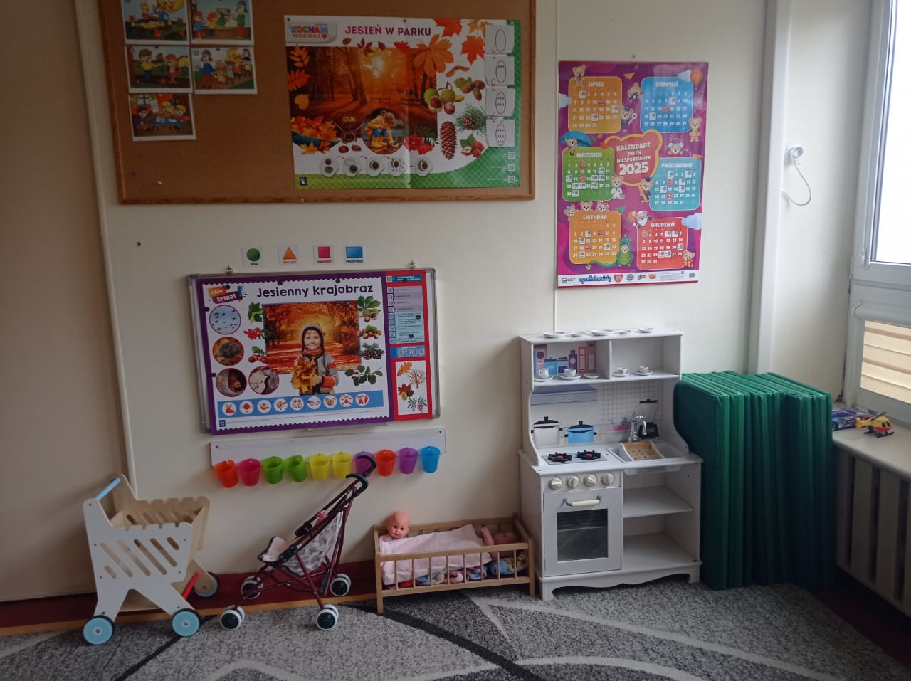
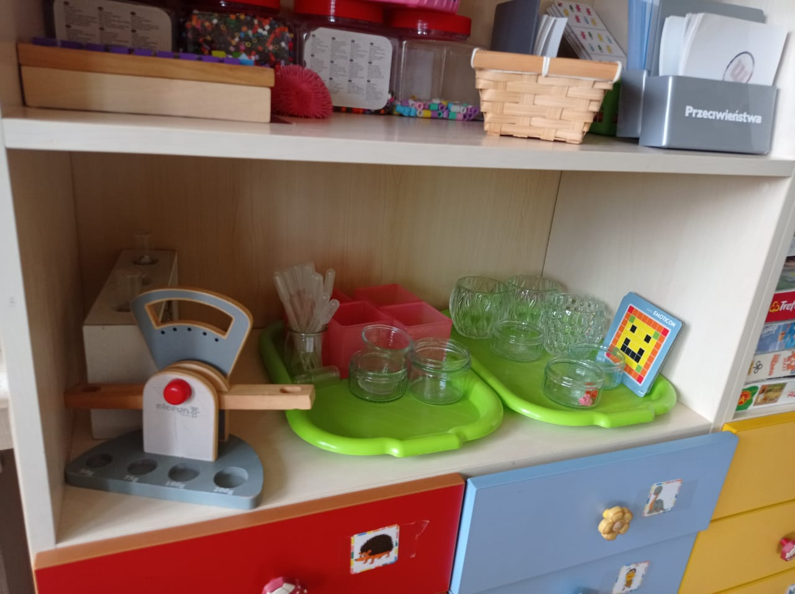

Slide 11


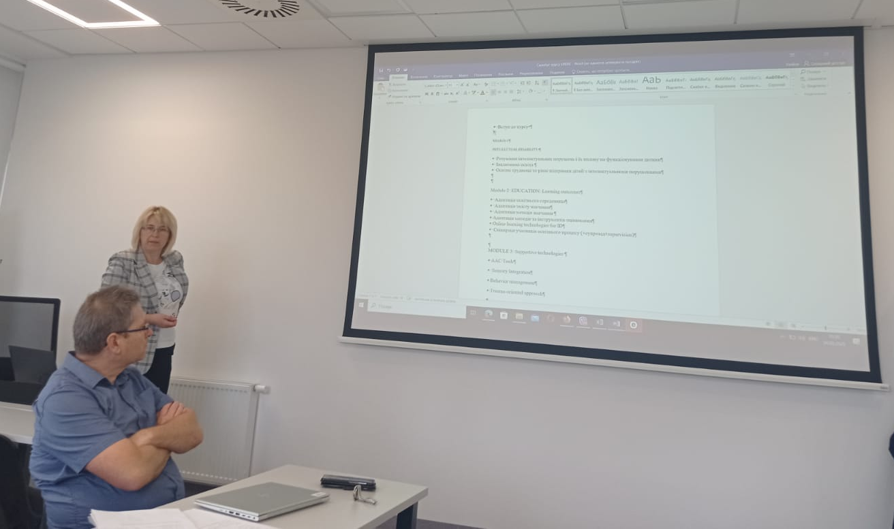

Day 2
Örebro Visit Planning
Training Modules
Thomas Barow outlines schedule and preparations for upcoming study visit
WP3 development discussion with MSPU, TNPU, and KSPU teams
Dissemination Strategy
WP4 outreach and publications planning session

Slide 12
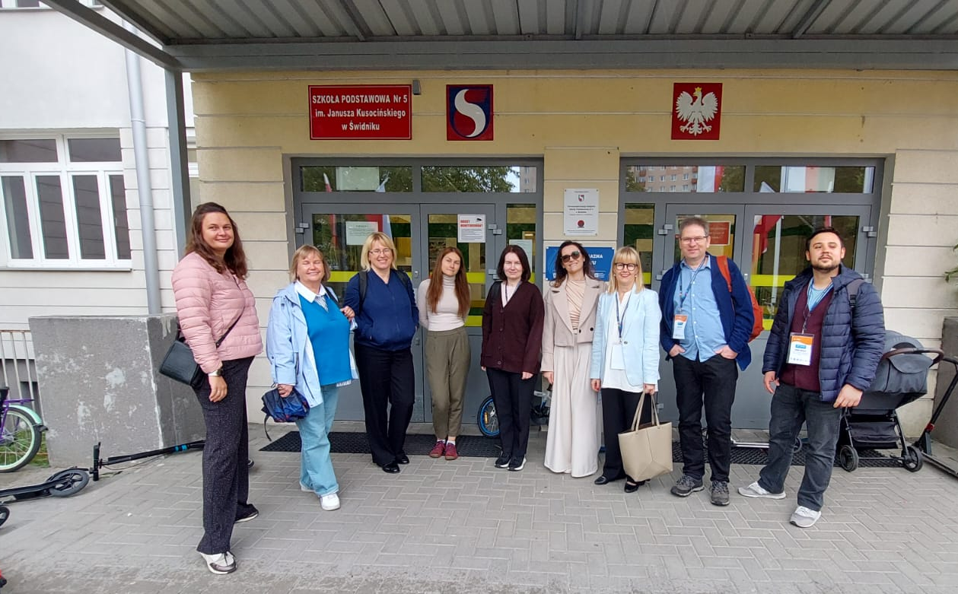
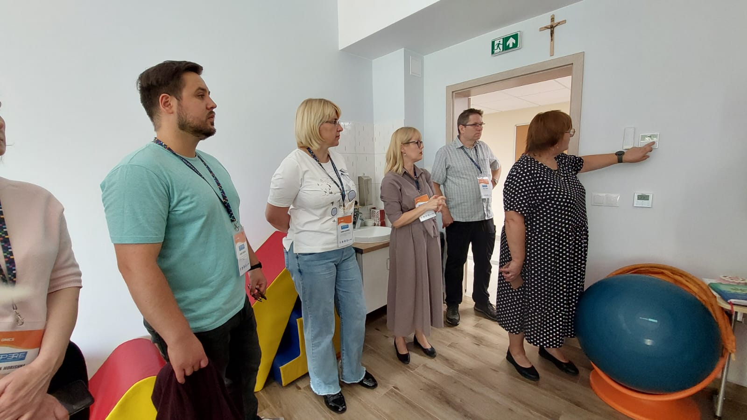
Day 3 Strategic Sessions
Dissemination and Sustainability planning including homepage development, conference participation, and long-term strategy
Project summary, task allocation, and next meeting planning to ensure continued momentum
Steering group meeting for QEW-CVLS
project coordination

Slide 13








Project Impact Goals
Research Excellence
Community Engagement
Conducting thorough needs assessments and developing evidence-based solutions
Mapping local needs and building sustainable support networks
Knowledge Sharing
Training Development
Disseminating findings through publications and conferences
Creating comprehensive modules for educators and support staff
The EPERE project aims to create lasting change in inclusive education through comprehensive
capacity building and opportunity development.

Slide 14
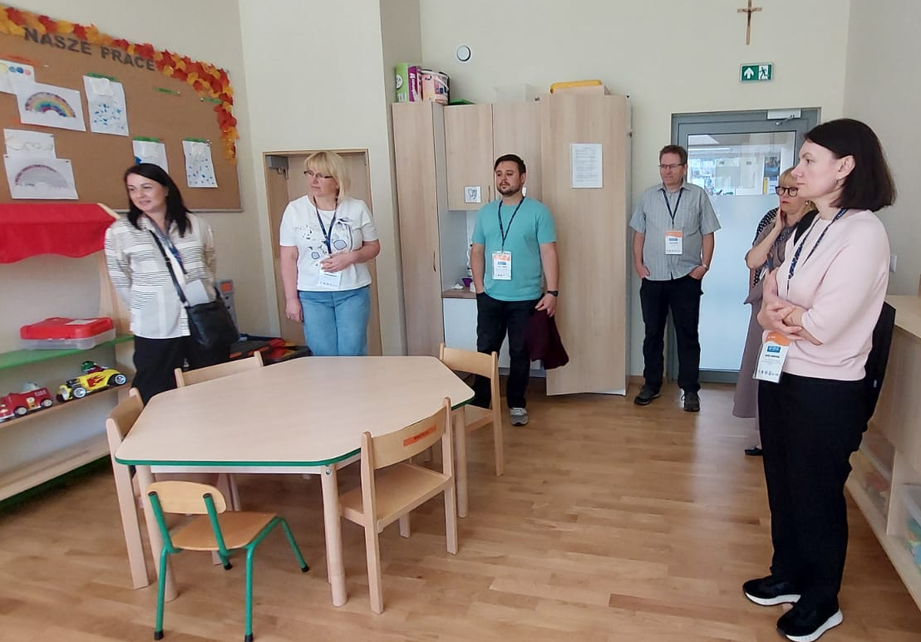
Building Inclusive Futures Together
This three-day meeting represents a crucial step in advancing inclusive education for children with intellectual disabilities across Europe. Through collaborative research, practical training, and sustainable partnerships, the EPERE project will create lasting positive change.
Immediate Outcomes
Long-term Vision
Sustainable Impact
Enhanced coordination between partner institutions and refined project deliverables
Improved educational opportunities and participation for children with intellectual disabilities
Capacity building that extends beyond the project timeline through trained educators and established networks
Together, we are building a more inclusive educational landscape
where every child has the opportunity to thrive and reach their full potential.

