Slide 1
An Introduction to Augmentative and Alternative Communication (AAC)
Sofia Wallin, PhD and SLP
sofia.m.wallin@vgregion.se
https://orcid.org/0000-0003-2222-4569

Slide 2
AAC
Augmentative and Alternative Communication
AAC includes systems, strategies, and tools that support or replace spoken or written communication for individuals with communication difficulties
  Condensed version of the American Speech-Language-Hearing Association (ASHA) definition
Includes both expressive and receptive communication

Slide 3
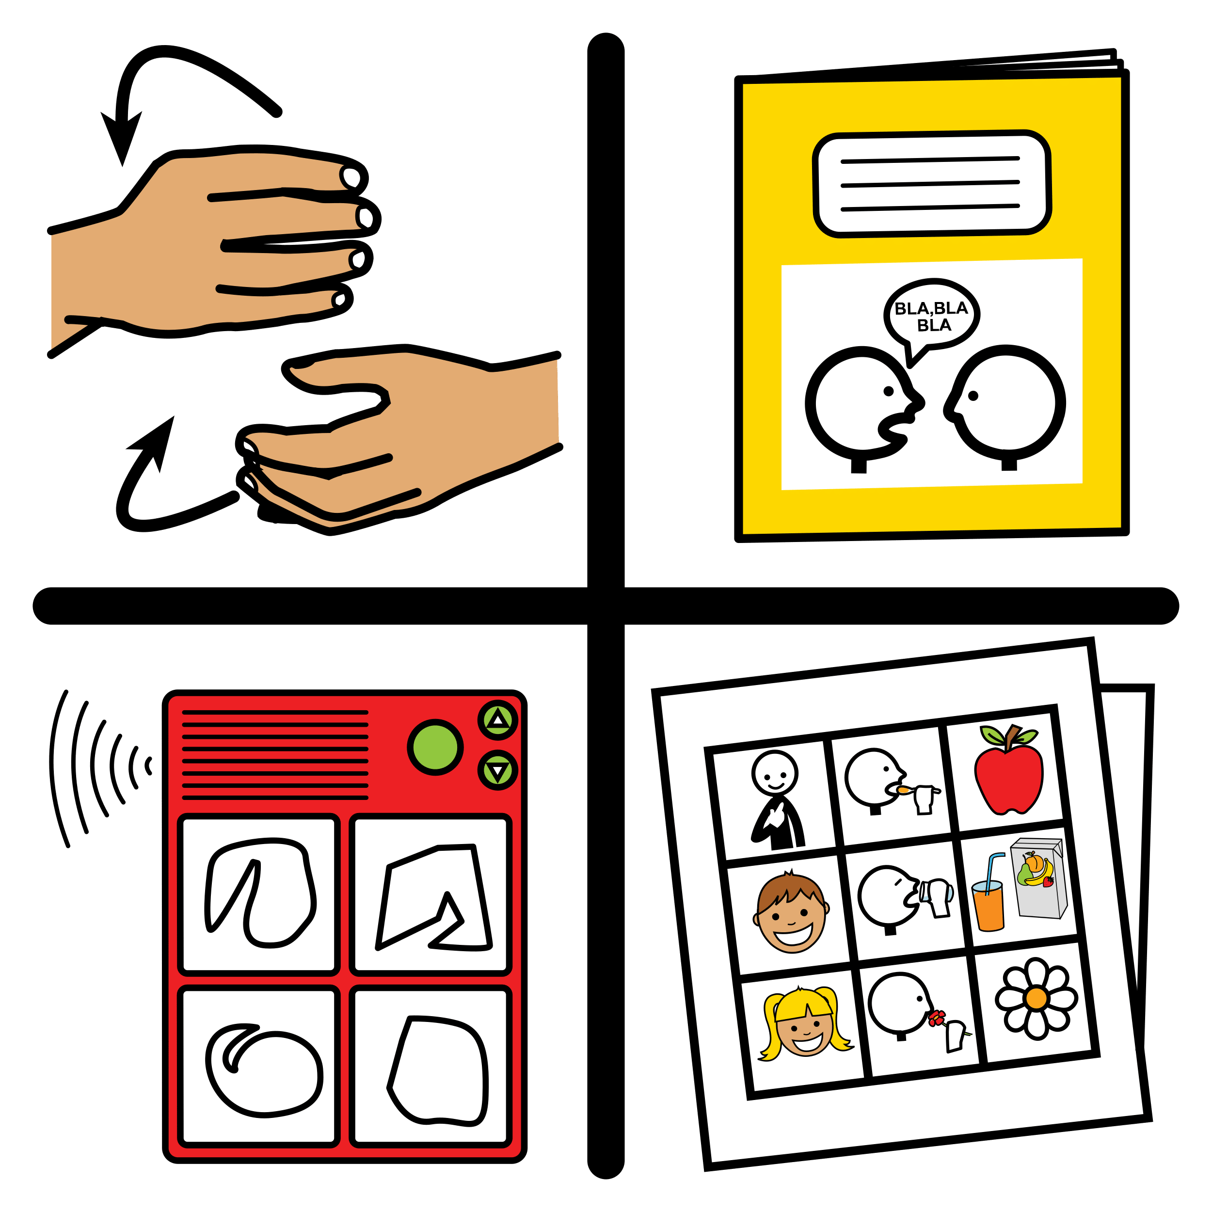
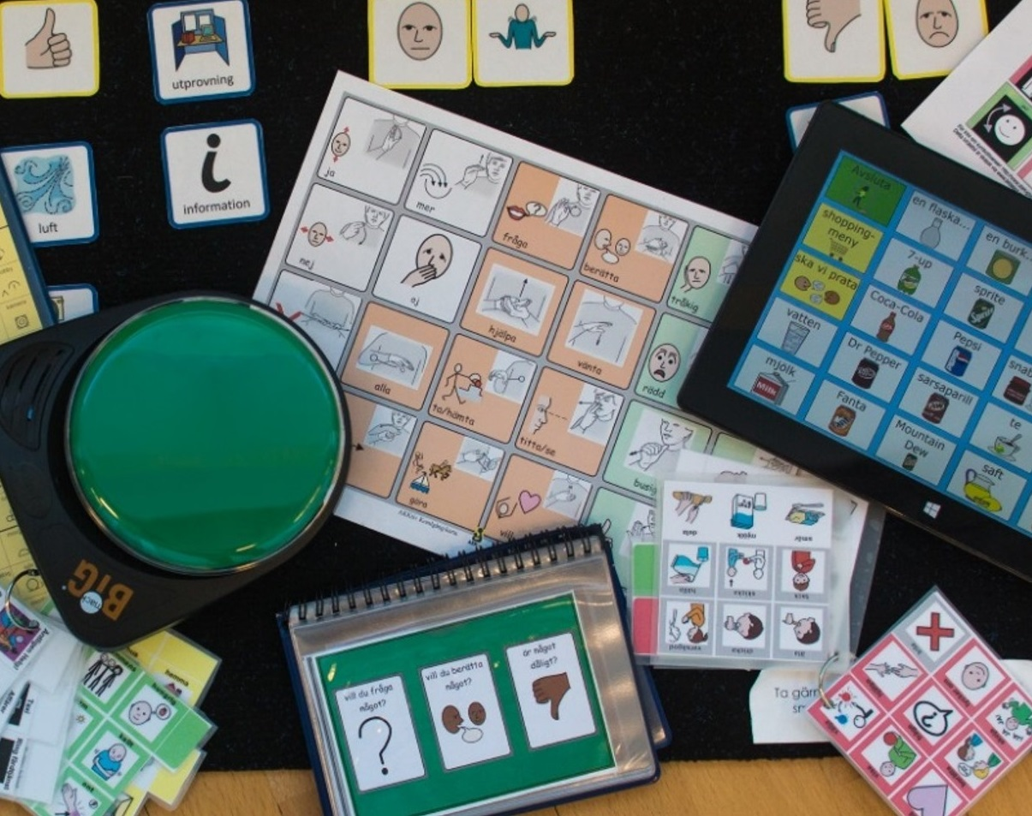
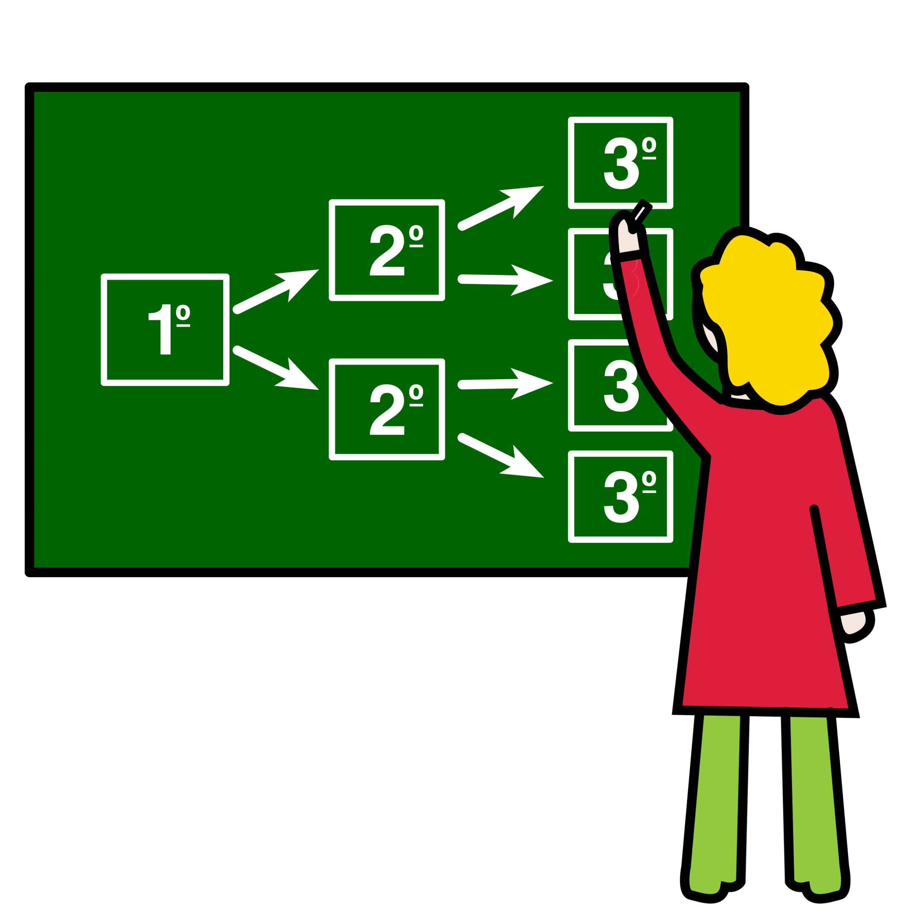
Systems
Strategies
Tools

Slide 4
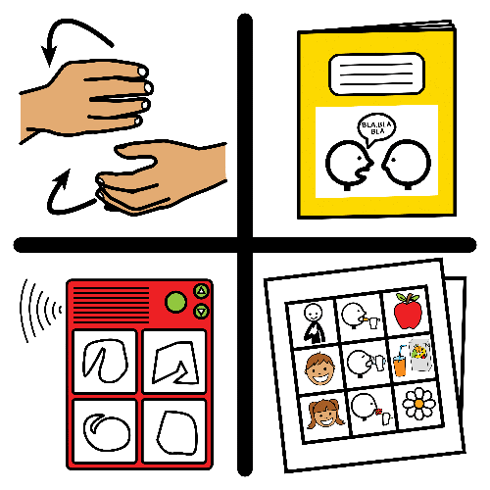
AAC systems
Provide a structure for vocabulary, grammar, and expression
Can be visual (pictures, objects), auditory (speech synthesis) gestural (manual signs), or tactile (objects, physical touch)
Picture from arasaac.org

Slide 5
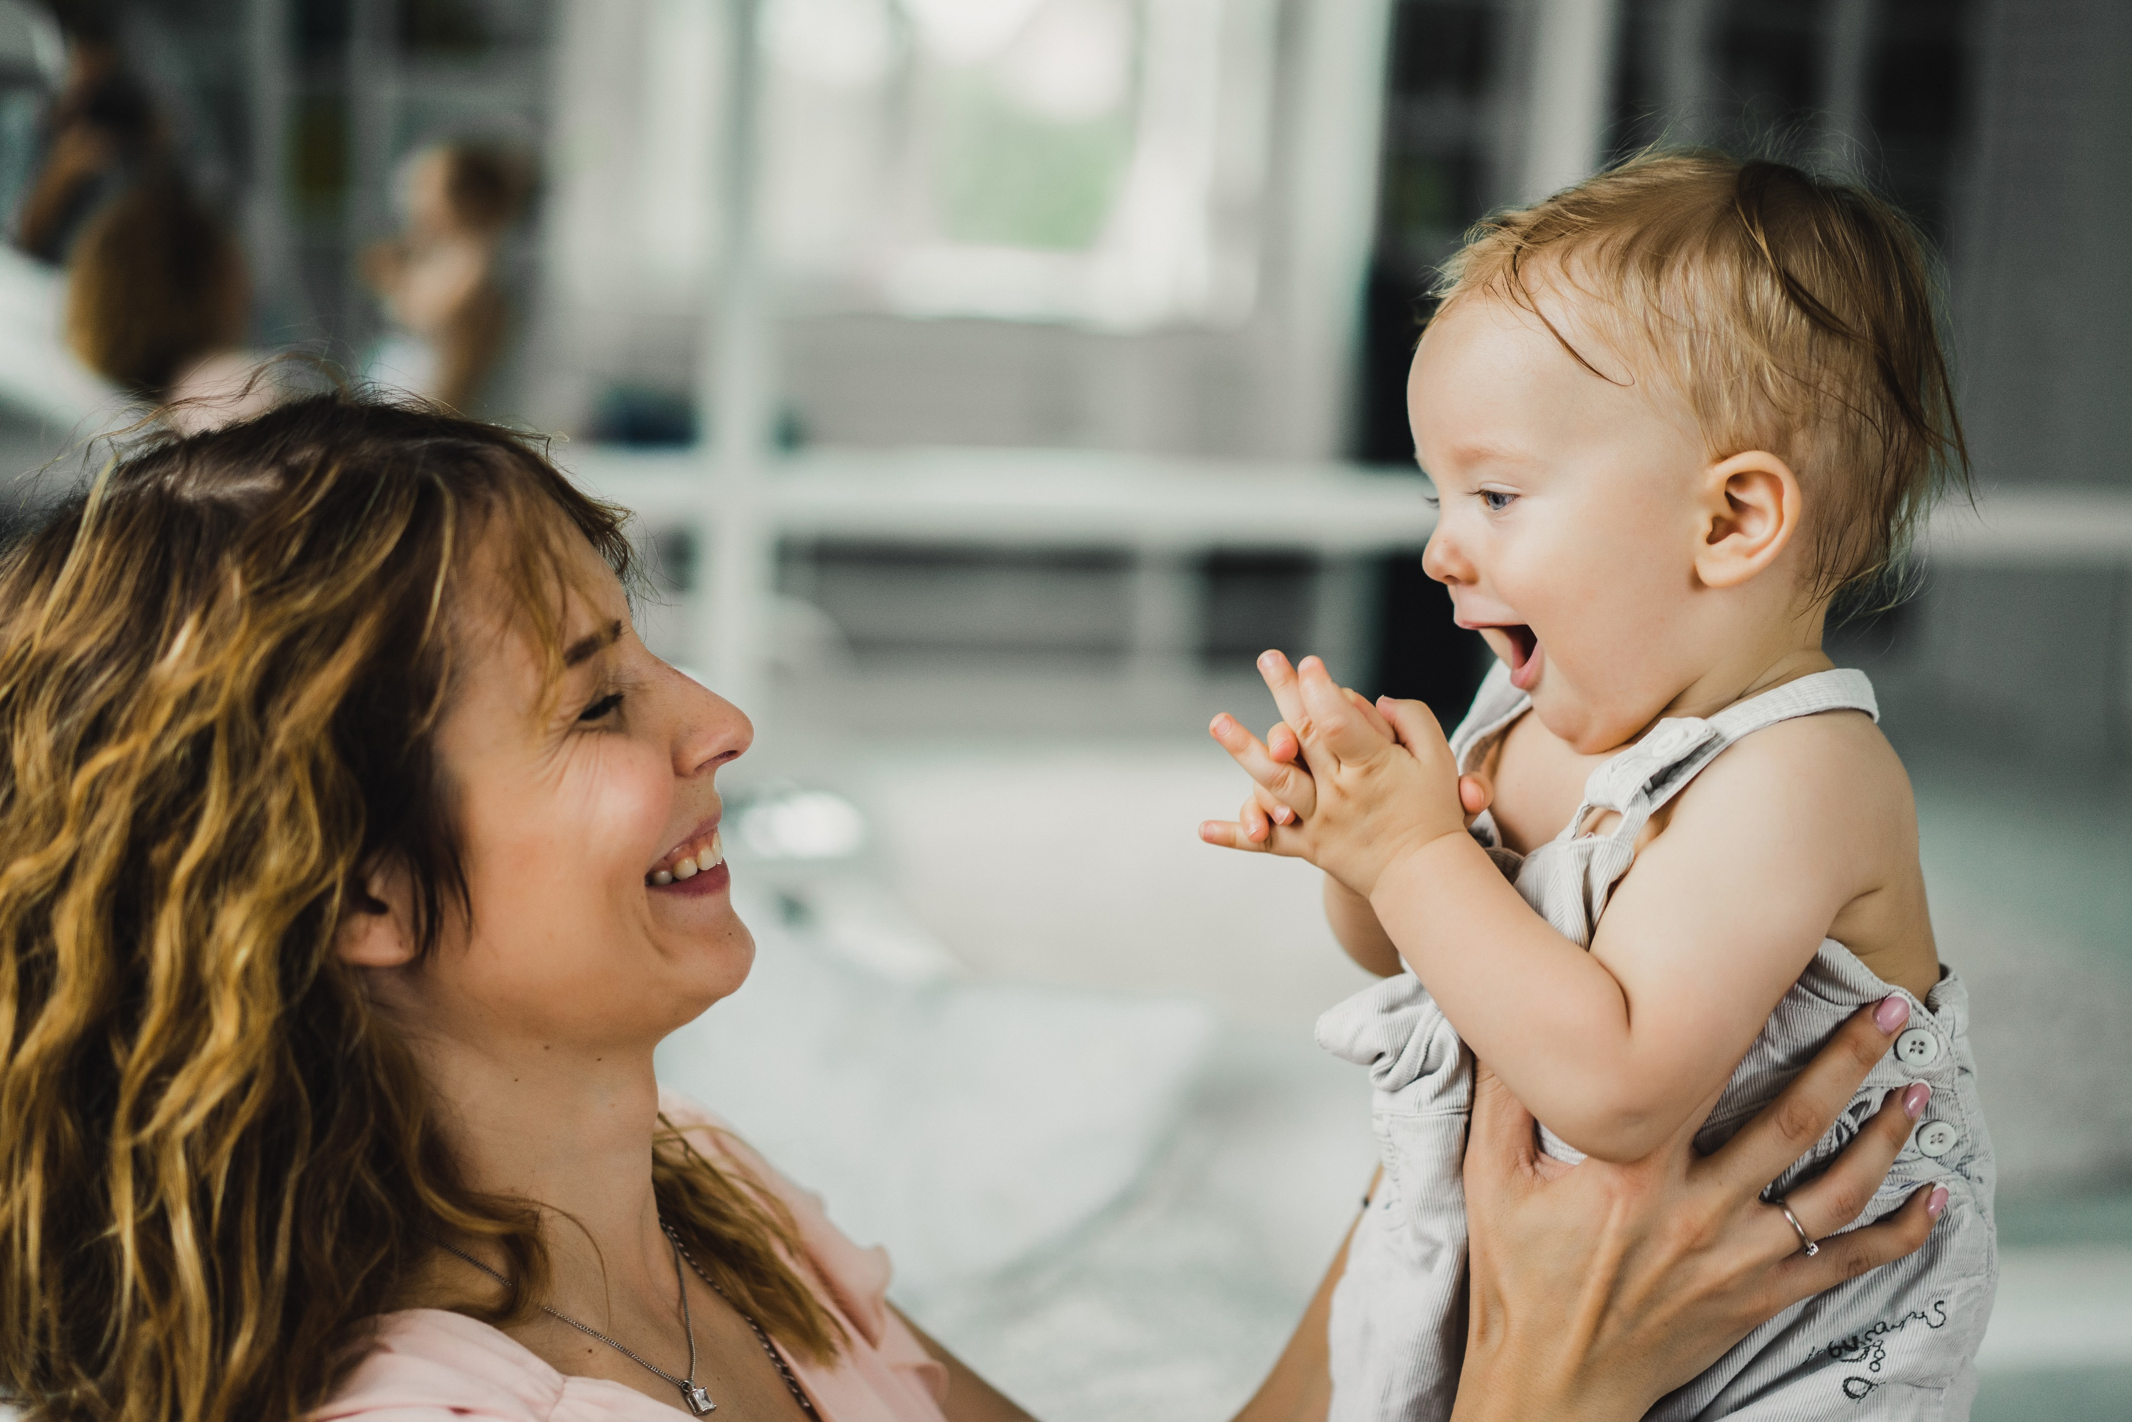
Baby talk
We talk A LOT to babies immediately when they are born
We use many spoken words although we do not expect them to fully understand them or use them themselves
First words: after about a year of rich exposure
3-year-old: knows 1,000–3,000 words
Photo from freepik.com

Slide 6
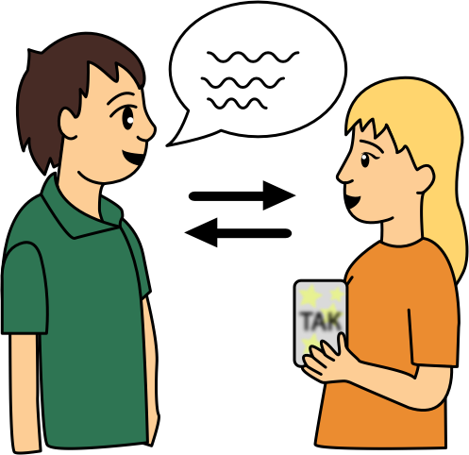
Intellectual disabilities (ID) and language/communication
Delayed overall development
Motor difficulties
Specific language disorders (in many genetic disorders)
Social interaction difficulties (for example in autism)
Impairment in body structures (for example cleft lip/palate)
Picture from www.dimobi.org.ua

Slide 7
AAC needs to be as rich as spoken language
Children with intellectual disability need more, not less, support to develop language
They require AAC systems that are equal to spoken language
Yet, we often think AAC is too difficult and provide narrow systems
We mean to help — but we end up reducing their opportunities to learn

Slide 8
Catch 22
Professionals provide systems based on an expectation of what is possible
The child can only demonstrate the abilities that professionals have made accessible to them
Professionals are influenced by what they see the person use

Slide 9
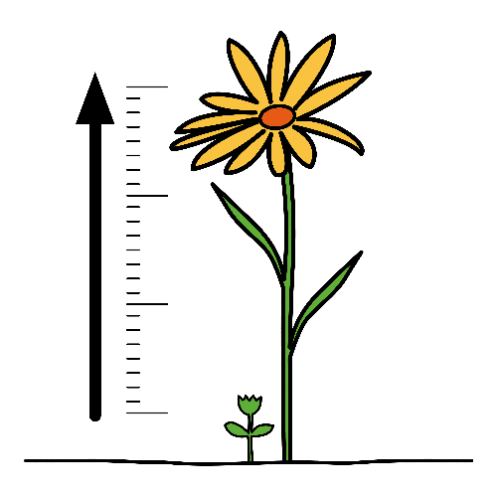
AAC systems needs to incorporate…
The language the child already knows
The language the child may need to understand and use in the future
Picture from arasaac.org

Slide 10

Communicative functions
– Why we communicate
Pictures from bildstod.se and arasaac.org

Slide 11



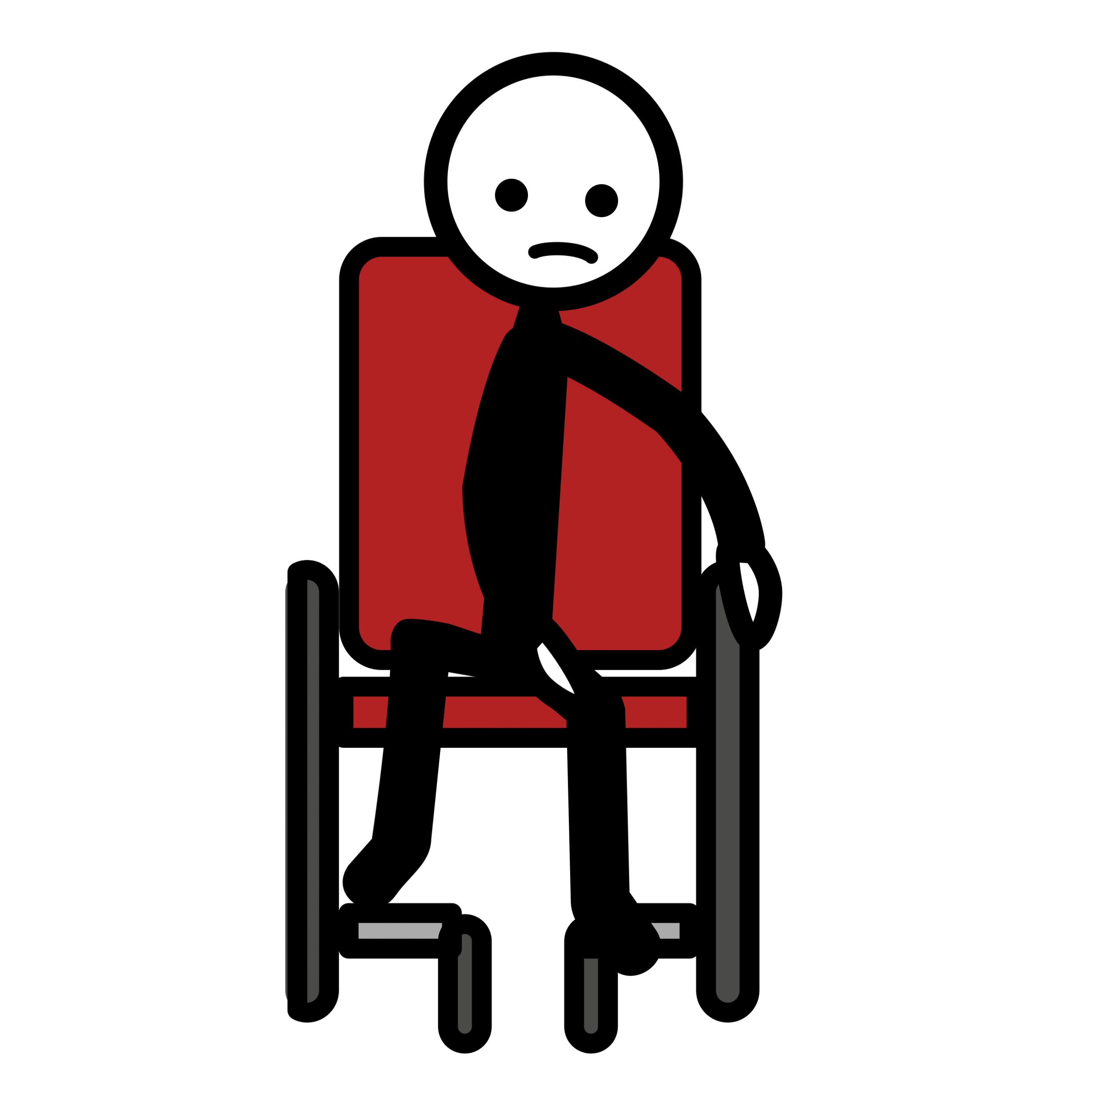





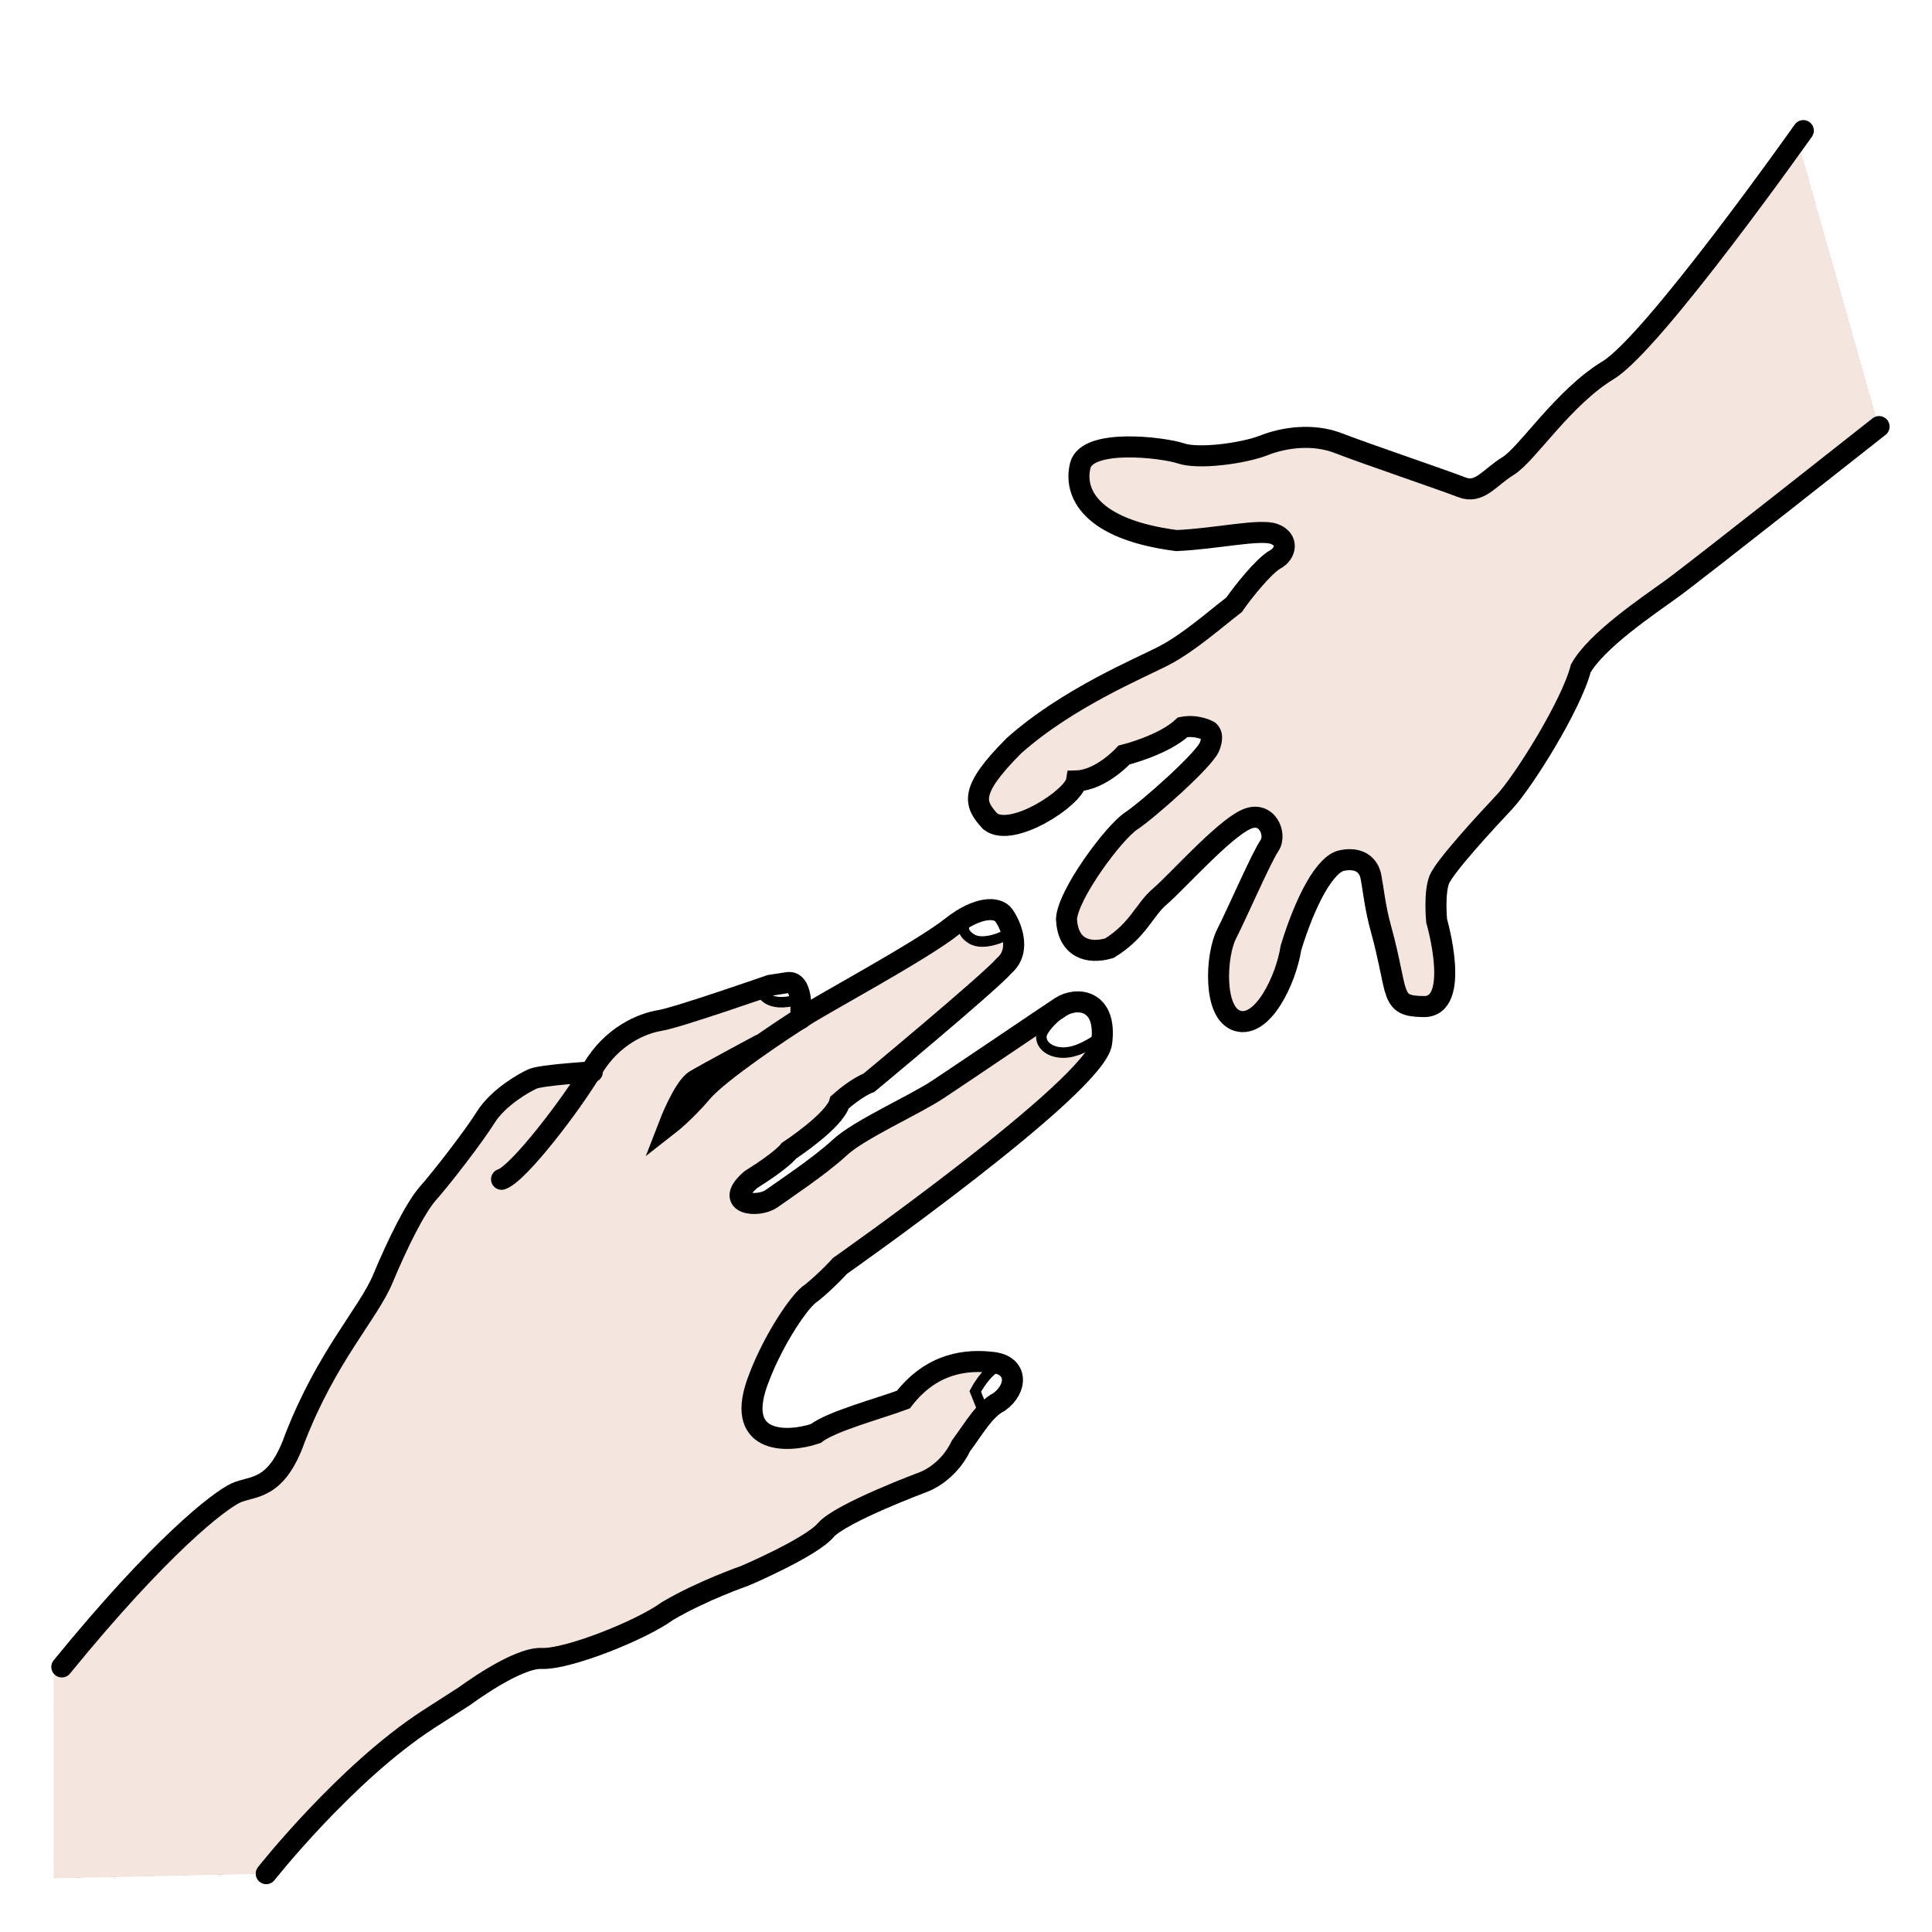

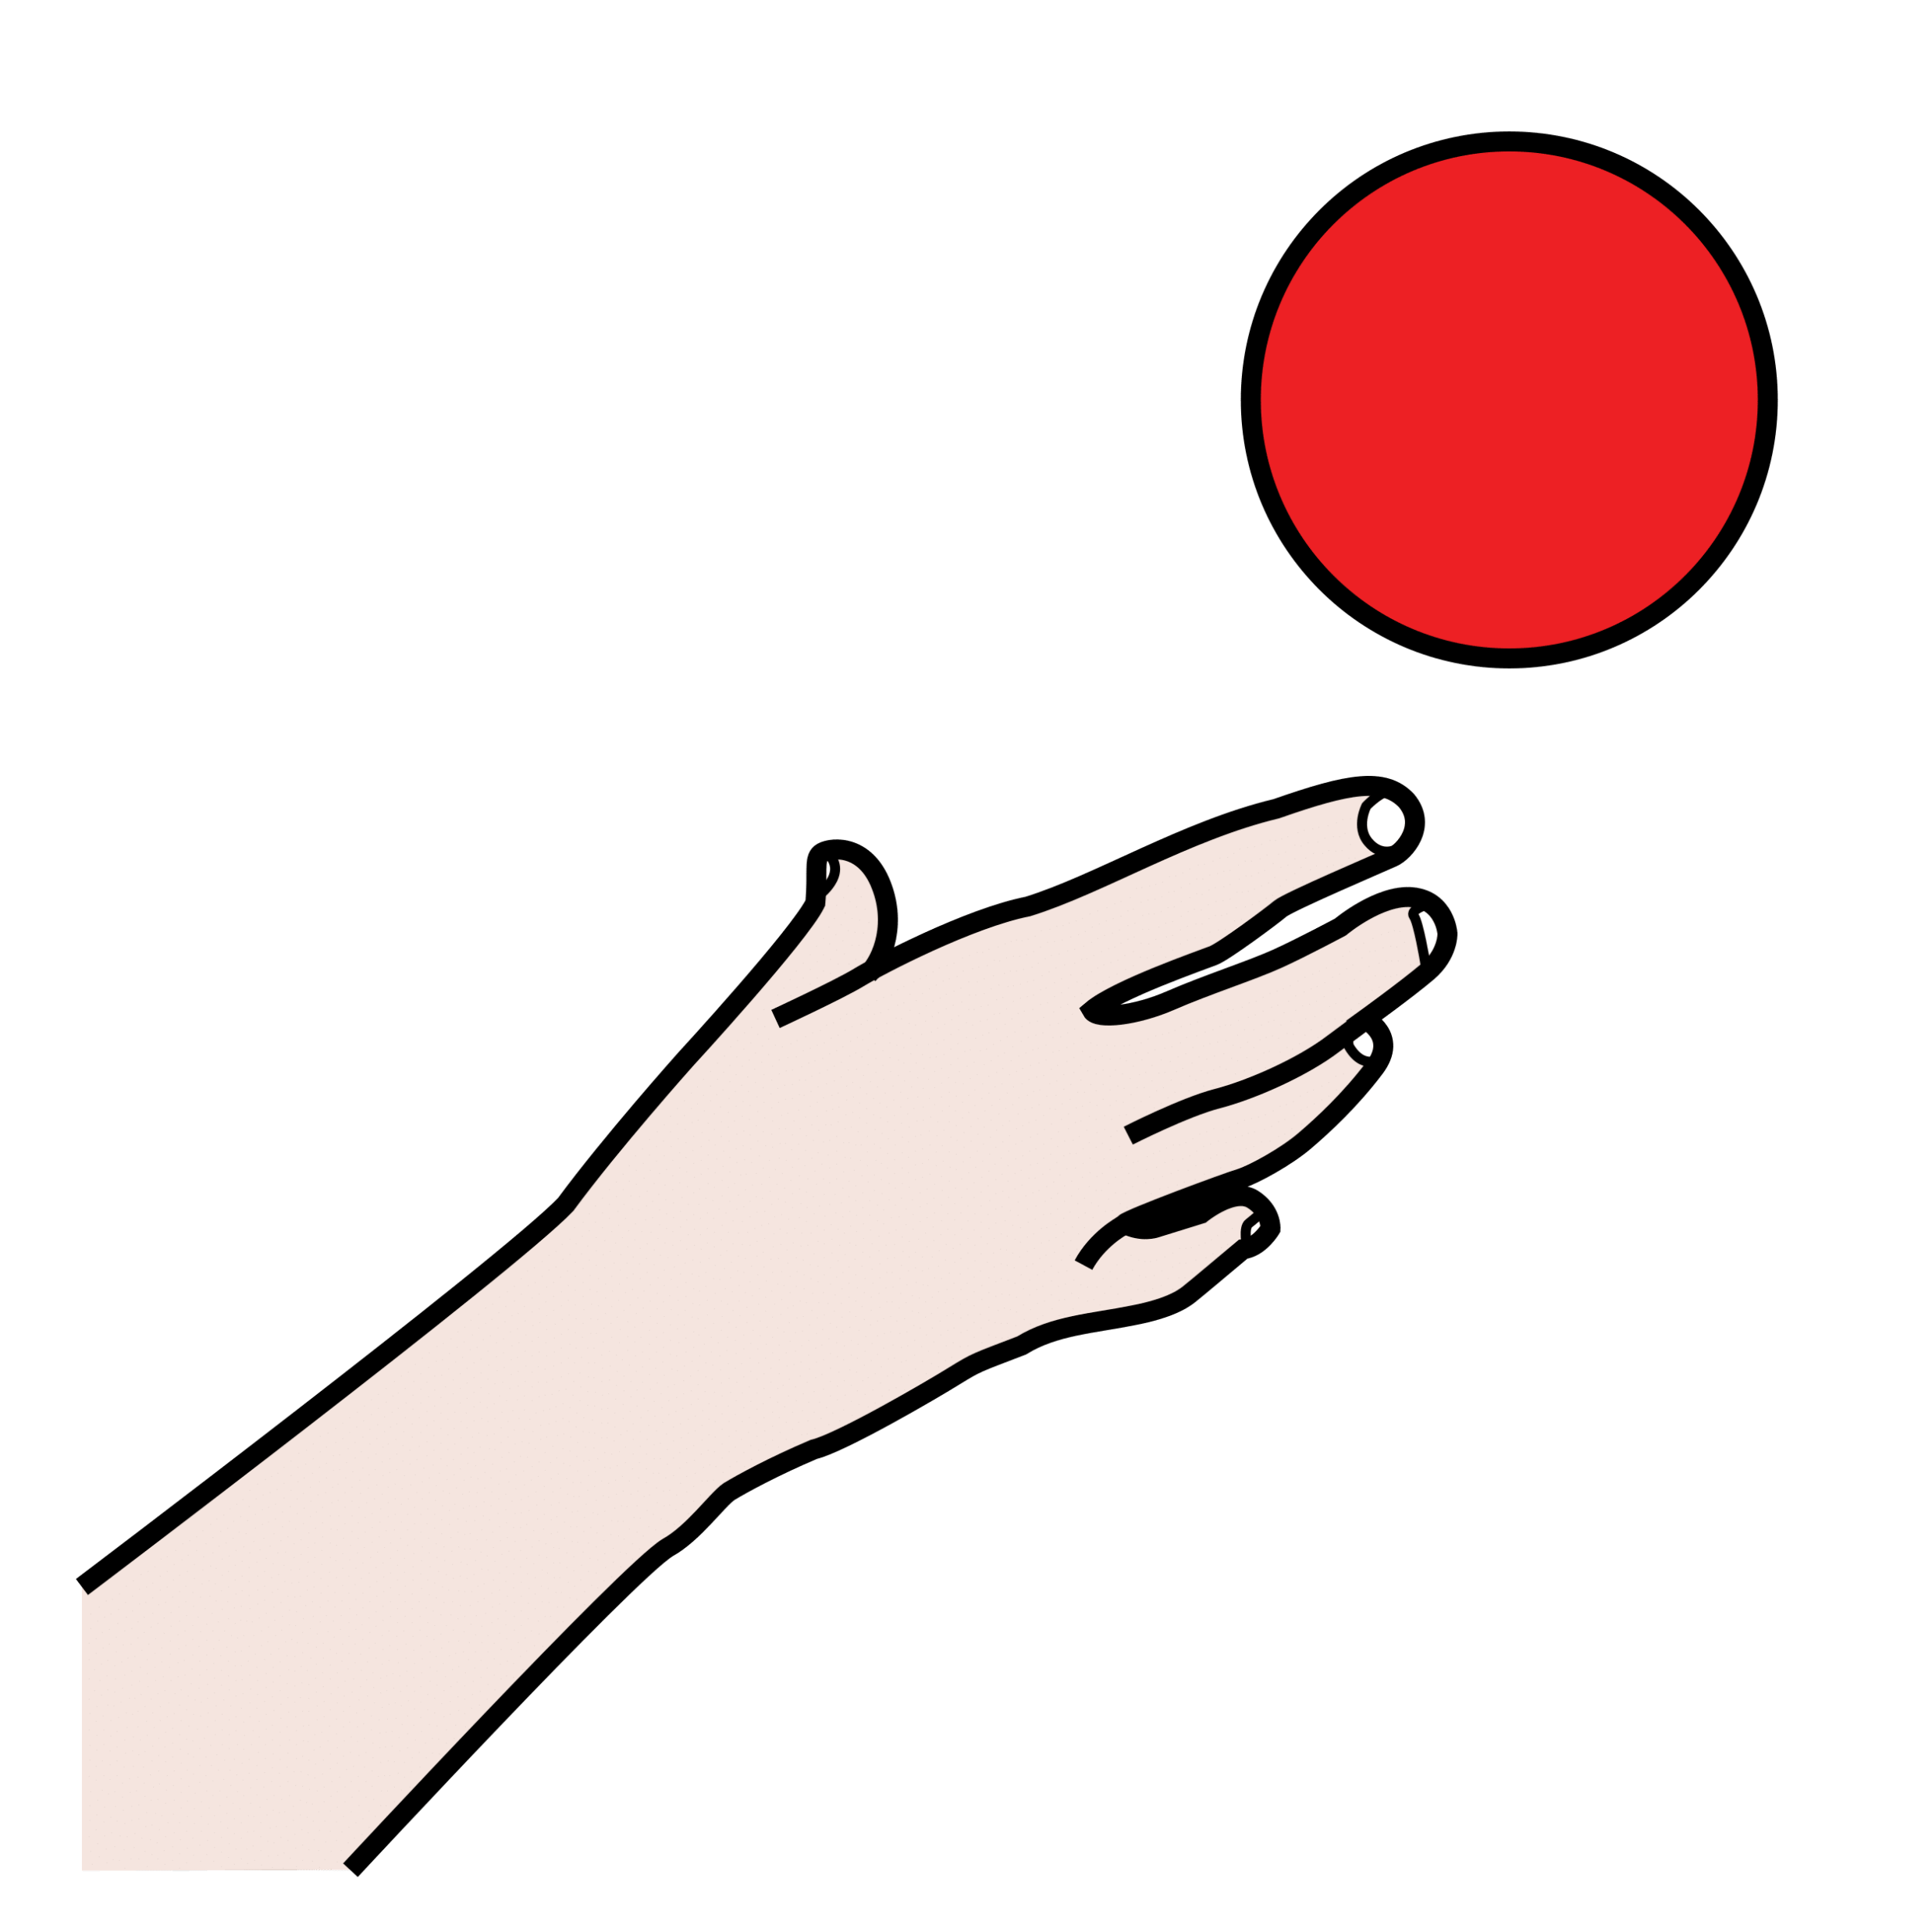


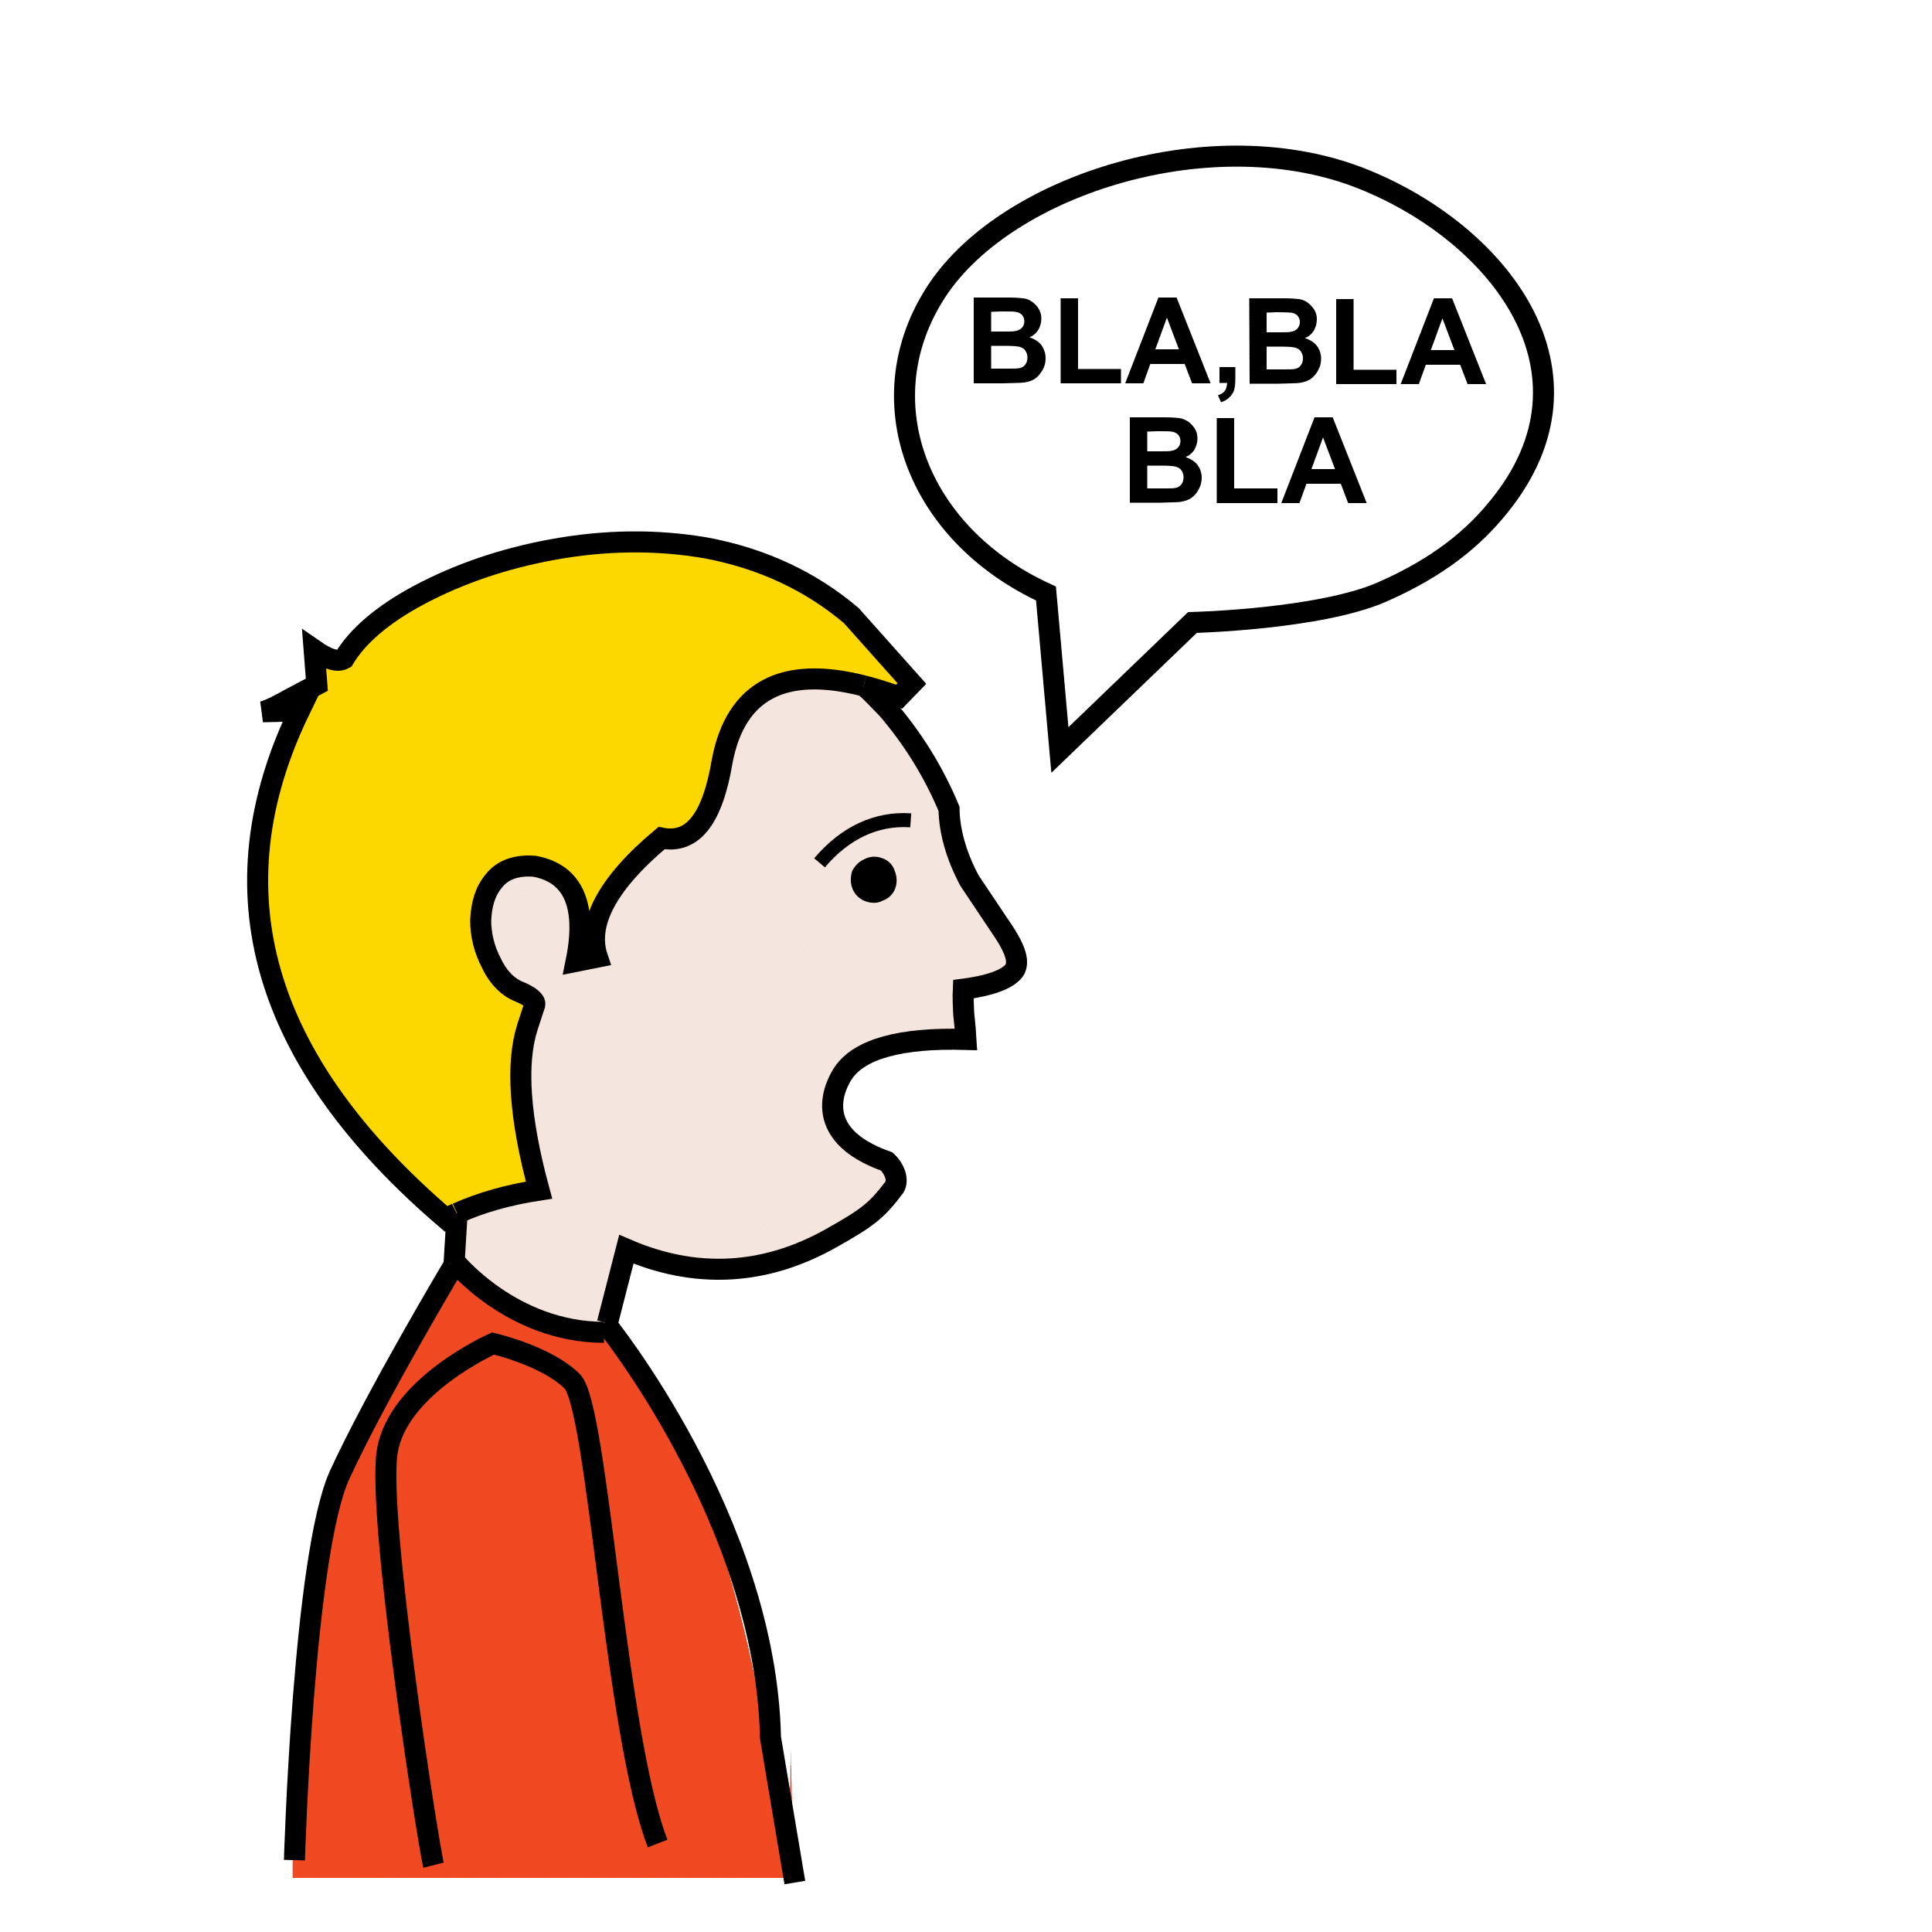





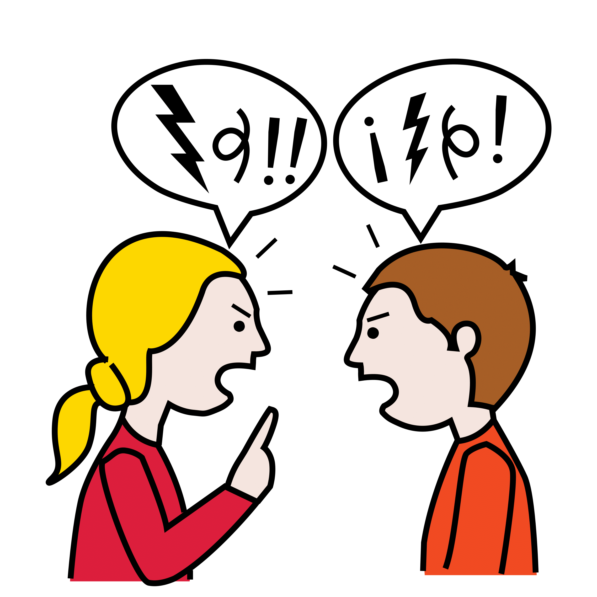

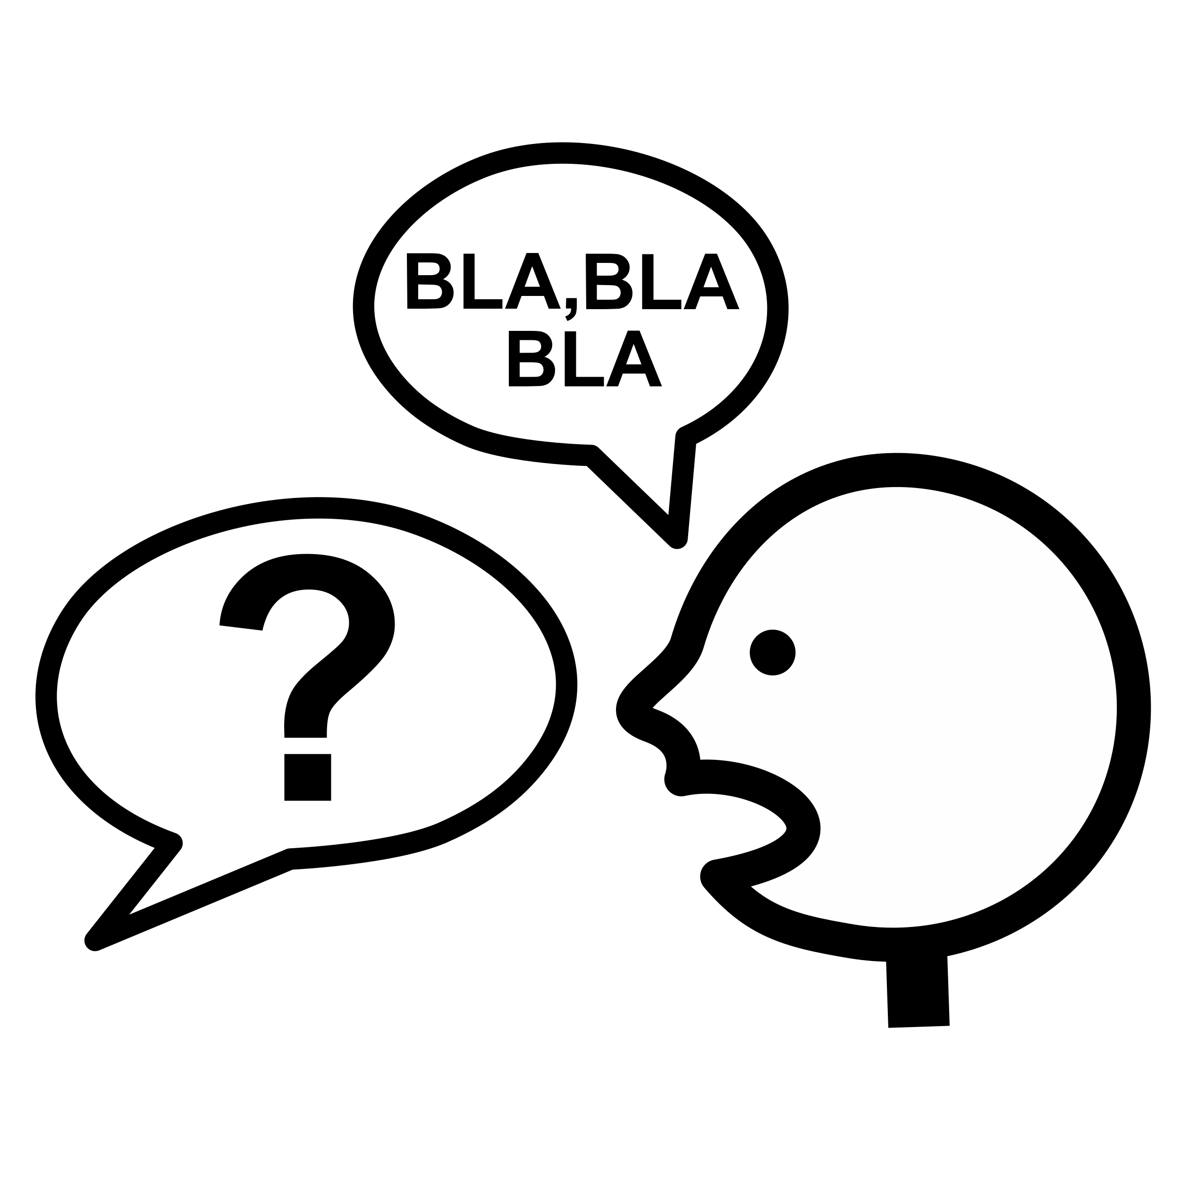
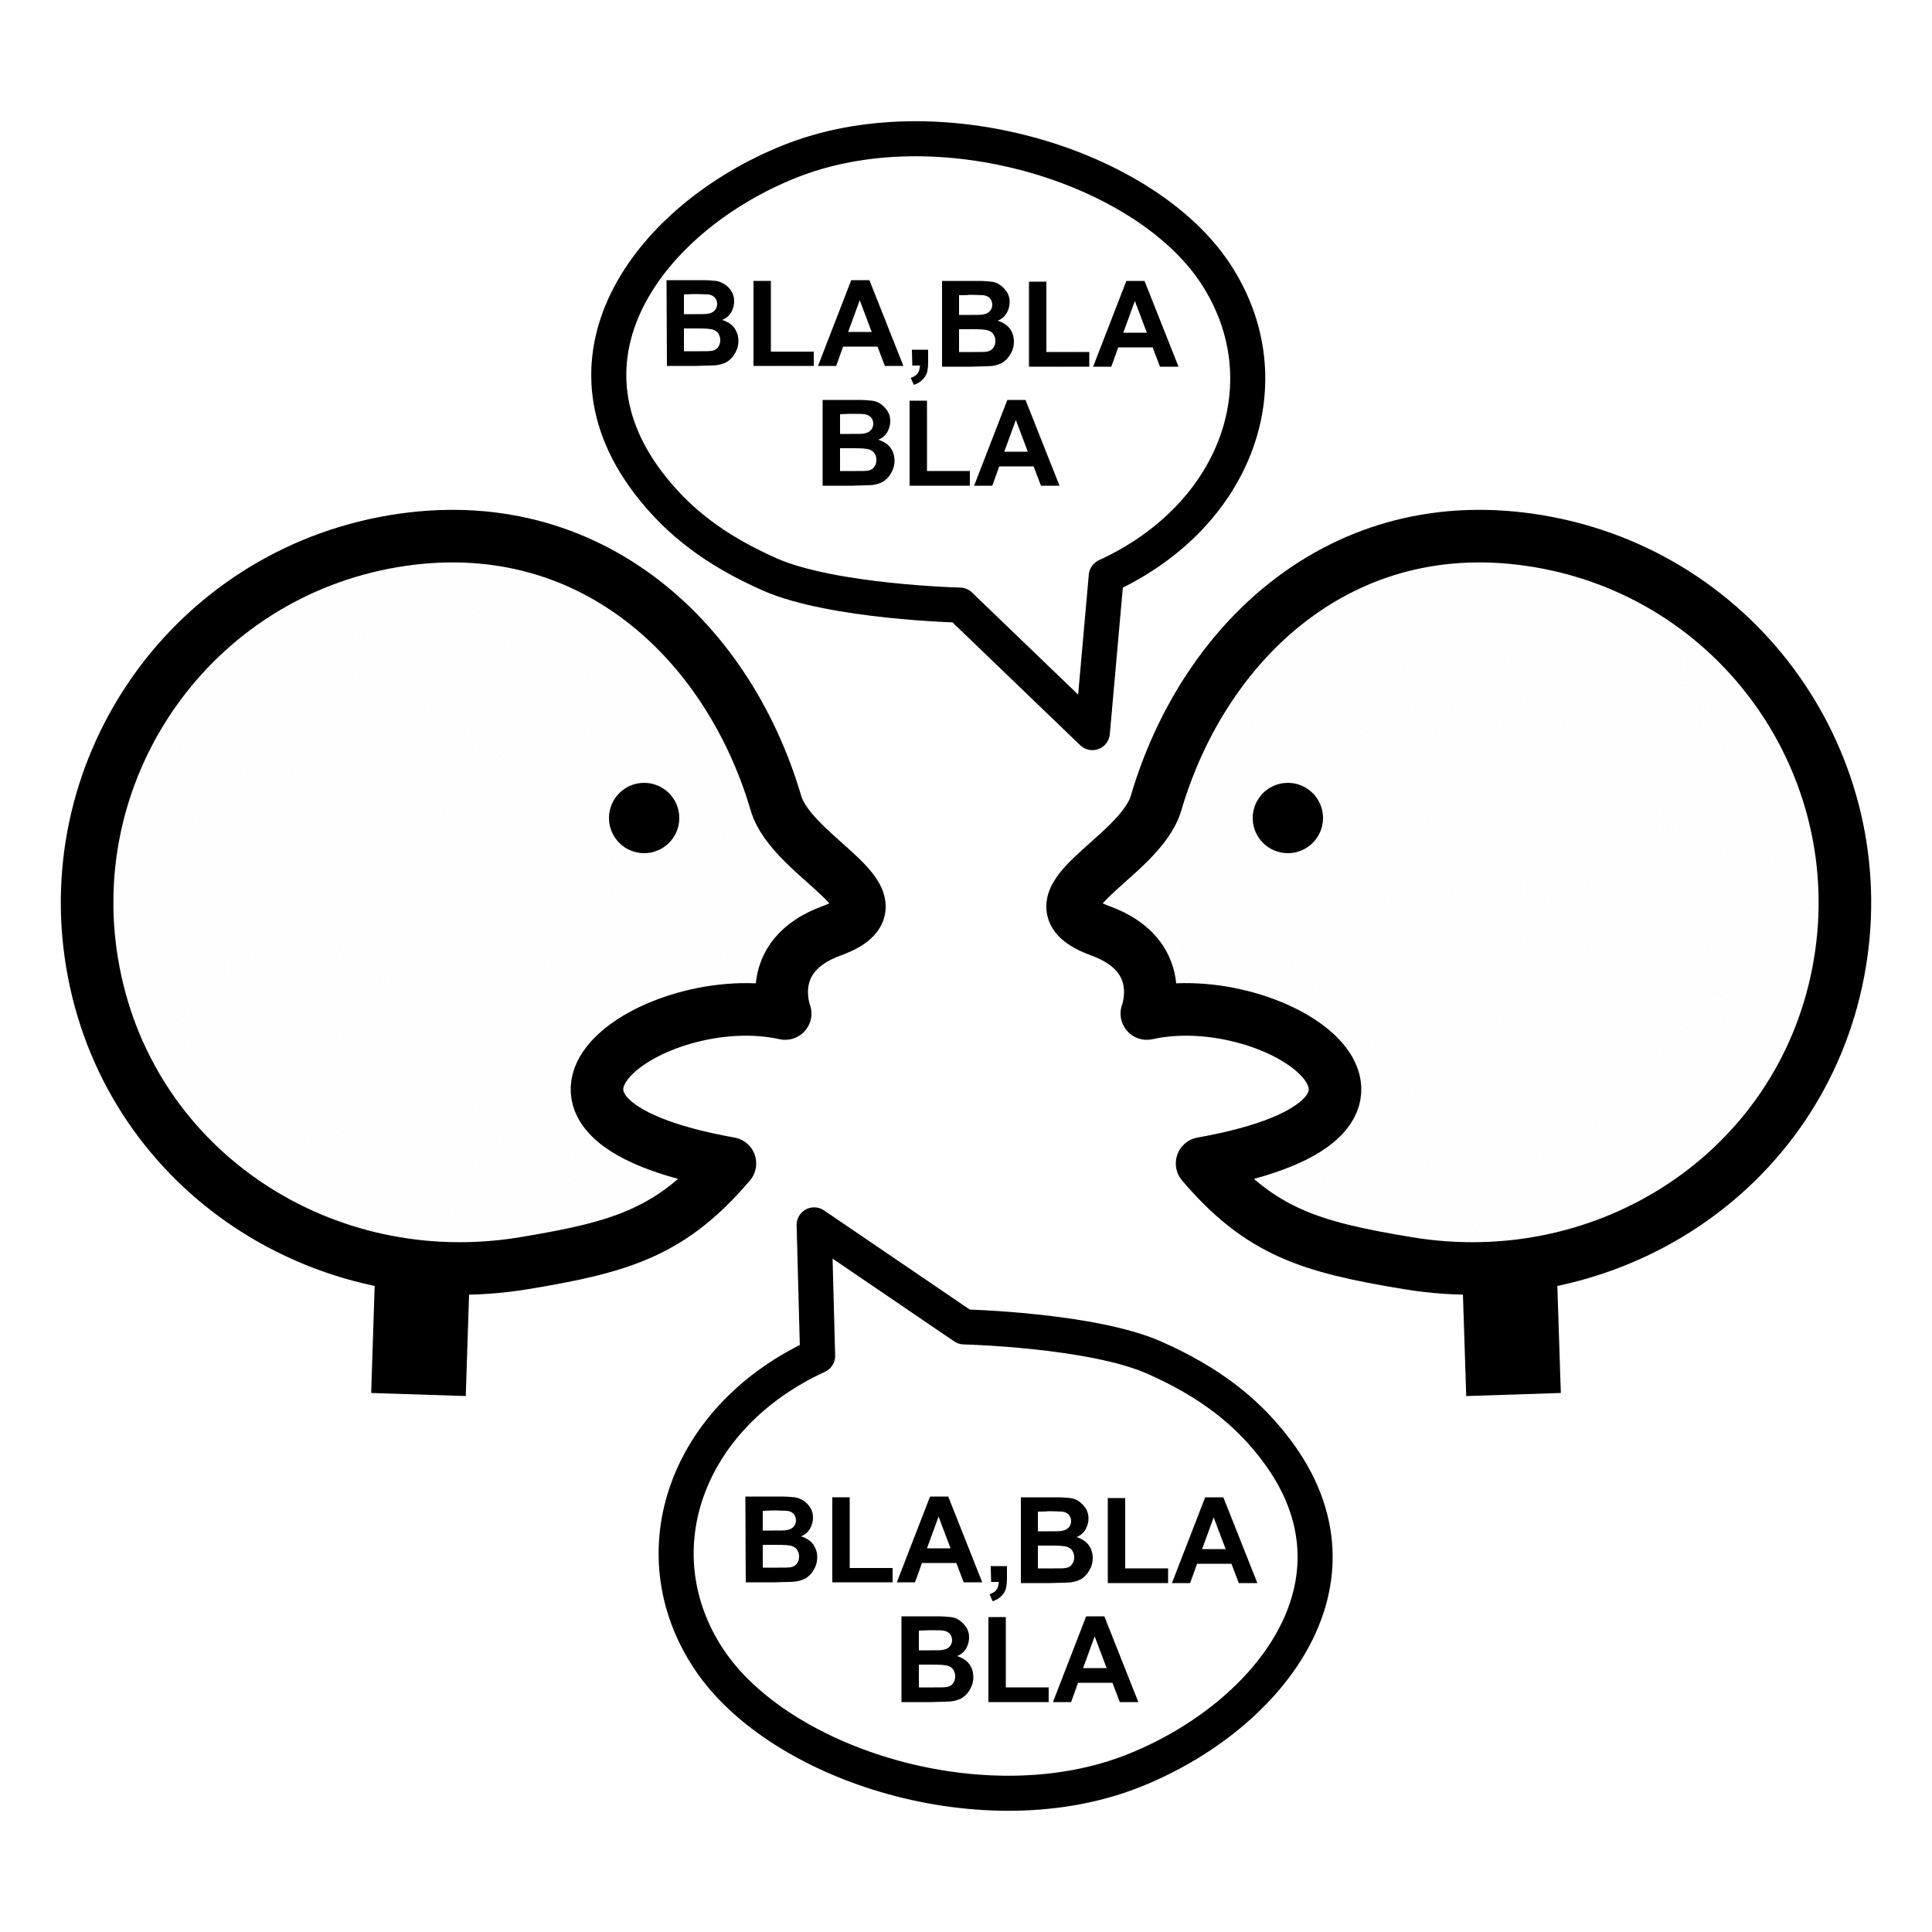
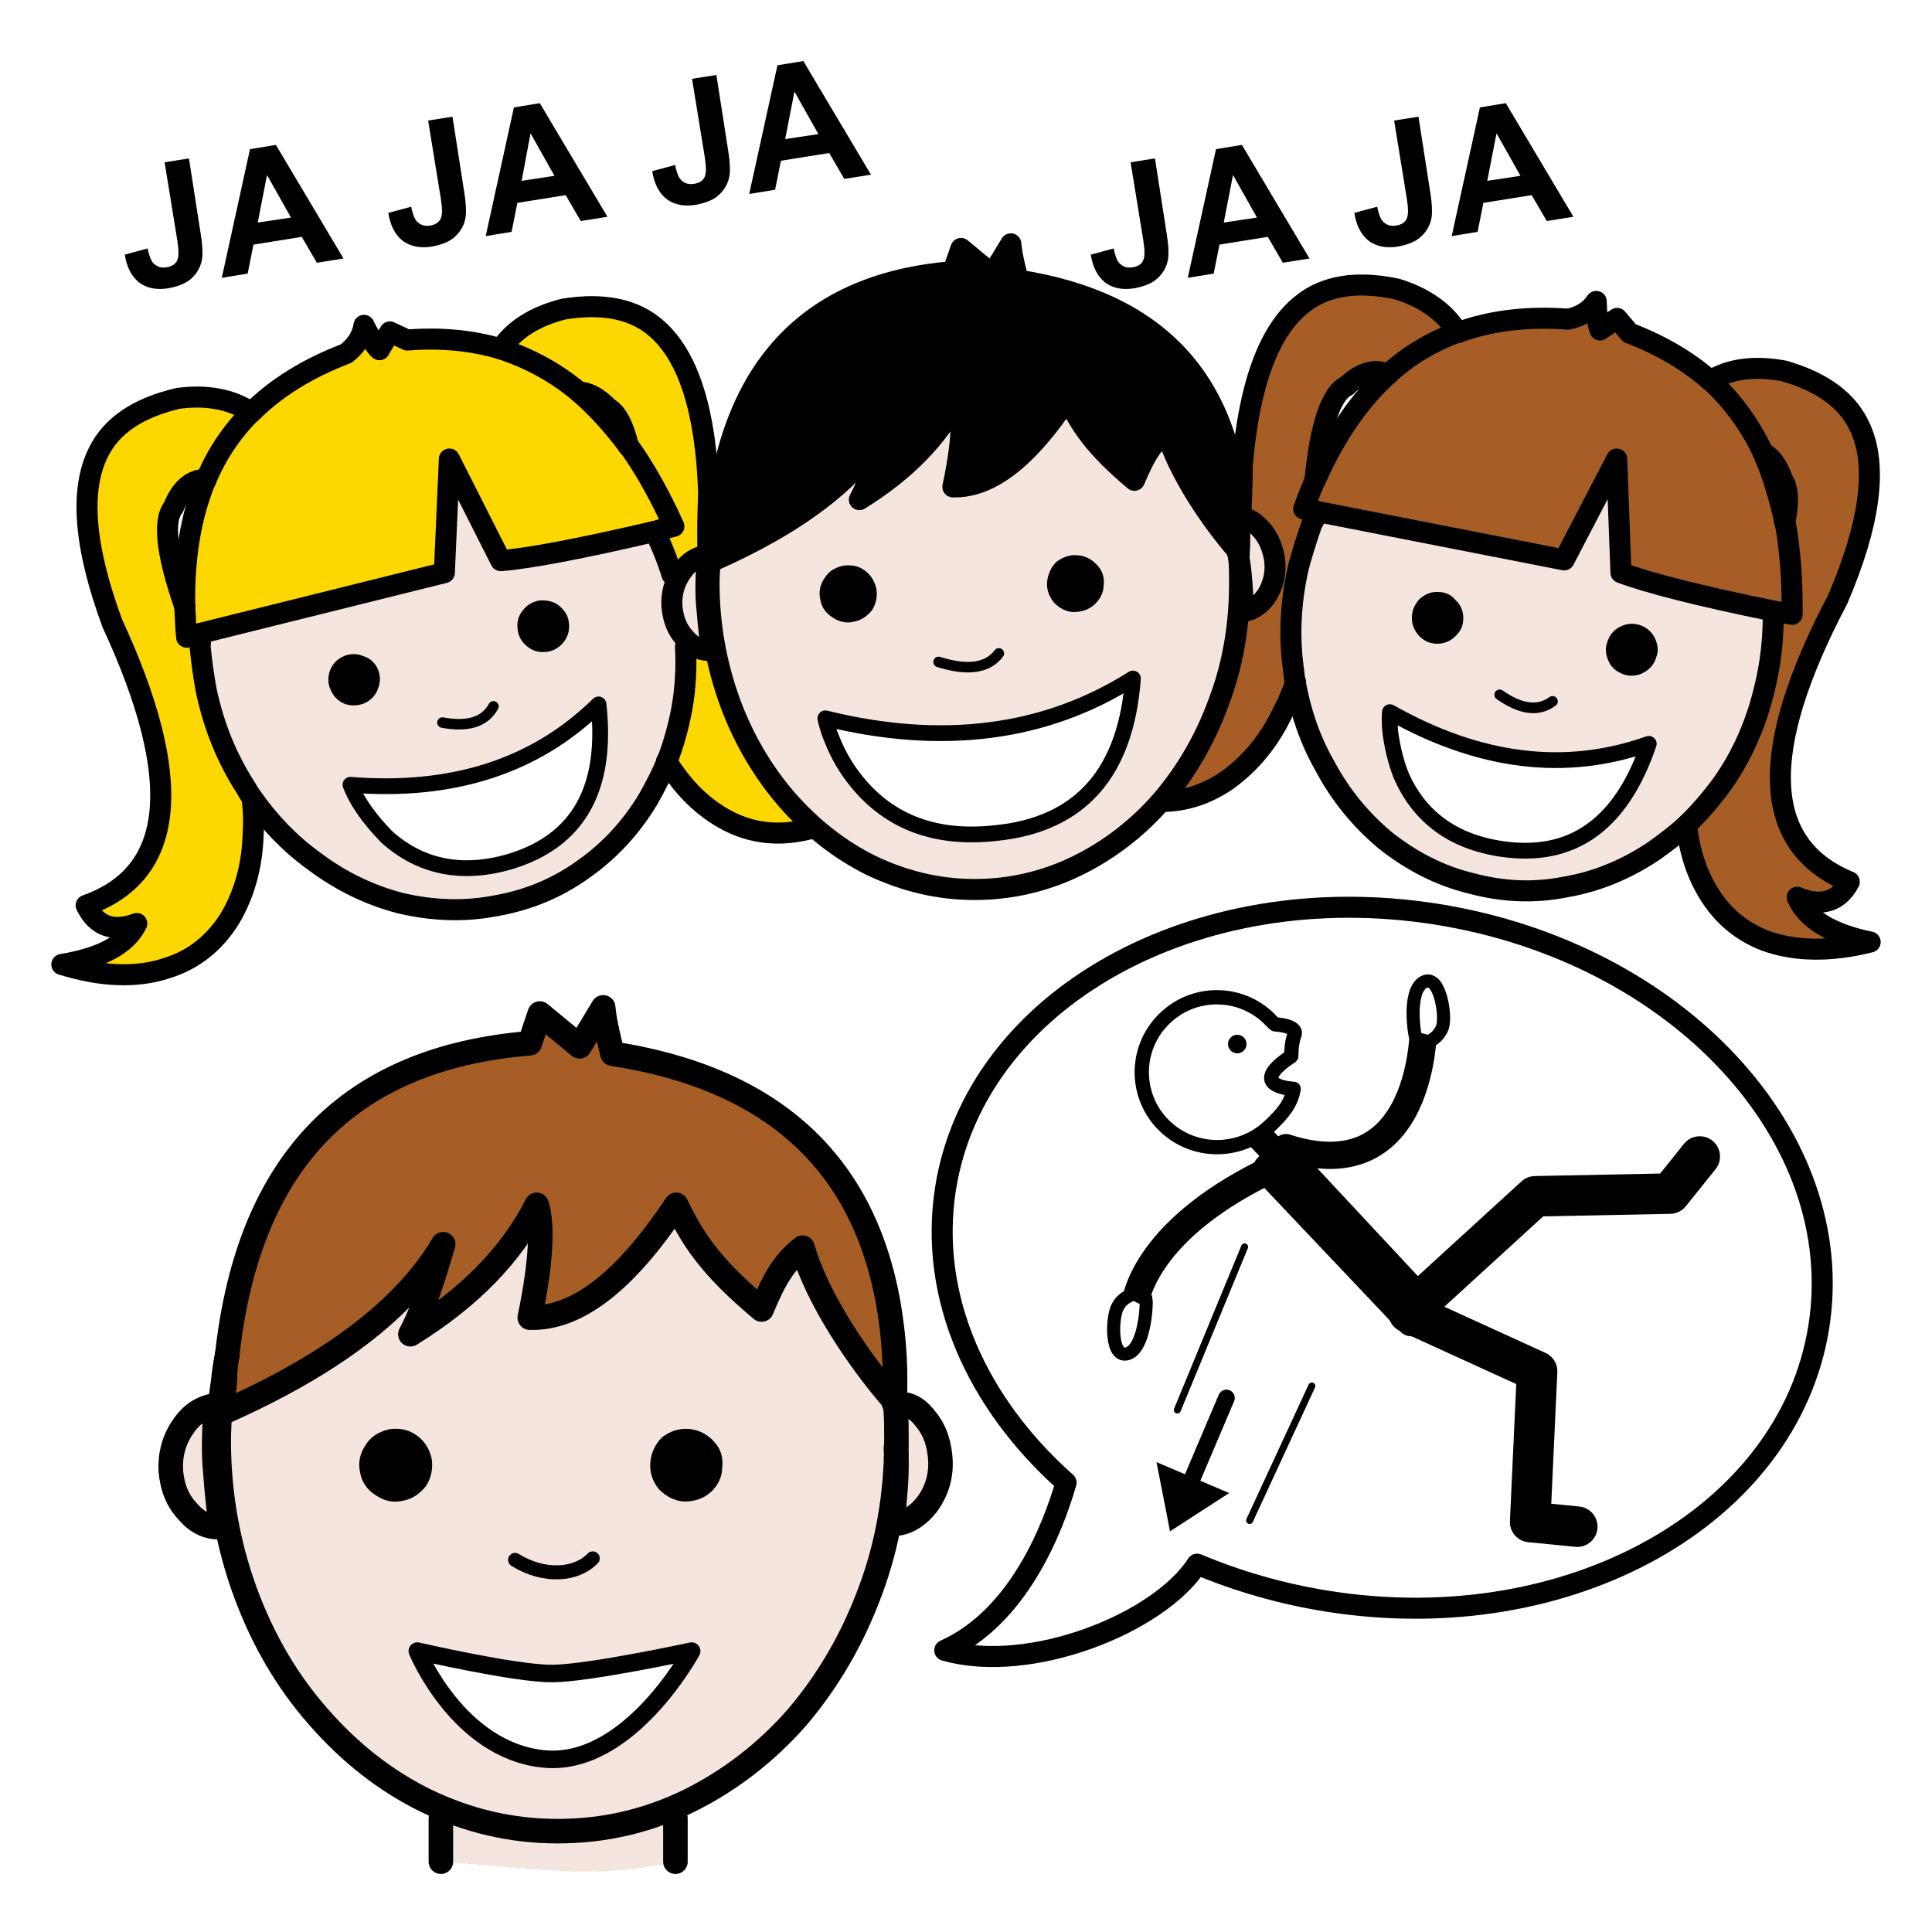

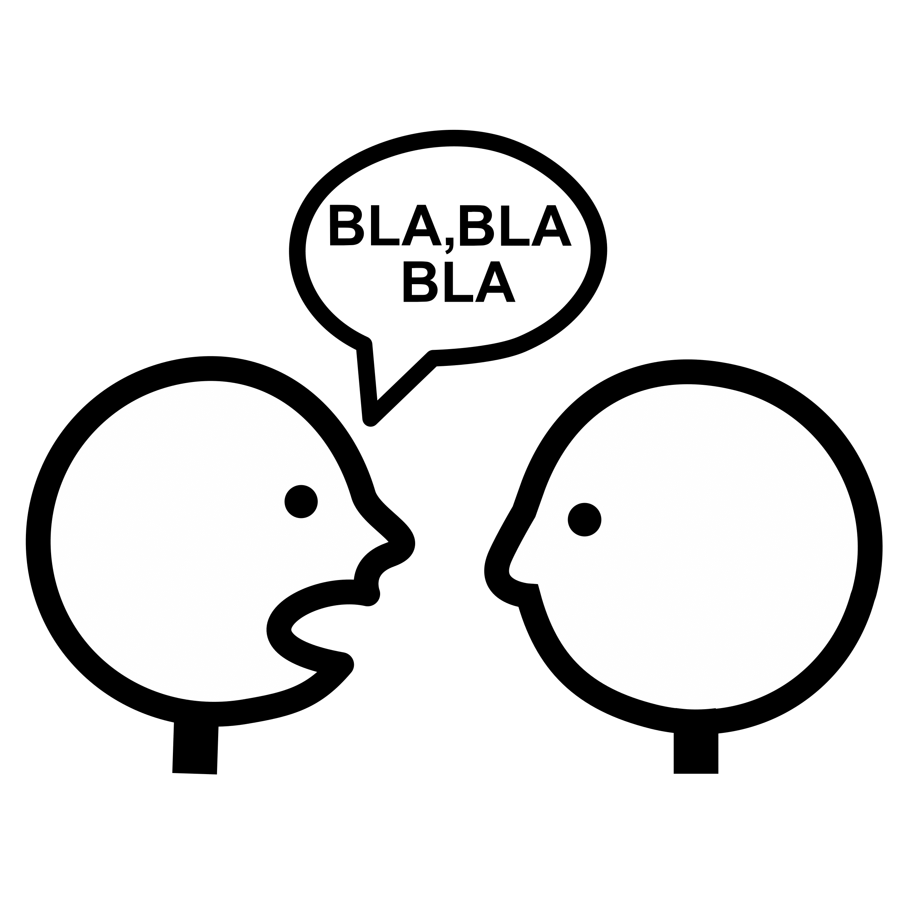
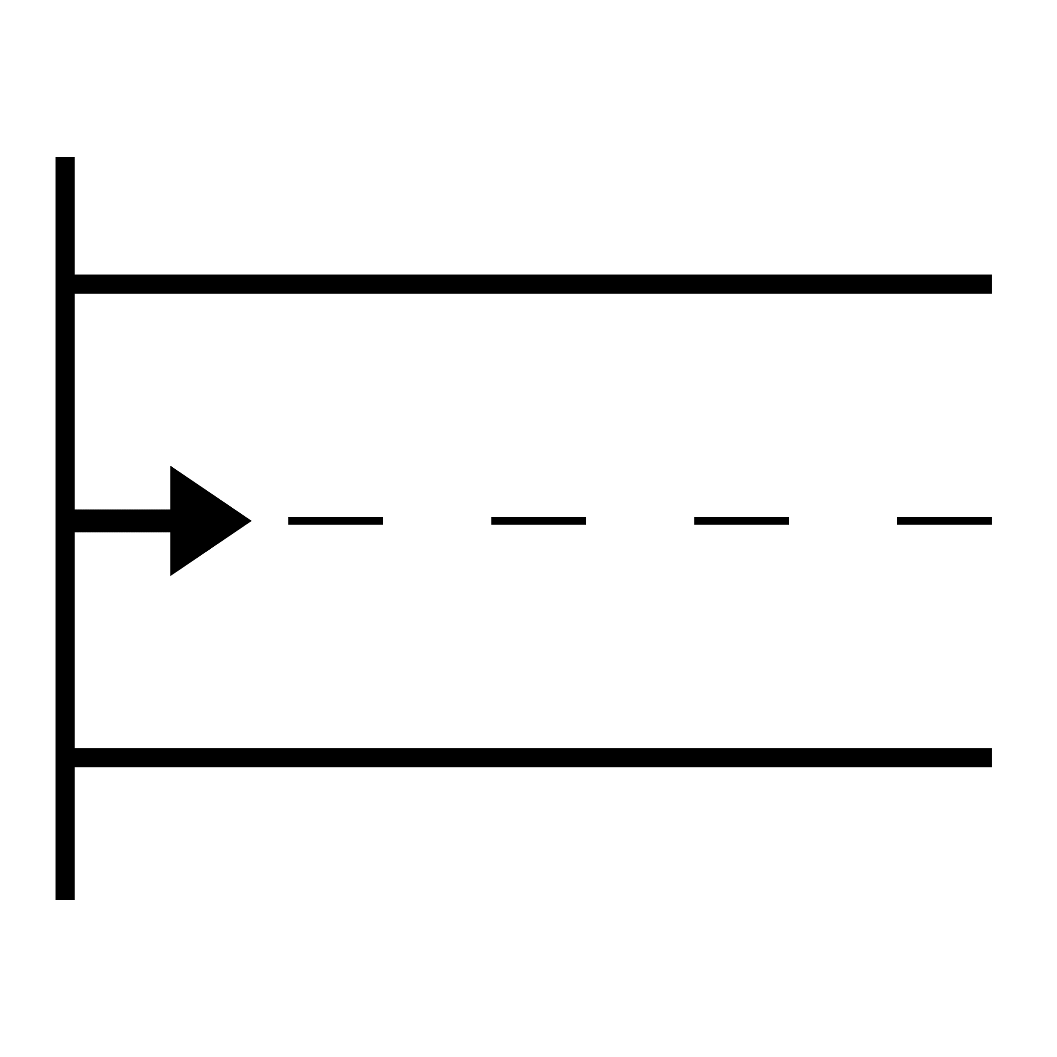
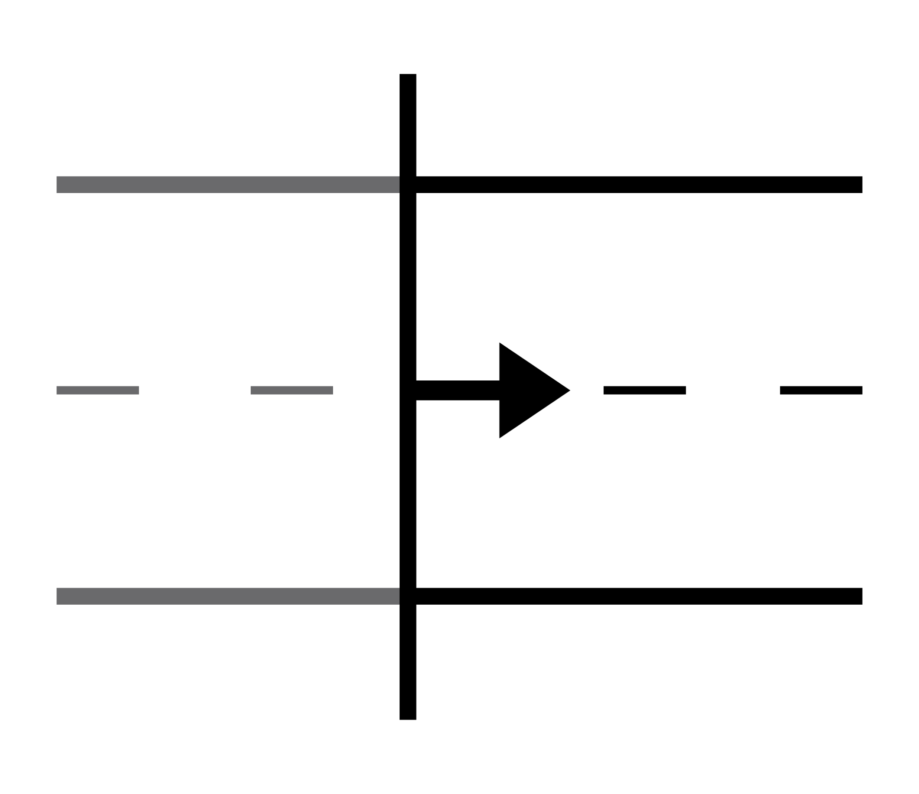
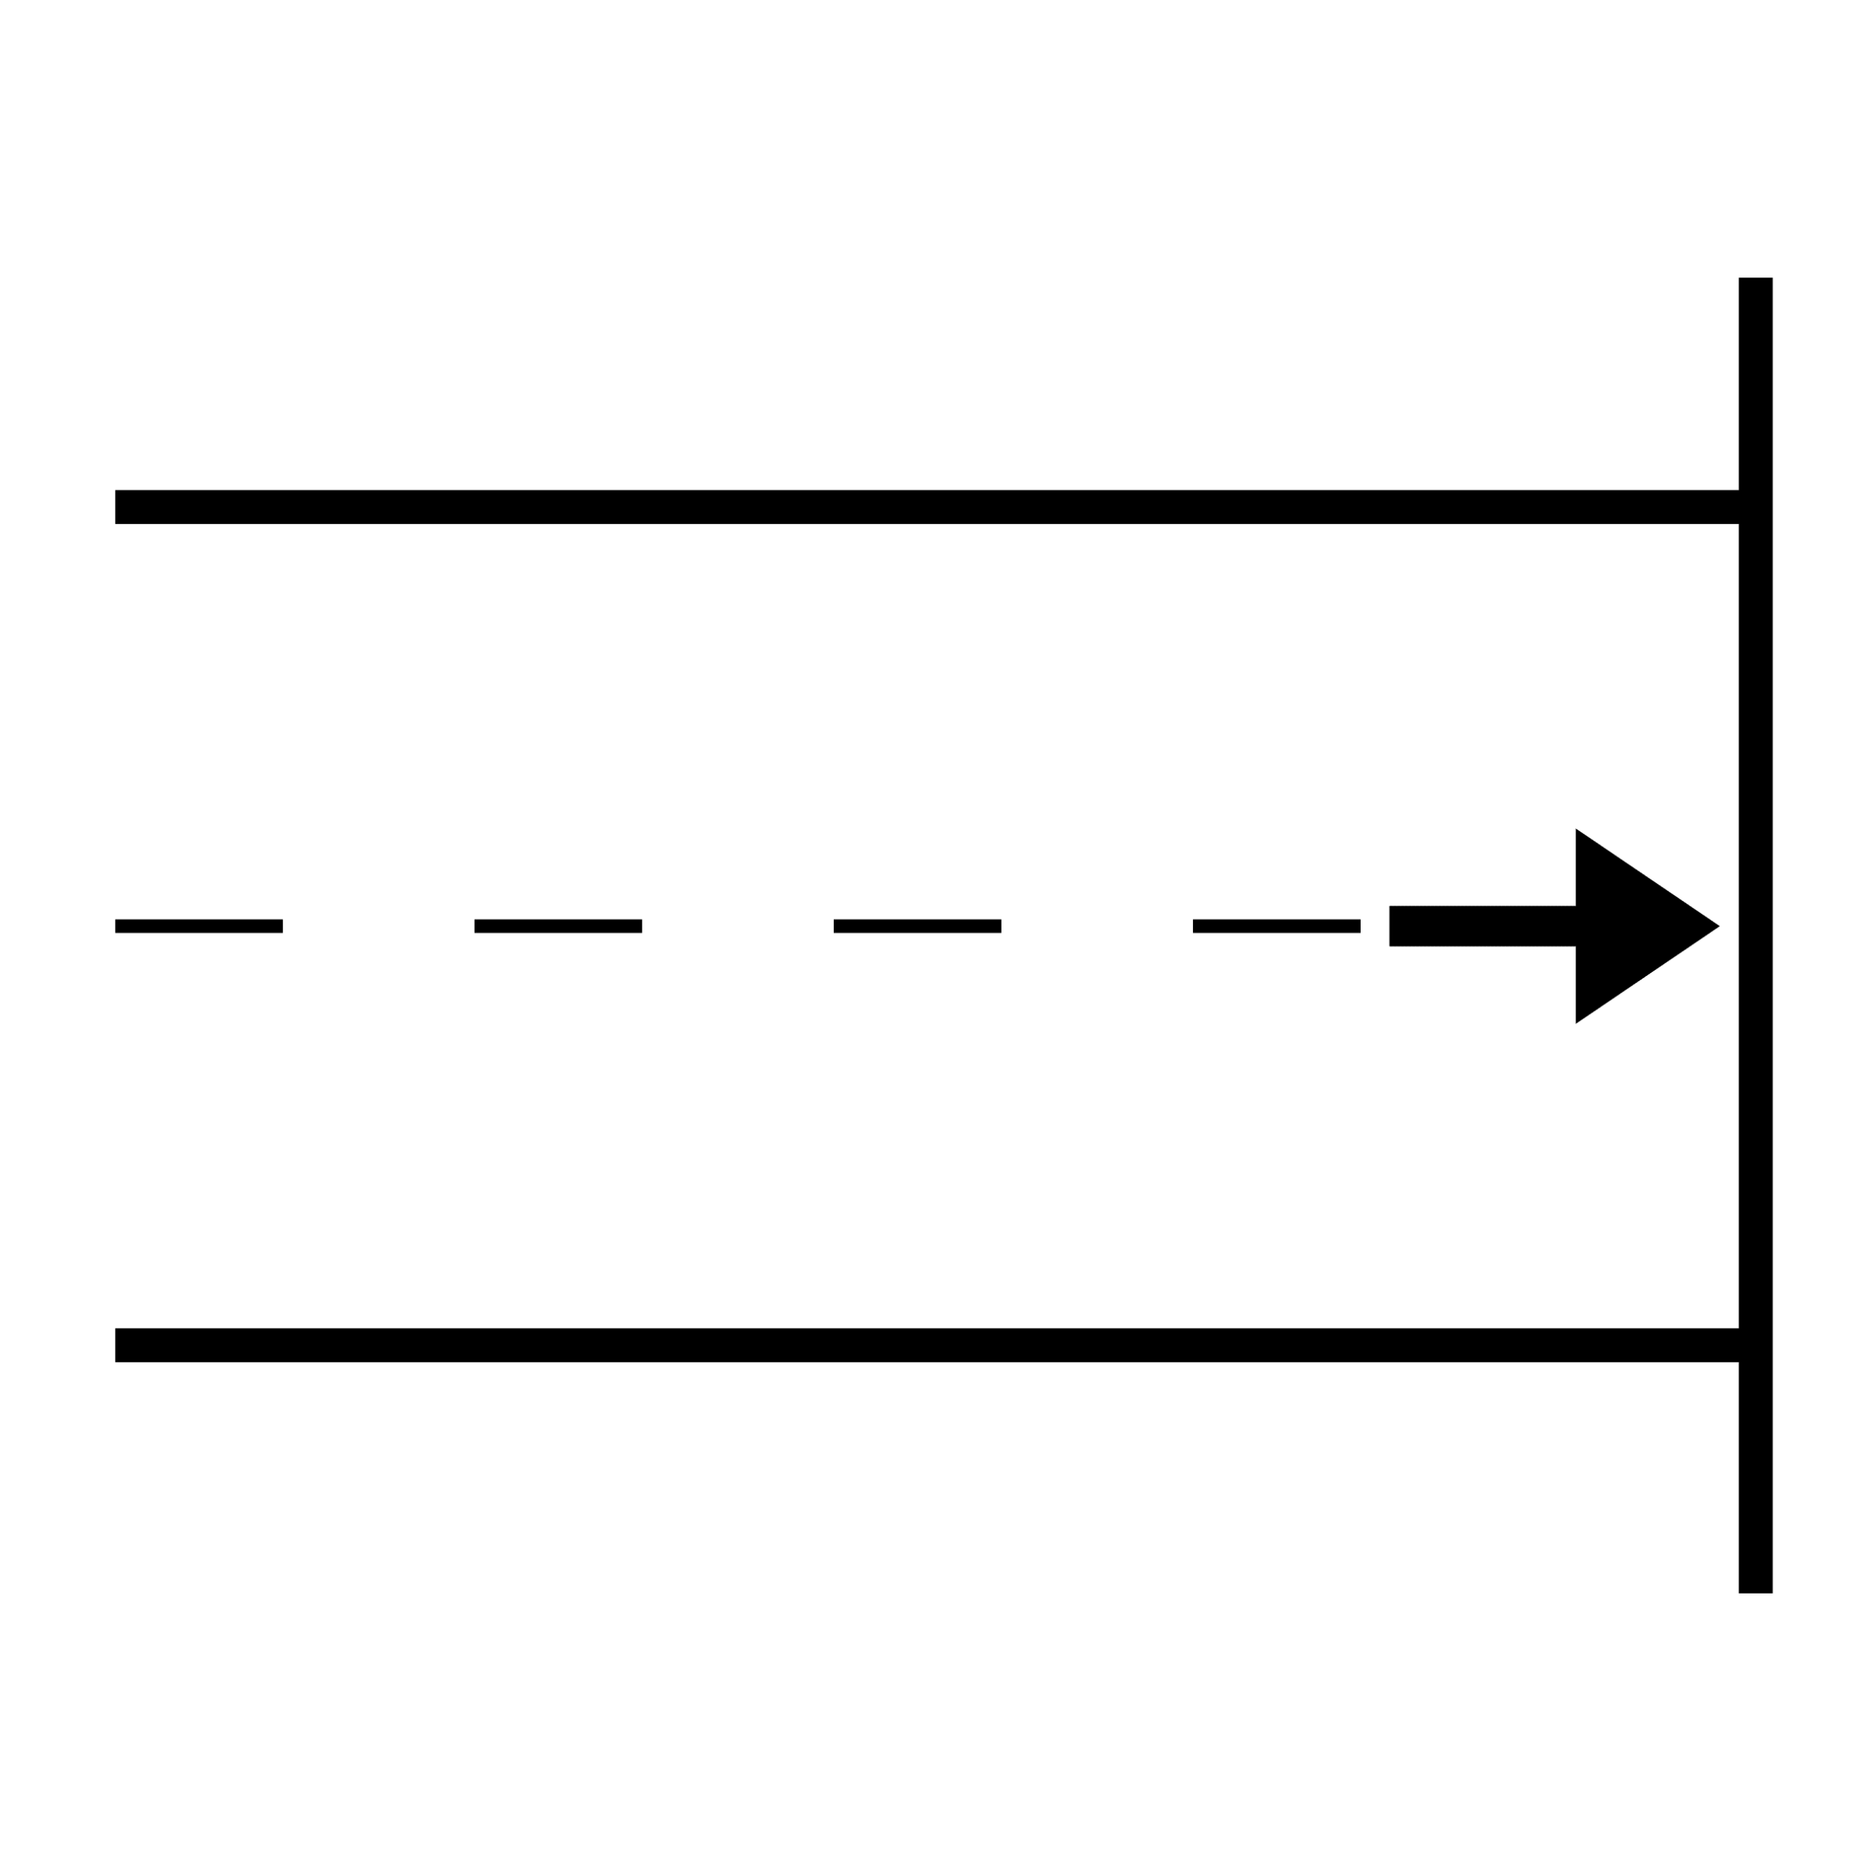
Express opinions
Express uncomfortableness
Express feelings
Express gratitude
Ask questions
greetings
Social conventions
Describe
actions
Express wants and needs
inform
help
Imagined
request
Tell something
Social functions
Person, object
Experienced
conversation
answer
Protest, reject
argue
comment
Joke, gossip, lie
Start maintain End
Express hopes and dreams
Janice Light, 1988
Pictures from bildstod.se and arasaac.org

Slide 12
For children with communication difficulties…
actions
Express wants and needs
inform
help
request
Person, object
Janice Light, 1988
Pictures from bildstod.se and arasaac.org

Slide 13
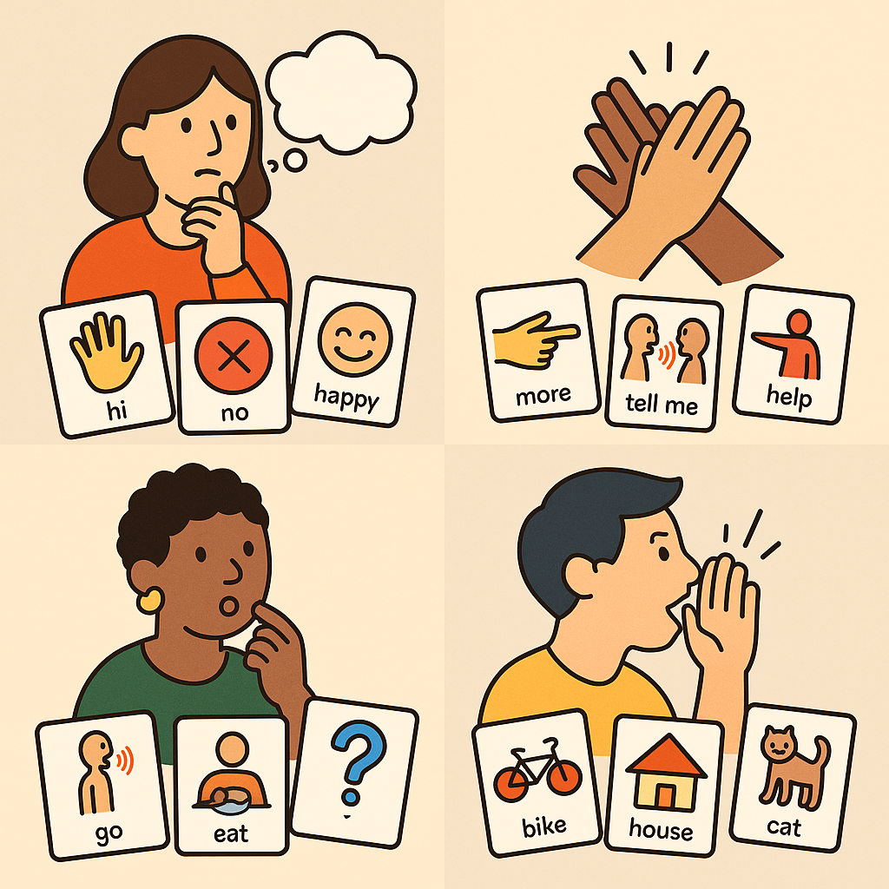
Systems: Take home message
AAC systems must include a range of words that can be used in many communicative situations/functions throughout the day
Therefore: A simple AAC system does not make it simple!
Picture by ChatGPT

Slide 14
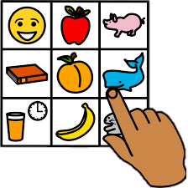
Augmented input
The communication partner reinforces their own speech using AAC
May include pictures, speech-generating devices, and manual signs
To demonstrate that AAC can be used for communication
(Biggs et al., 2018; Romski & Sevcik, 1996)
To increase vocabulary
(Allen et al., 2017; Biggs et al., 2018)
To reduce the gap between receptive and expressive communication modes
(Smith & Grove, 2003)
Picture: bildstod.se

Slide 15

Input
Output
Speech
Speech
Symmetry
Picture: bildstod.se

Slide 16

Input
Output
Speech
AAC
Asymmetry
Picture: bildstod.se

Slide 17

Input
Output
AAC + Speech
AAC
Symmetry
Picture: bildstod.se

Slide 18

Responsive strategies
The adult adapts to the child’s communicative level – without eliciting a response from the child
(Broberg et al., 2012; Harwood, Kerri et al., 2002; Landry et al., 2006; Mahoney et al., 2006; Shalev & Hetzroni, 2020)
”To be like an owl” (AKKtiv.se, 2025)
  Observe & Listen
  Wait & Expect
  Interpret & Respond
Picture: bildstod.se

Slide 19

Environmental Milieu Teaching (EMT)
The adult embeds language strategies within everyday interactions
(Kaiser et al., 1993; Kaiser & Wright, 2013)
Responsive strategies
Mand-model – prompts or asks a question, then models the target if needed
Be cunning as a fox “foxing” (AKKtiv.se, 2025)
  Arrange a situation that you think the child will react to.
  Wait & Expect
  Interpret & Respond
Picture: bildstod.se

Slide 20
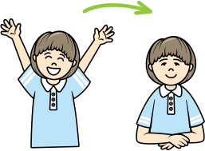
Provide access to communication
All the time—not just when the child is expected to respond
About everything—not just what we consider appropriate
Compare with speaking children:
  They sometimes stay on topic and say what is expected, but also:
  Take turns from others/respond to questions directed to someone else
  Interrupt
  Talk about things not on the agenda
  Talk constantly/Go on and on about the same thing
  Swear or use slang
Picture from www.dimobi.org.ua

Slide 21
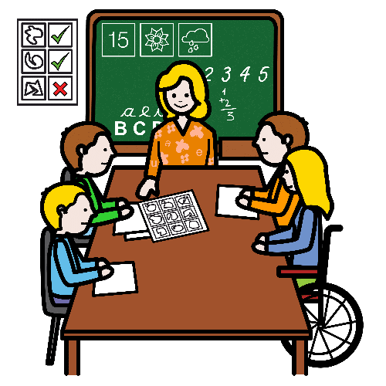

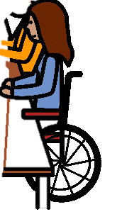
Strategies: Take home message
Communication partners can make a huge difference!
Be a model
  For multimodal communication modes
  For multiple communication purposes throughout the day
    NOT ONLY preplanned topics or lectures
    During transitions, breaks and informal interactions too!
  It’s ok to struggle – be a model for that too!
Expect communication
Picture from arasaac.org

Slide 22
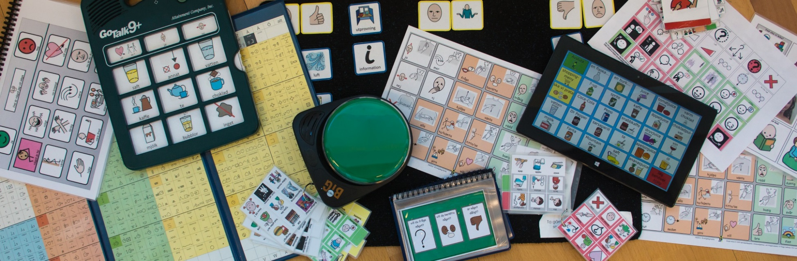
Tools and access methods
Usually, what people think AAC is
Examples:

Slide 23

Tools
Research consistently show that access to an AAC tool alone is not sufficient to support meaningful communication
  Access to a language system and large vocabulary throughout the day
  Models that uses AAC to communicate
  (not only to inform!)
  TIME – don’t give up!
Picture from arasaac.org

Slide 24
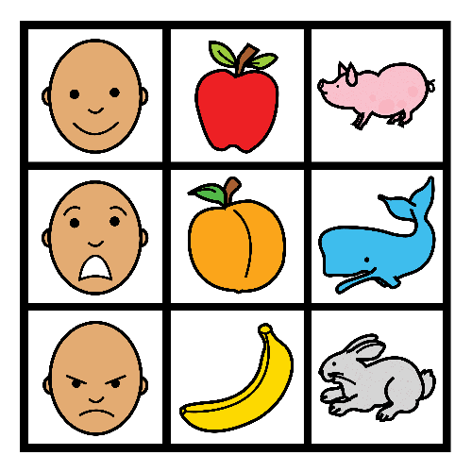
Communication boards
Core boards/General boards (words that can be used in many situations)
Activity-specific boards (words tailored to specific activities)
Recommendation: Combination
Strategies:
Always carry a core board with you
Place activity-specific boards within reach for the intended activity
Use the boards yourself!
Picture from arasaac.org

Slide 25
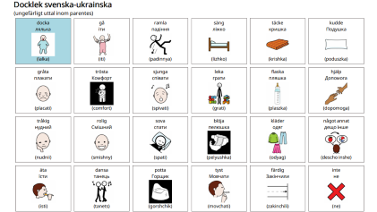
bildstod.se
Download ready-made boards to edit/print
  Search for “Ukrainska” – the Swedish word for Ukrainian
Create your own communication board for print
Its a Swedish free-of-charge online tool (the page can be automatically translated through google translate)
Pictures are searchable in English (and Swedish)
Ukrainian letters can be used in picture labels

Slide 26
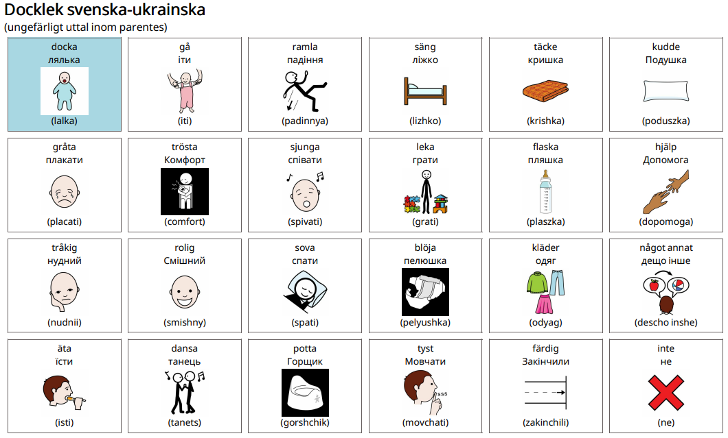

Slide 27
Other resources – communication boards
https://ittybittyspeech.com/core-word-vocabulary-communication-board-translation-library/
https://www.tobiidynavox.com/pages/ukraine-refugee-communication-resources#s-d96ef7ac-8c33-41ff-9aaf-8549830bdf0e
https://www.widgit.com/products/health/refugee-support/index.htm#Ukrainian
https://thinksmartbox.com/news/ukrainian-communication-boards/
https://arasaac.org/

Slide 28
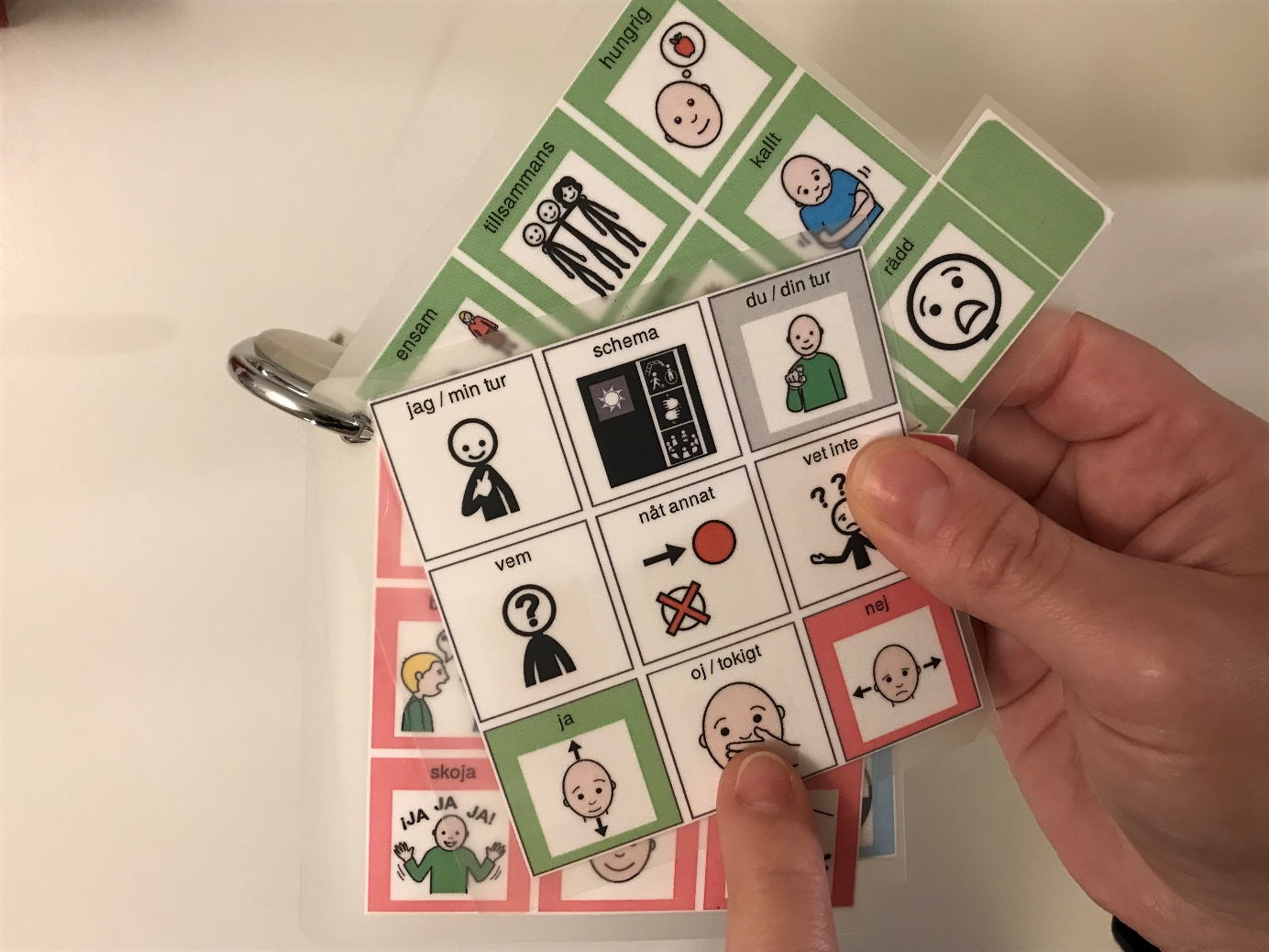
Bunches
A small set of communication boards
Retractable keychain
School staff carry these – for augmented input
Also available at bildstod.se

Slide 29

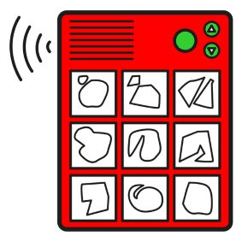
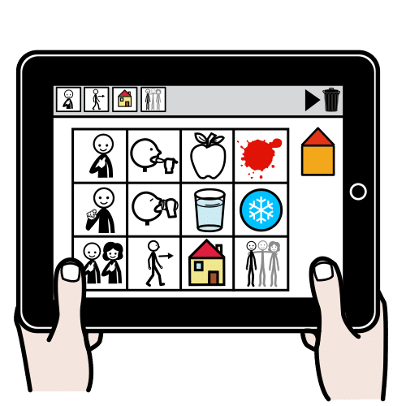
Speech-output technologies
Also called speech-generating-devices or high-tech AAC
Everything from simple speech-switches to computers and tablets
Apps with comprehensive communication vocabularies are expensive and often lack multilingual support
  Grid 3/Grid for iPad https://thinksmartbox.com/
  TD snap https://se.tobiidynavox.com/pages/td-snap
  Avaz https://avazapp.com/products/avaz-aac-app/
Pictures: bildstod.se, arasaac.org

Slide 30
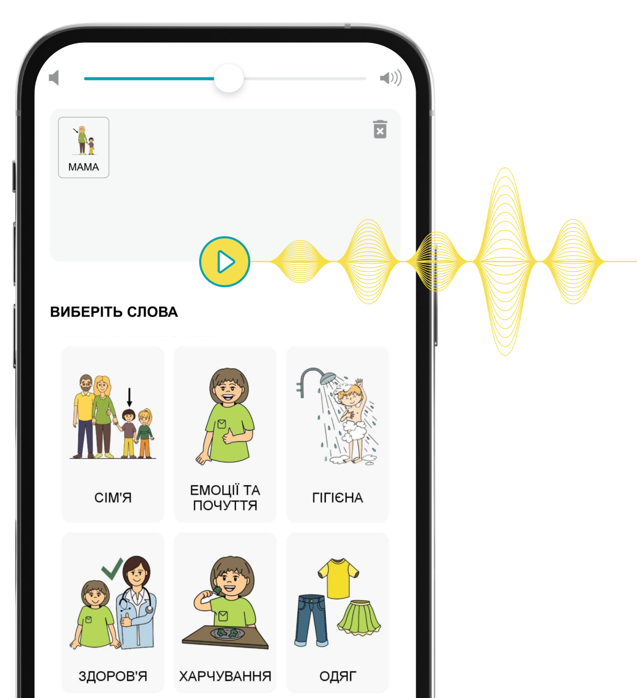
Digital inclusion app and symbols
https://www.dimobi.org.ua/
Huawei AppGallery, AppStore, Google Play
Online version
Free-to-use symbols
Speech synthesis
Illustration from www.dimobi.org.ua

Slide 31
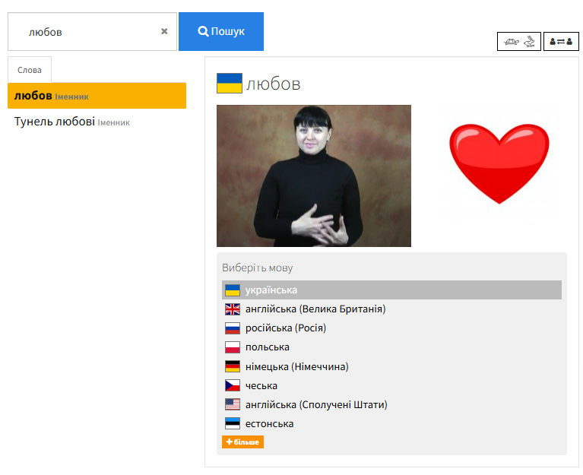
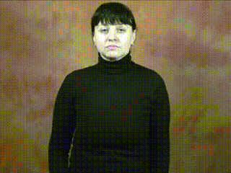
Spread the sign
https://www.spreadthesign.com/uk.ua
AppStore, Google Play
Online version
Sign language dictionary (with videos)
Multiple languages, including Ukrainian
Screenshot from https://www.spreadthesign.com

Slide 32

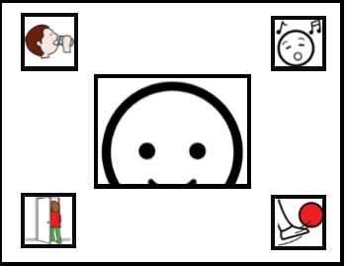
Access methods
Not everyone can point with their fingers
There are plenty of access methods
  Optimally, a professional specialized in body functions take part in the assessment (for example, occupational therapist or physiotherapist)
Pictures: bildstod.se

Slide 33
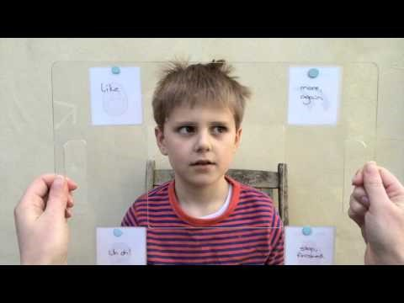
Eye pointing
https://www.youtube.com/watch?v=cuwgD8YZD3k

Slide 34
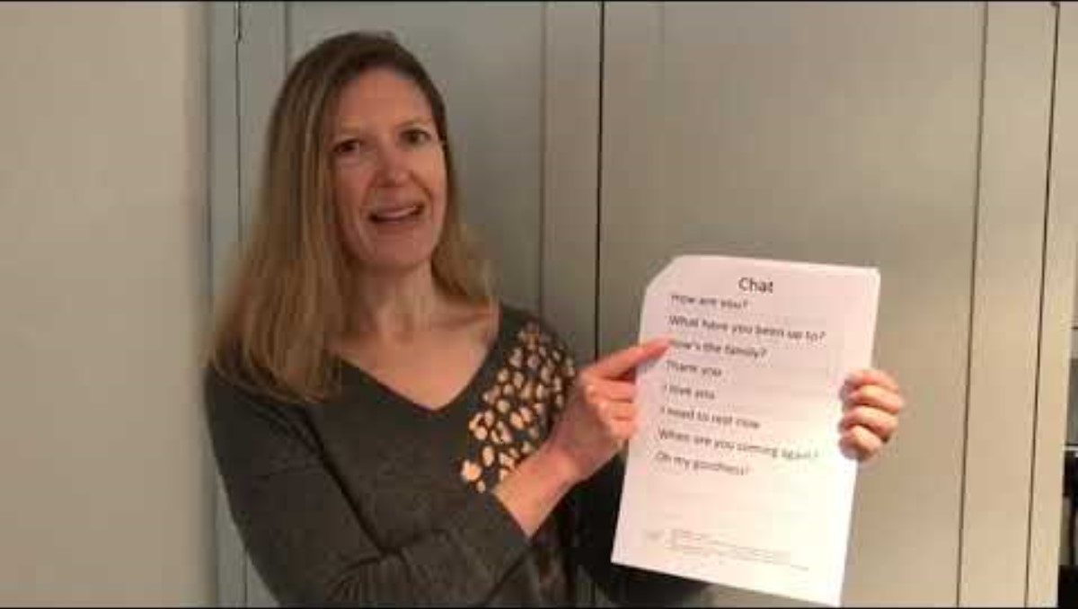
Auditory scanning
https://www.youtube.com/watch?v=3I9DOHtB8Oc

Slide 35
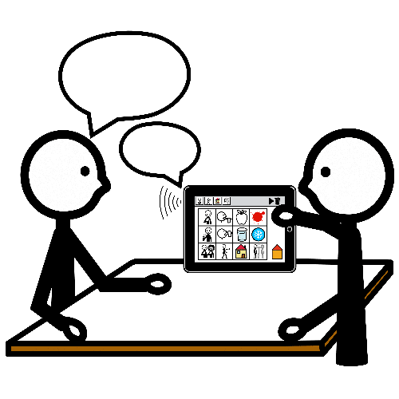
Tools: Take home message
There are no such thing as a “perfect solution” or “perfect match”
Focus on using the tools, not on designing/developing them
Pictures: bildstod.se

