Slide 1

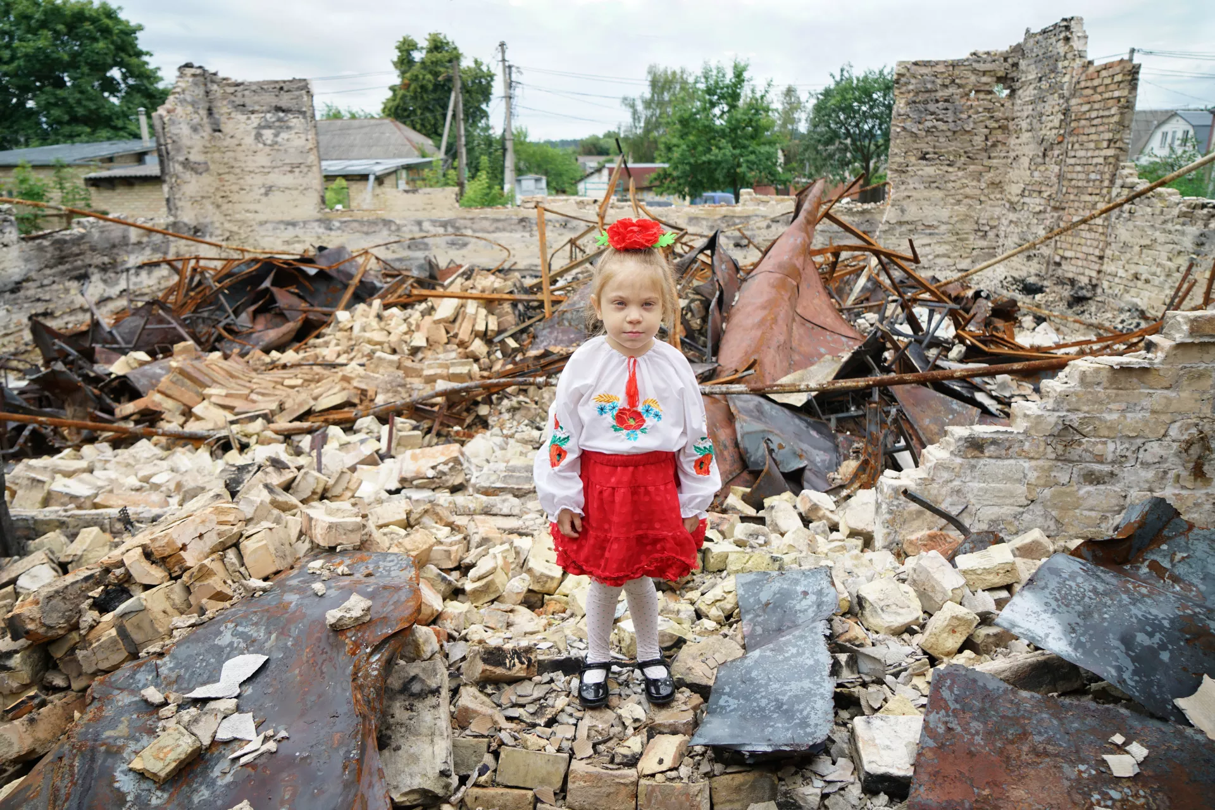
Education Under Fire:
Between Survival and Renewal
Nadiia Horishna, Associate Professor,
Ternopil Volodymyr Hnatyuk National Pedagogical University

Slide 2
Dimensions of War-Related Educational Losses
Infrastructure Damage
Interrupted Schooling
"In every conflict, children's education is among the first casualties and among the last services restored."
(UN Report on Children and Armed Conflict, 1996)
Human Capital
Loss
Institutional
Loss

Slide 3
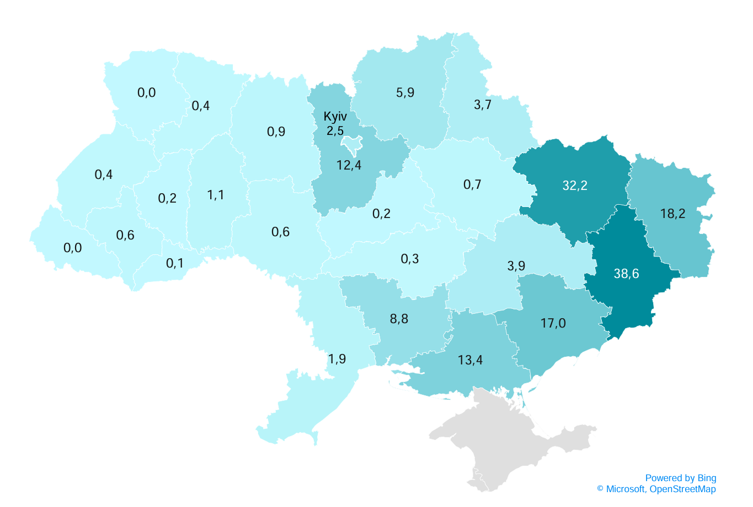
Infrastructure Damage
Total War-Related Damages in Ukraine
Since the start of the full-scale invasion, damage to buildings, infrastructure and inventories is estimated at almost USD 170 billion.
Damages to Educational Institutions in Ukraine
Total estimated damage: USD 7.3 billion
Around 4,000 education buildings damaged or destroyed
Most damage recorded in preschool and secondary schools
Although active hostilities took place in 11 regions, educational facilities were damaged in 22 regions
Source: KSE. (2025 February). Report on damages to infrastructure from the destruction caused by Russia's military aggression against Ukraine as of November 2024. https://kse.ua/wp-content/uploads/2025/02/KSE_Damages_Report-November-2024---ENG.pdf
Distribution of damages by regions, $ billion.

Slide 4

Human Capital Loss
An estimated 700,000 displaced Ukrainian children were enrolled in EU schools during the 2023-2024 school year (European Commission, 2024).
In the 2022/2023 academic year the number of Ukrainian students abroad grew by 35,000 (47% year-on-year) (VoxUkraine, 2025)
Over 43,000 teachers displaced since 2022 (Save the Children, 2024)
By early 2024, 12% of university faculty had emigrated or relocated internally, nearly 30% were working remotely, and over 1,500 researchers had joined the armed forces (United Nations Ukraine, 2024). .
Critical shortages of psychologists, speech therapists, special education teacher, SEN teachers.
The equivalent of about 150 classrooms of children have been killed or injured in Ukraine
since the start of full-scale war (Save the Children, 2025)

Slide 5
Interrupted Schooling
Children in frontline regions have lost 25% more school days than the world's longest COVID-19 closures, due to the lack of safe shelters.
About 400,000 children have spent 580 days without entering a classroom at all since Feb 2022.
Another 780,000 children alternate weekly between remote and in-person learning.
One in three school-aged children – 1.2 million – has began a fourth consecutive year of disrupted schooling.
Teaching time is fragmented, making completion of the curriculum difficult across all regions.
Source: Save the Children (1 Sept 2025). Children on Ukraine’s frontlines lose more days of school than the world’s longest COVID-19 school closures

Slide 6



Institutional Loss
Relocated and "split" schools and universities operating across several regions.
Disrupted continuity in the core academic processes that keep higher education stable and developing.
Dispersed professional communities as teachers and academics move inside and outside Ukraine.

Slide 7

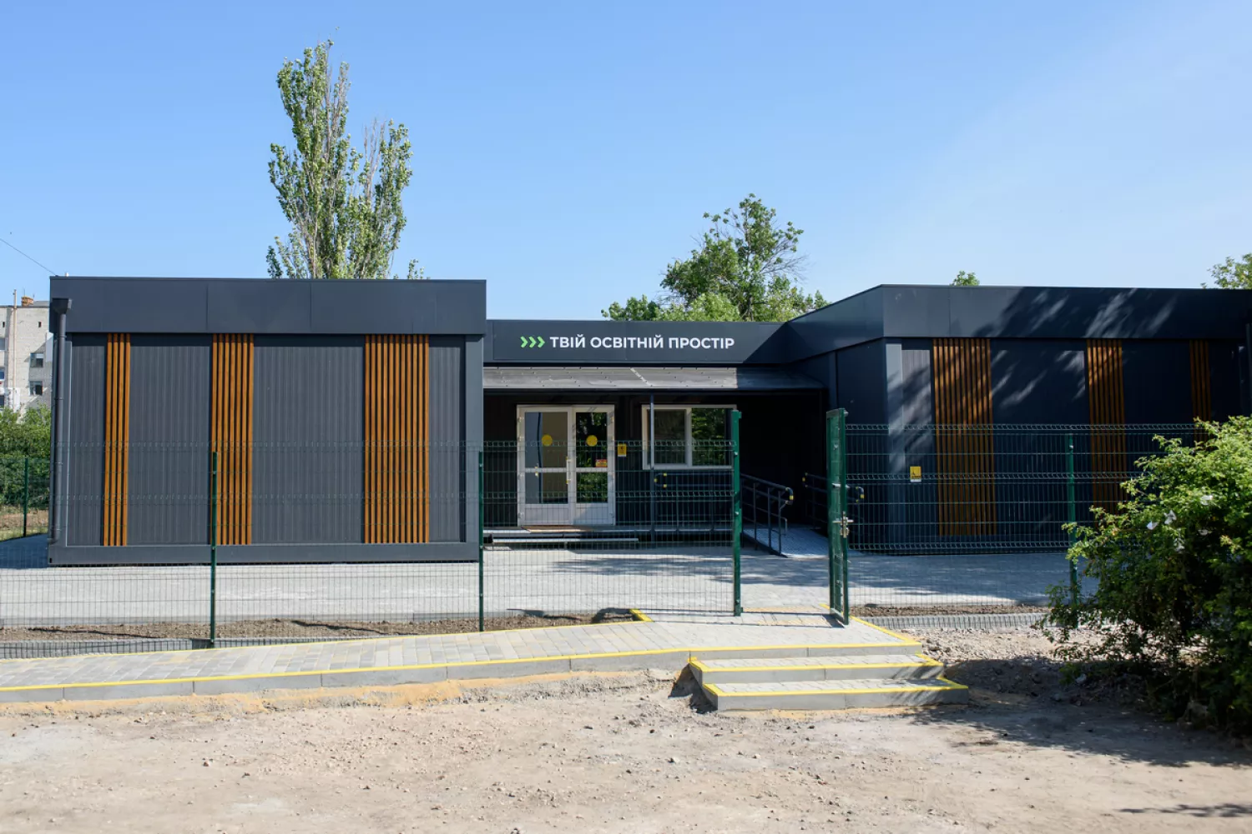
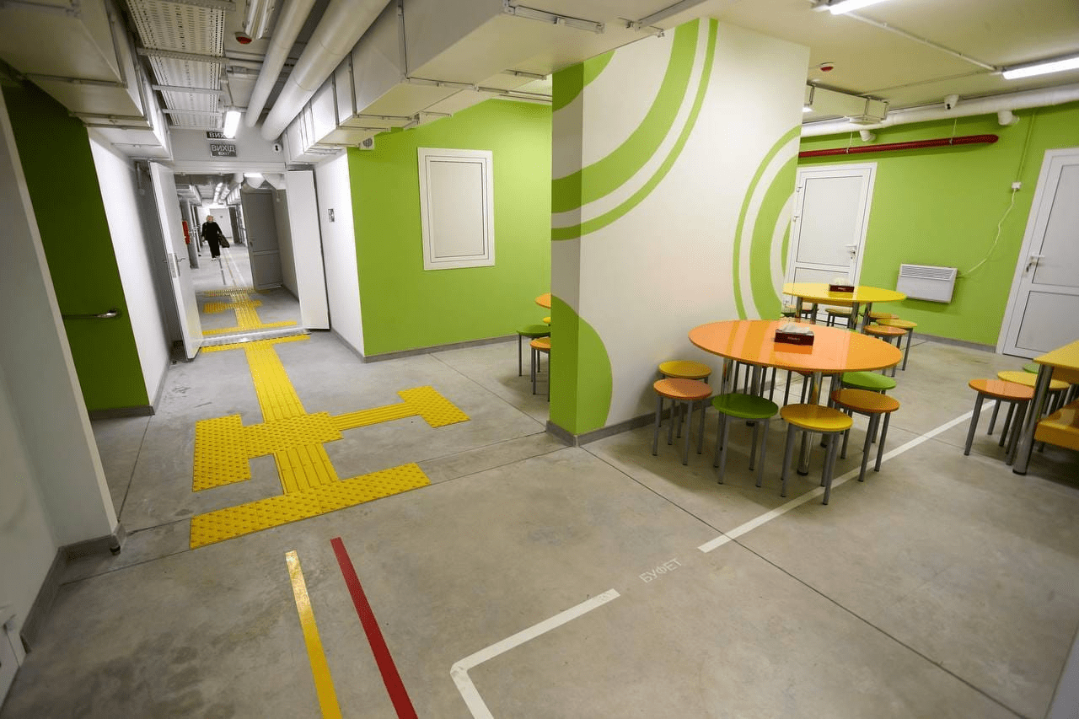
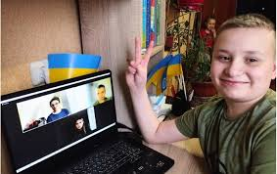

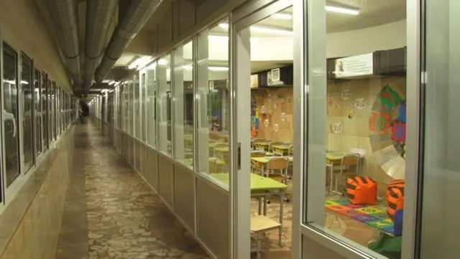
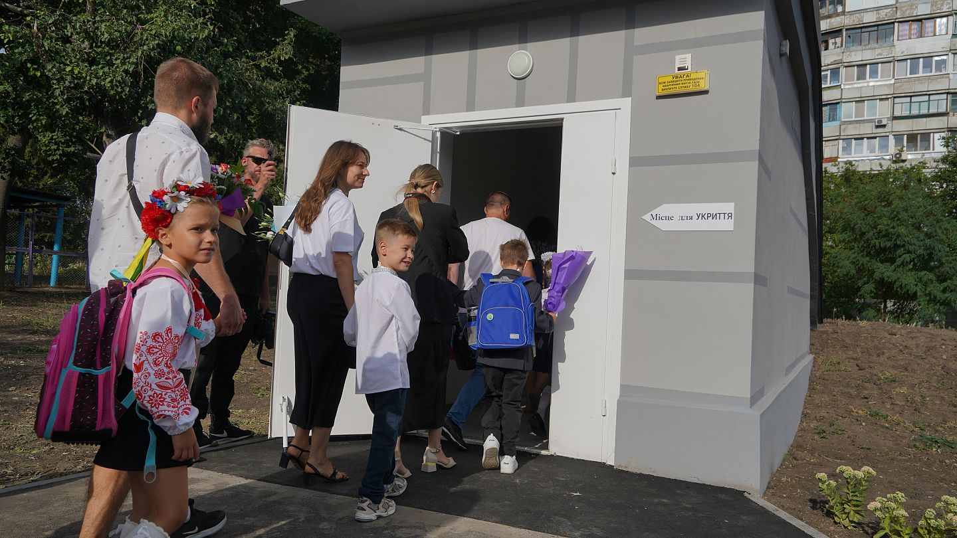
The Infrastructure Response: New Types of Schools
New types of schools: relocated schools, metro schools, underground schools, shelter schools, modular safe schools, network schools.
By late 2024, 73% of Ukrainian schools had equipped shelters.
Source: UNICEF Ukraine Humanitarian Situation Report No. 47, 2024

Slide 8




System Response to Human Capital Loss
Response to Human Capital Loss
Digital Solutions
Mental Health Support
Academic Capacity
All-Ukrainian Online School with 820k+ users in 80+ countries
EU and partners created a coordinated package of:
"How are you?" national mental health platform
Approximately 1.2 million students learn fully or partly online
• Fellowships for researchers
UNICEF school-based MHPSS as the main support backbone
• Grants and mobility schemes
• Remote collaboration opportunities
EU schools host about 700,000 Ukrainian children (2023/24)
60k+ educators trained in PSS and safe-school practices
48k teachers completed UNESCO's "Digital Teacher" course
Many follow Ukrainian language/history and online modules in parallel
Integration of mental health services into educational settings
Keeping Ukrainian researchers active and connected to home institutions
Sources: European Commission (2024, July 29). Ukrainian children in EU education systems – what is the state of play?;
UNICEF Ukraine (2024). Brief: Mental health and psychosocial support (MHPSS) in Ukraine;
GPE. (2024). Ukraine: Education brings mental health support to children;
UNESCO. (2024). Analysis of war damage to the Ukrainian science sector and its consequences.
8/10

Slide 9












Response to Interrupted Schooling
New Learning Formats
Learning Recovery Programs
Split-Campus Learning
National Tutoring
Students divided between multiple locations to ensure safety
Systematic one-on-one and small group tutoring to address learning loss
Rotating Timetables
Alternating between in-person and remote learning to reduce overcrowding
Remedial Courses
Targeted educational interventions to fill knowledge gaps
Hybrid Shelter-Classroom Schedules
UNICEF–MoES Learning Recovery
Combining in-person teaching with shelter-based learning
Collaborative initiatives for reading, maths, and psychosocial learning
Fully Online Schooling
Complete transition to digital learning in frontline areas
Sources: UNICEF. (2024). Ukraine: Humanitarian Situation Report No. 47 (Jan-Dec 2024);
Linnik O. et al. (2024). Education During War: The Ukrainian Schoolsʼ Experience. Analytical Report. Kyiv.
9/10

Slide 10



Institutional Loss: How Higher Education Responds
Agile Governance & Digital Coordination
Universities as Civic & Humanitarian Hubs
Shifted toward faster, adaptive decision-making
Expanded social functions during crisis
Shared virtual workspaces for coordination
Volunteer coordination and management
Cloud-based document management
Humanitarian aid distribution
Crisis-response communication platforms
Psycho-social assistance to community
Hosting internally displaced people
Source: CIVICA Consortium & NAWA (2024)

Slide 11






Towards Renewal
Global Case Study
Long-term Investment
Social Recovery
Ukraine as a model for crisis-informed education approaches
Building back better with focus on people and institutions
Education as a cornerstone of national healing
11/10

Slide 12
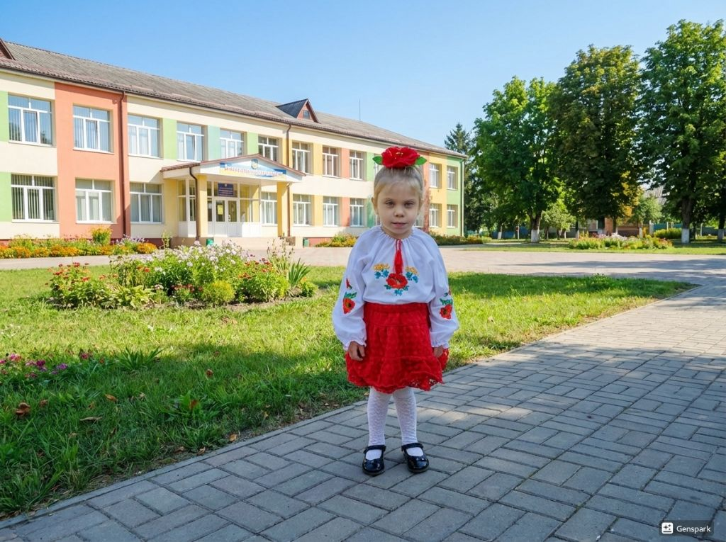
Social Recovery
Thank you!
Education as a cornerstone of national healing
11/10

