Slide 1
Future English teacher's portfolio
Siry Artem
Group: 212-сг
Specialty: 014.01 Secondary education. Ukrainian language.

Slide 2

• My name is Artem Siry. I'm a student of the Bogdan Khmelnytsky Melitopol State Pedagogical University.
• The most important European values ​​for me are:
– tolerance and respect
– freedom
– equality.

Slide 3
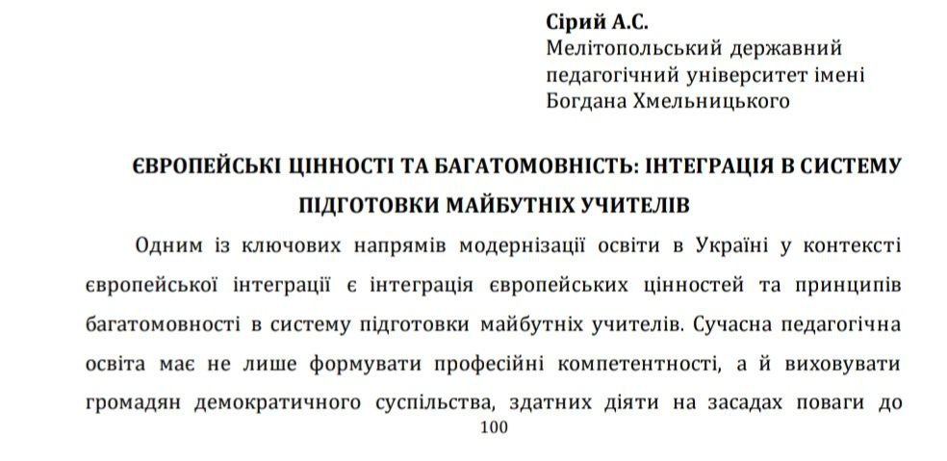
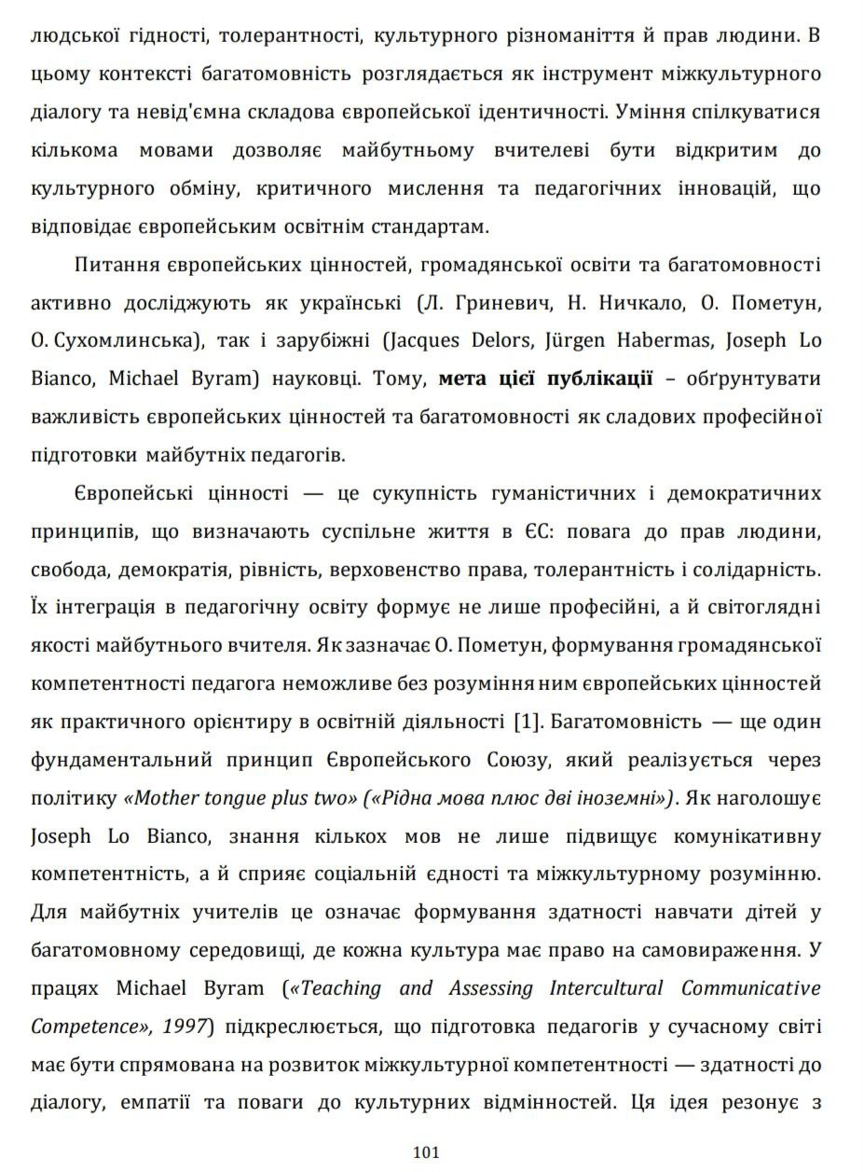
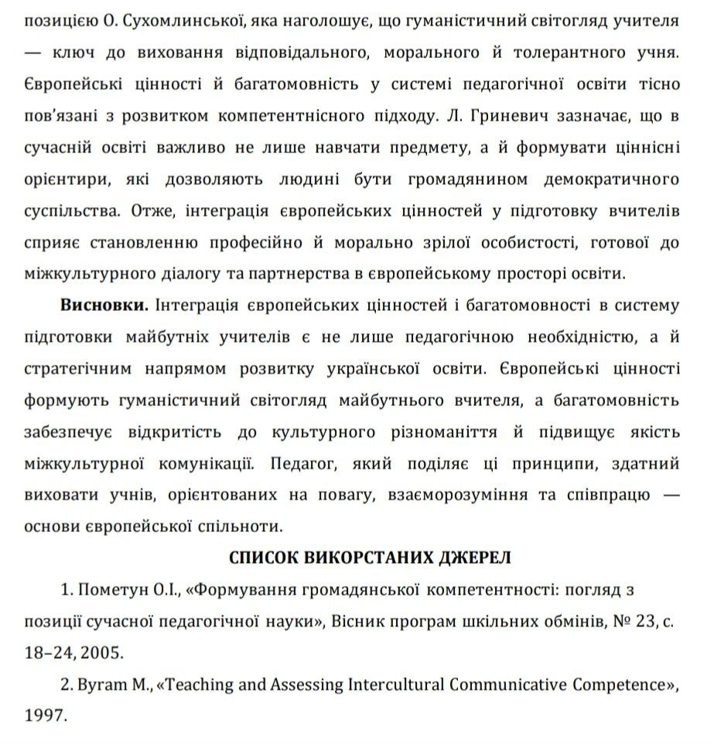
Abstracts of my conference report:
"Strengthening Common European Values ​​through Education"

Slide 4
How I promote EU values through my teaching
– I allow others to express their opinions on a particular issue;
– I respect the opinions of others.
In this way, I demonstrate the freedom and equality of others, as well as my respect for them.

Slide 5
How to build monologue
– decide on the topic you want to express in your monologue;
– make outlines that include key ideas and examples from life on the topic;
– compose the text (its paragraphs and their sequence);
– give yourself time to develop the monologue;
– deliver the monologue itself.

Slide 6
The example of a monologue on the topic: «Equality»
P.1
Equality is a very important value in our modern world. As for me, equality means that all people have the same rights and opportunities, no matter who they are. It doesn't matter where a person comes from, what language they speak, what they look like, or whether they are a boy or a girl. Everyone deserves respect and fair treatment.
P.2:
In our everyday life, we can see many examples of equality. In school, all students should feel safe and included. Teachers should support every child and help them learn in the best way. When everyone has the same chance to succeed, the whole class becomes stronger and happier.
P.3:
Equality is also important in society. People should not be judged because of their nationality, religion, appearance, or abilities. We should learn to listen to each other, understand different opinions, and work together. When we respect diversity, we build a better and kinder world.
P.4:
I believe that equality starts with small actions. We can show equality by being kind, not bullying others, and treating people fairly. We can help classmates who feel lonely, stand up for someone who is being treated unfairly, and use kind words instead of hurtful ones.
P.5:
To me, equality is not just a rule — it's a way of thinking. If we all try to be fair and understanding, our school, our community, and even our country will become more peaceful. I think that every person can make a difference, even with small steps. And I hope that in the future, equality will be a part of everyone's life.

Slide 7
How to make a dialogue
– choose a partner to conduct the dialogue with;
– decide on a topic for the dialogue;
– sketch out lines;
– create a sequence of lines;
– decide who will deliver which line;
– deliver the dialogue (feedback from the partners is important).

Slide 8
The Example of a dialogue on the topic: «Colors of the Seasons»
Anna: Hi, Max! What is your favourite season? Max: Hi, Anna! I like spring the most. The colours are so bright. The trees are light green, and many flowers are pink, yellow, and purple. Anna: Yes, spring is beautiful. I like summer more. Everything is so sunny and warm. The sky is bright blue, and the fields are green. Max: That's true. Summer feels happy. What about autumn? Do you like it? Anna: A little. I like the colours — red, orange, brown, and gold. The leaves look amazing. Max: I agree. Autumn is like a picture. But winter is different. Everything is white and cold. Anna: Yes, winter colours are simple: white snow, grey sky, and dark trees. But I still like winter because it feels magical. Max: So every season has its own colours. Anna: Exactly! And that's why the year is never boring.

Slide 9
Disclaimer: Funded by the European Union. Views and opinions expressed are however those of the author(s)only and do not necessarily reflect those of the European Union or the European Education and Culture Executive Agency (EACEA). Neither the European Union nor the granting authority can be held responsible for them.

