Slide 1
My future English teacher’s portfolio
Anastasia

Slide 2
My name is Anastasia
I am a student of
Bogdan Khmelnytsky
Melitopol State
Pedagogical University.
112/1- сг
The most important European values for me are: freedom, tolerance, human rights, gender equality.

Slide 3
How I promote EU common values through
my teaching
Since I plan to work in my specialty in the future, such European values as freedom, tolerance, human rights, and gender equality are very important in my professional activities. Therefore, I will talk about them in more detail.

Slide 4

Freedom is one of the fundamental European values. It is viewed not simply as the absence of restrictions, but as a set of rights and opportunities that ensure the dignity and self-realization of every person.

Slide 5
In the European context, tolerance is not simply passive patience or ignoring differences, but active recognition, respect and acceptance of the fact that the world and society are diverse in cultural, religious, ethnic, social and other ways.

Slide 6
Human rights are a cornerstone and an indisputable European value that underpins the entire legal and political system of the European Union and the Council of Europe.
They are not just a set of legal norms, but a philosophical framework that determines how states should treat their citizens and how citizens should treat each other.

Slide 7
Gender equality means that women and men (and people of all gender identities) have equal rights, responsibilities, opportunities and equal treatment in all areas of life: economic, political, social and cultural.

Slide 8
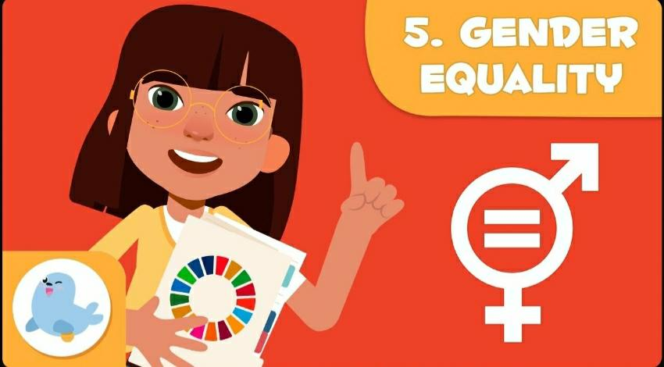
Link to video about gender equality: https://youtu.be/F-OURmsmEKo?feature=shared

Slide 9
Gender equality is an important topic at all times, and especially in the scientific world, the contribution of women is an integral part.

Slide 10
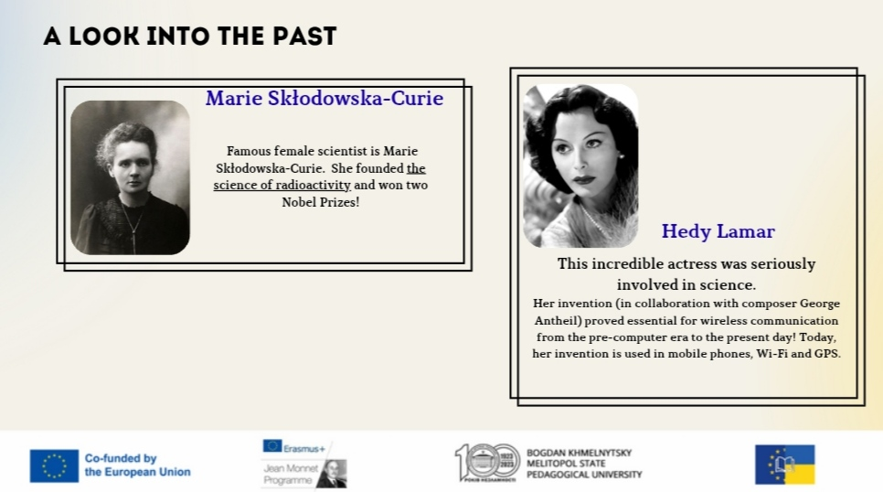

Slide 11
Disclaimer: Funded by the European Union. Views and opinions expressed are however those of the author(s)only and do not necessarily reflect those of the European Union or the European Education and Culture Executive Agency (EACEA). Neither the European Union nor the granting authority can be held responsible for them.

